Slide 1










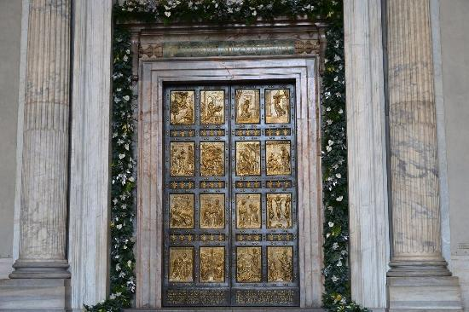



FOOD
BANK
Open the Holy Door
December
Let us Pray.
We thank you, for the many gifts you give us. As the Holy Door is opened for this Year of Jubilee, guide us through it to encounter you and share our time, gifts and talents with those most in need.
Open the doors of our heart.
Open the doors of welcome.
Open the doors of power.
Open the doors of our mind.
Open the doors to opportunity.
Amen.
December

Slide 2




FOOD
BANK
Call to action
In this Jubilee year can you create a door of hope?
Write message or a prayer of hope that can be stuck to the back of the door to remind those passing through that we are called to be people of Hope.
be kind
and
love

Slide 3

FOOD
BANK
Open the door to dialogue
Let us pray, please bless the way that people communicate with one another- at home, at school, at work, and in the wider world. May people’s words and actions be gentle and kind, reflecting the love that you have for us all.
Open the doors of our heart.
Open the doors of welcome.
Open the doors of power.
Open the doors of our mind.
Open the doors to opportunity.
Amen.
January

Slide 4



FOOD
BANK
Call to action
Identify a group of people that you could write ‘A note of Care’ to. This could be for those who are lonely or isolated in the local parish, family
members, friends. It could be residents at the local care home or those who have been in hospital for a while etc. This small act of communication could brighten up their day and is a small way to bring hope.

Slide 5

FOOD
BANK
Open the door to a work of art
Let us pray. Each one of us is a work of art, beautifully designed and created by You. Bless all artists who use their gifts to create masterpieces of their own to share with others. May their work delight you and inspire others to do the same.
Open the doors of our heart.
Open the doors of welcome.
Open the doors of power.
Open the doors of our mind.
Open the doors to opportunity.
Amen.
February

Slide 6


FOOD
BANK
Call to action
Create a piece of artwork as a group to connect with your community. Could you gift it to a local care home, SVP Support Project, Charity Shop, Homeless Shelter?

Slide 7
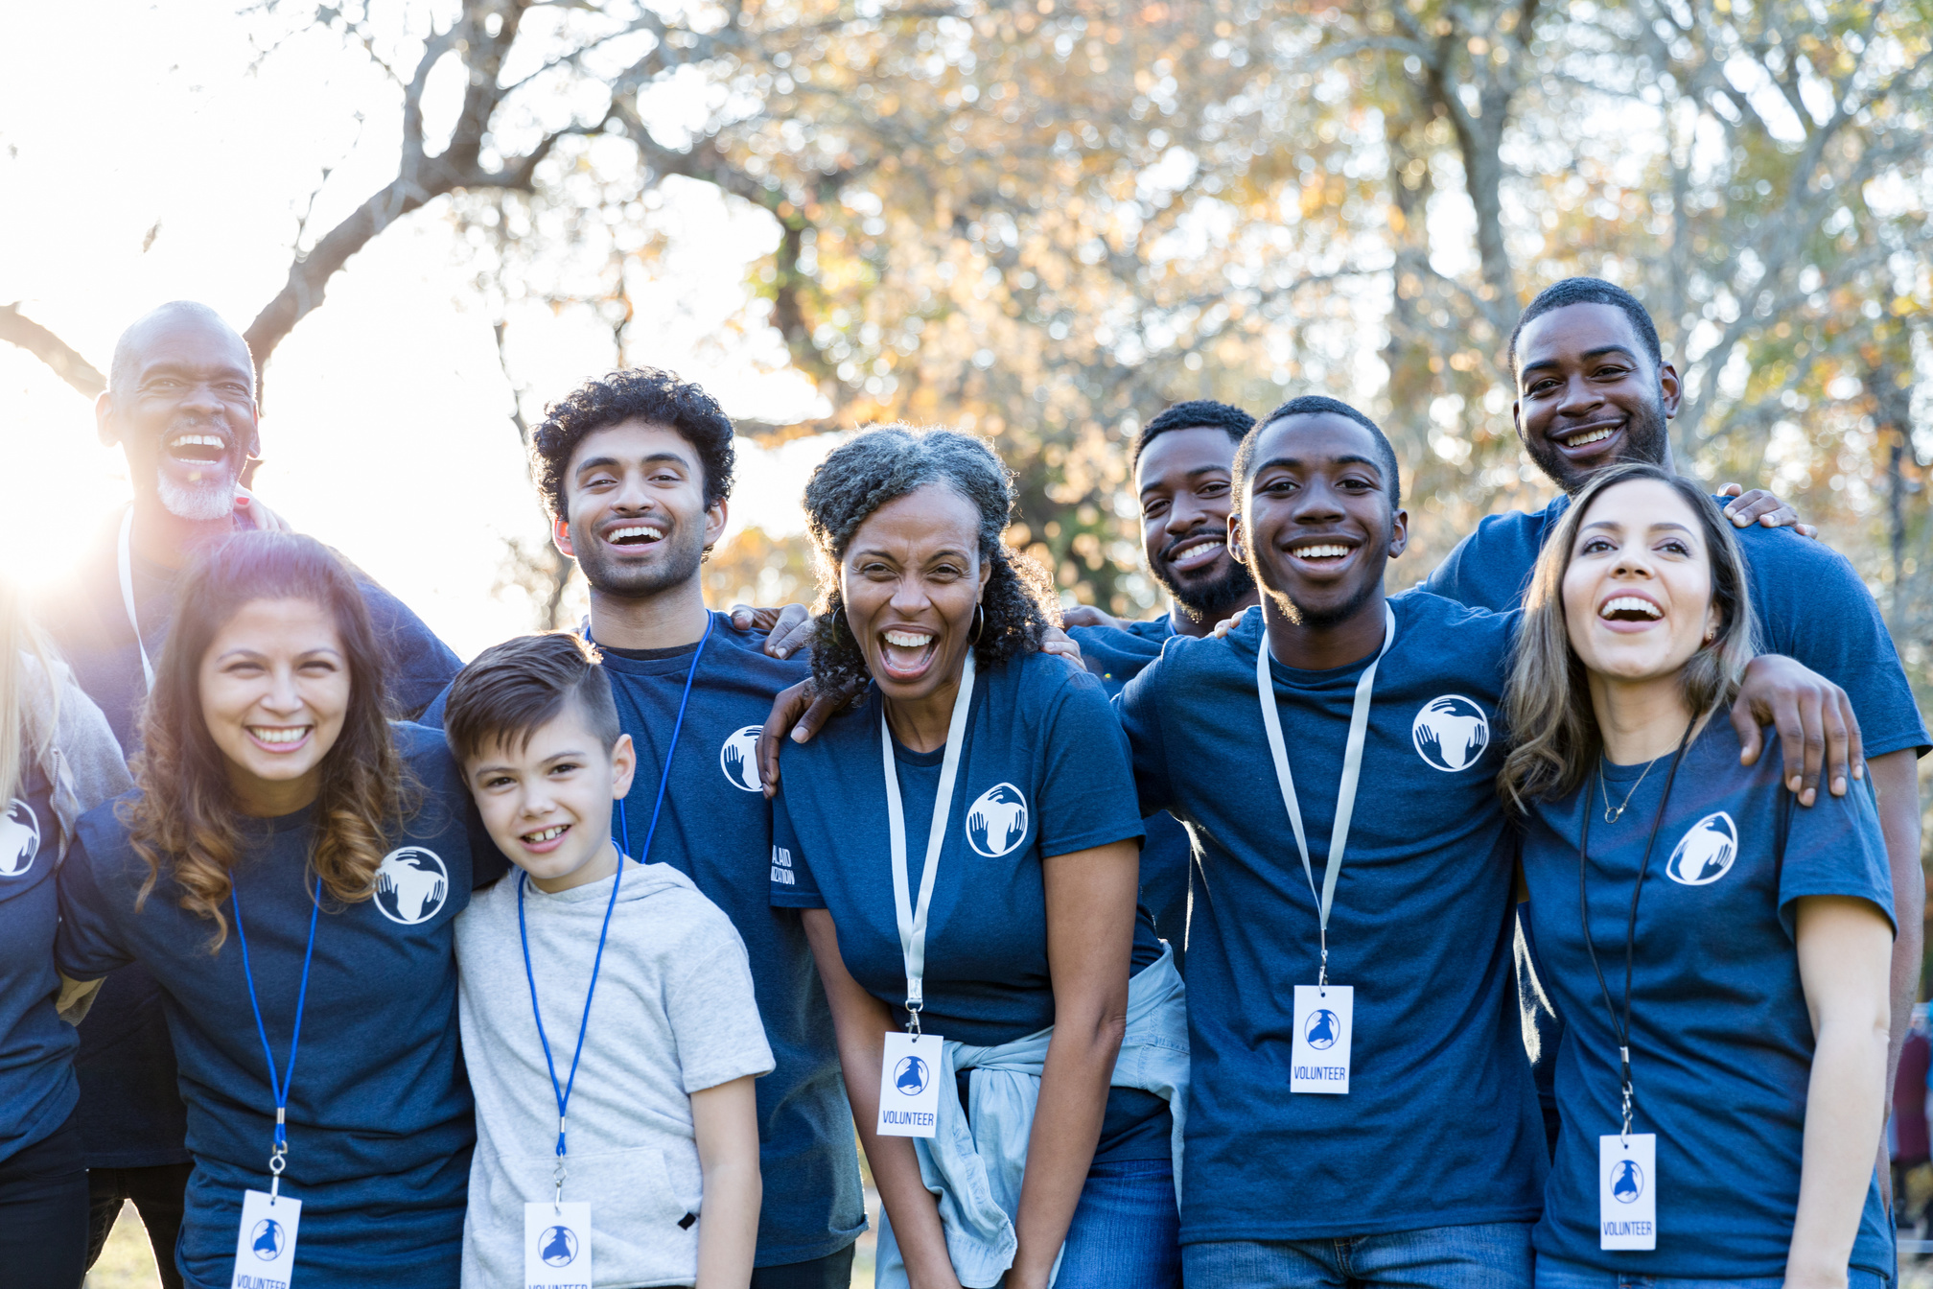
FOOD
BANK
Open the door to serve one another
Let us Pray. Father, You call us all to love our neighbour and serve one another. Bless all those who volunteer their time and talents to help those most in need. Show us all the path to do the same.
Open the doors of our heart.
Open the doors of welcome.
Open the doors of power.
Open the doors of our mind.
Open the doors to opportunity.
Amen.
March

Slide 8

FOOD
BANK
Call to action
The challenge. Look at opportunities to volunteer in school, in the local parish or in the community.
Can you give an hour
of your time this
month to volunteer and help others. How many are in your class? If you all did an hour volunteering how many hours could you achieve?

Slide 9

FOOD
BANK
Open the door of Healing
Let us pray for healing and strength for all those who are sick at this time. Bless those who are taking care of them at home, in hospitals and in the community. May those who feel alone know that you are with them during this time of need.
Open the doors of our heart.
Open the doors of welcome.
Open the doors of power.
Open the doors of our mind.
Open the doors to opportunity.
Amen.
April

Slide 10
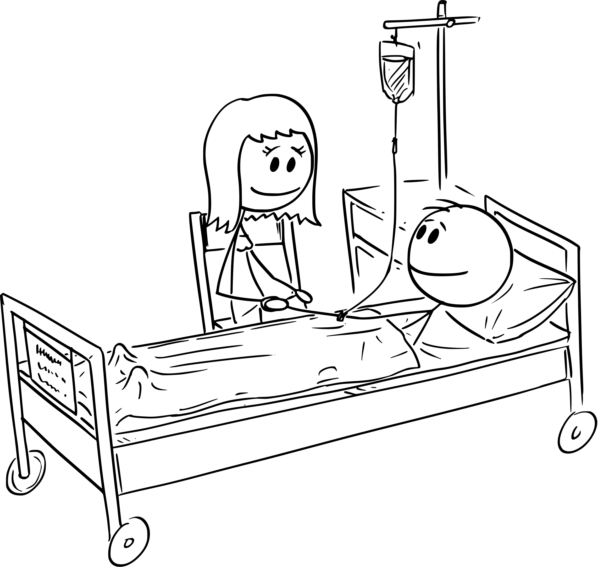
FOOD
BANK
Call to action
As a group, create something that can be displayed in your school or parish to show appreciation
for those who take care of the sick.
How about creating appreciation cards to send to local hospitals, hospices, or care homes to show gratitude to the caregivers and medics?

Slide 11

FOOD
BANK
Open the door to God’s family
Let us pray. Thank you for gifting us the people in our lives; those who care for us and help us to grow and feel safe. Thank you that family can come in all shapes and sizes. Help us share your love with those who feel they don’t belong and to work for a world welcoming to all.
Open the doors of our heart.
Open the doors of welcome.
Open the doors of power.
Open the doors of our mind.
Open the doors to opportunity.
Amen.
May

Slide 12

FOOD
BANK
Call to action
Take some time to think of ways that you could show appreciation to those who love and care for you.
Perhaps a small
note or card telling them about how they are a gift for you.
Or maybe taking on an extra role at home or choose to spend quality time doing something fun with that person or people.

Slide 13
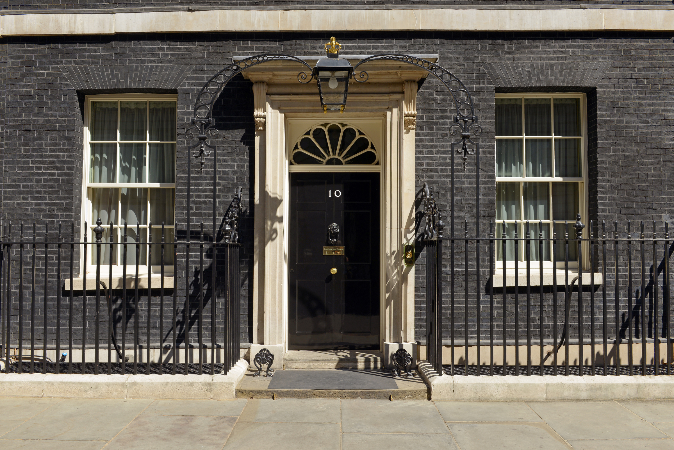
FOOD
BANK
Open the door to the power of prayer
Let us pray, bless and guide those in power around the world. May they work together to bring peace and unity. Give us the strength to raise our voices when we want to see change.
Open the doors of our heart.
Open the doors of welcome.
Open the doors of power.
Open the doors of our mind.
Open the doors to opportunity.
Amen.
June

Slide 14

FOOD
BANK
Call to action
What concerns do you have in your local community?
Write a letter to those with authority to make change-your local council, your local MP, your Bishop. Use our template to help you form your letter.

Slide 15
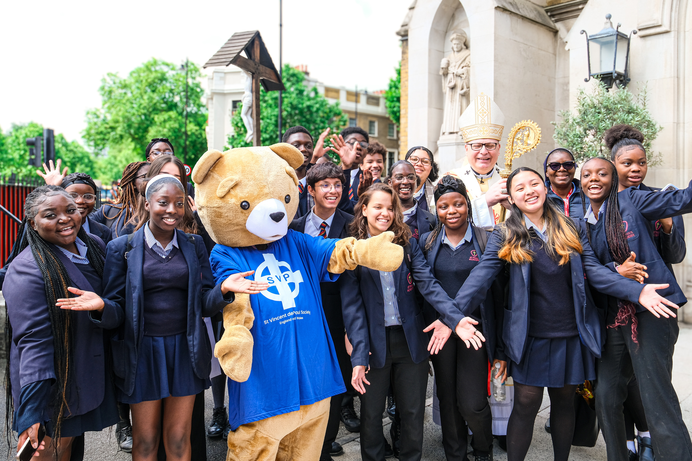
FOOD
BANK
Open the door to young people
Let us pray. We thank you for the gift of youth. We ask you to free our Church from those who would make her grow old, encase her in the past, hold her back or keep her at a standstill. Like the young saints may we be bold enough to hold open the door to your Holy Spirit working in our life. So that through us people might experience your transforming love.
Open the doors of our heart.
Open the doors of welcome.
Open the doors of power.
Open the doors of our mind.
Open the doors to opportunity.
Amen.
July

Slide 16


FOOD
BANK
Call to action
In this month when we celebrate youth lets start a wave of kindness. The ask: do three anonymous random acts of kindness for people this month who aren’t in your friendship group.
It doesn’t need to be big. Small acts can make a huge impact.

Slide 17
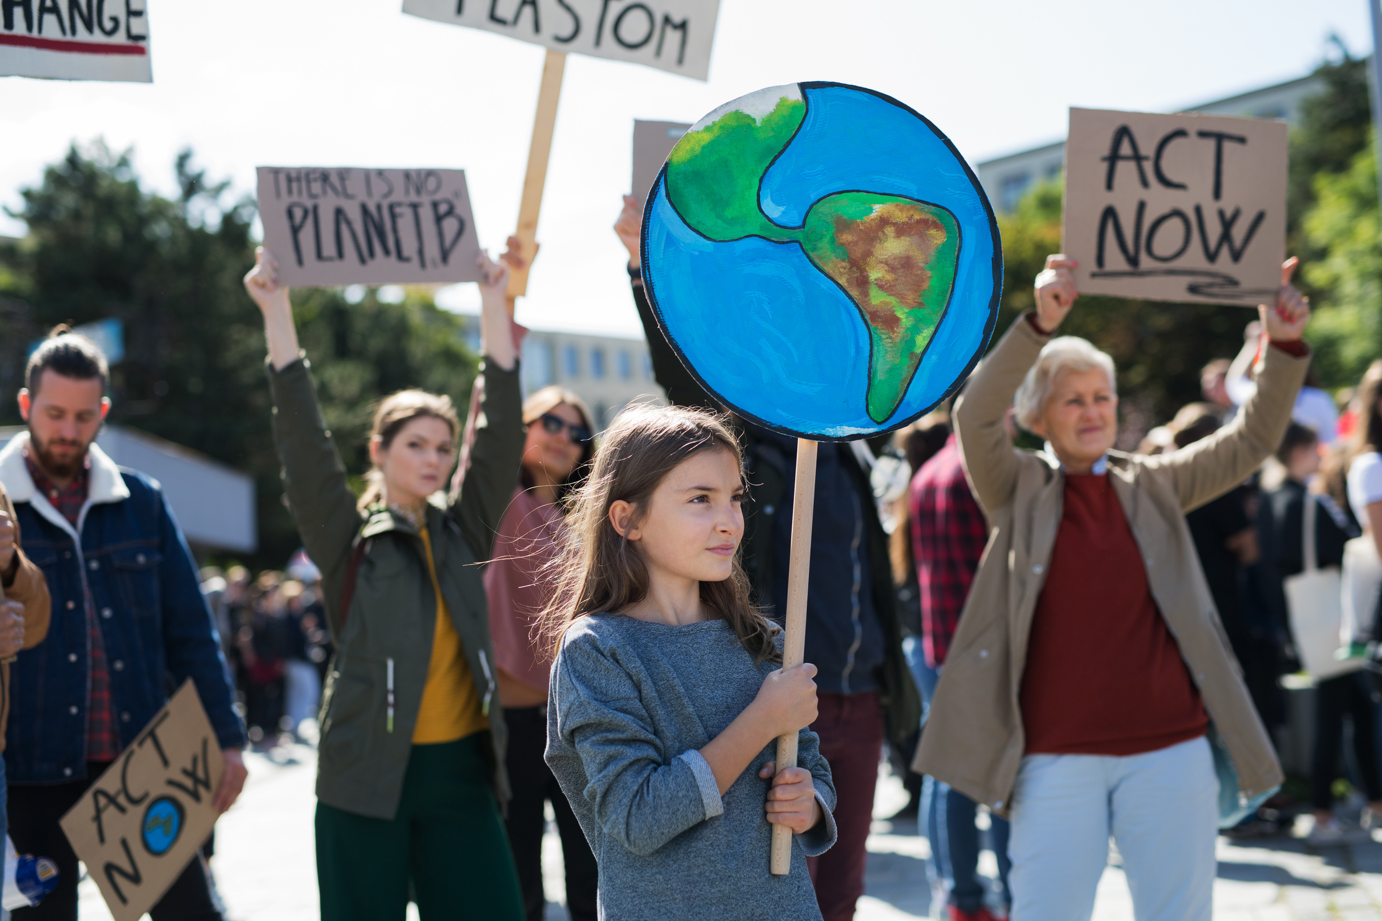
FOOD
BANK
Open the door to Justice
Let us pray. Open our eyes to see those most in need, and open our ears to hear how we can do our best to help. Help us to use our voices for change, following in your footsteps.
Open the doors of our heart.
Open the doors of welcome.
Open the doors of power.
Open the doors of our mind.
Open the doors to opportunity.
Amen.
September

Slide 18

FOOD
BANK
Call to action
Head to the SVP website and look on the social justice page at the policy priorities (the things we are encouraging the government to tackle).
Look at one of the subjects and learn more as a class or as individuals about who and how that issue is affecting people.
How could you use your voice to share the message?

Slide 19
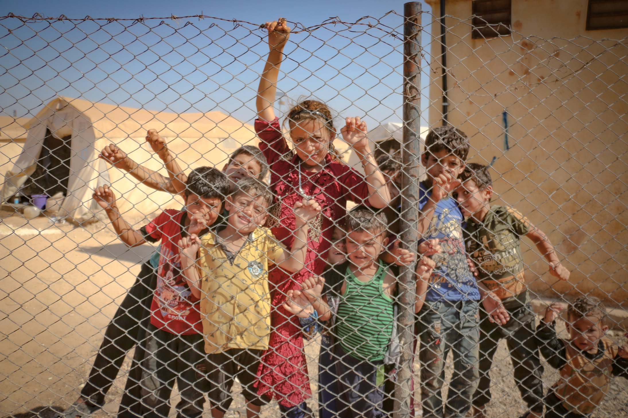
FOOD
BANK
Open the door to welcome the stranger
Let us pray. Bless those who have left their country for any reason. May they find a welcome and support into their new home with love and warmth. Protect those who are away from friends and family, and help them find a supportive community wherever they are.
Open the doors of our heart.
Open the doors of welcome.
Open the doors of power.
Open the doors of our mind.
Open the doors to opportunity.
Amen.
October

Slide 20




FOOD
BANK
Call to action
Write cards of welcome to send on to your local charity that supports refugees and asylum seekers.

Slide 21

FOOD
BANK
Open the door to the Poor
We pray for all who suffer. Help us to hear their cries and come to their aid. Teach us to see with your eyes their tremendous dignity and to care for them as you care. Let us see in them your face, that through our solidarity with them they may experience your compassion, concern and love.
Open the doors of our heart.
Open the doors of welcome.
Open the doors of power.
Open the doors of our mind.
Open the doors to opportunity.
Amen.
November

Slide 22
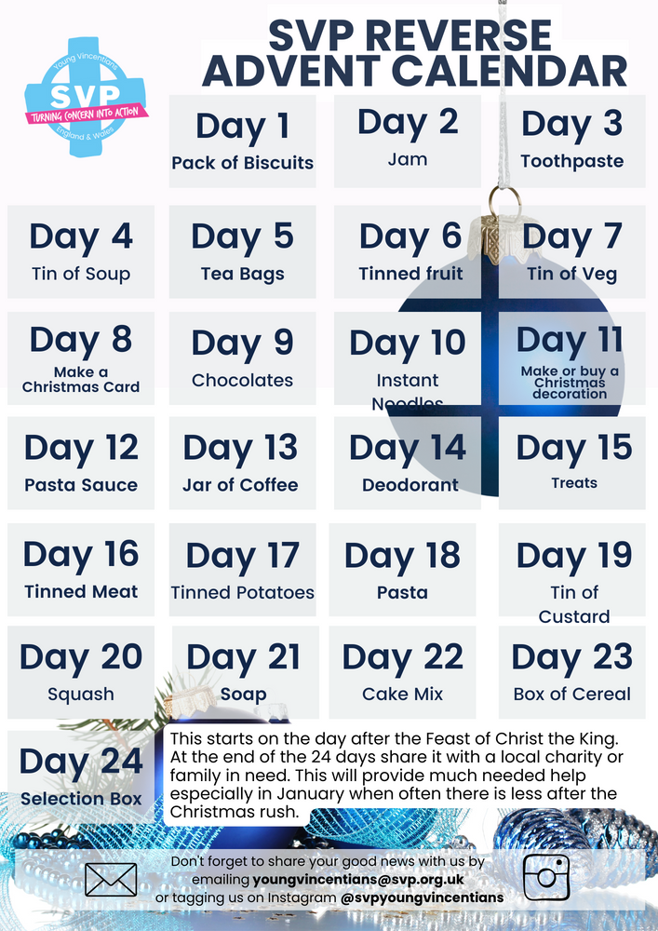
FOOD
BANK
Call to action
As a group, why not take part in the SVP Reverse Advent Calendar this year, which begins on Monday 25 November? Click here to print off your calendar.

Slide 23

FOOD
BANK
Open the doors to forgiveness
We pray for all those in prison. Your love offers freedom and forgiveness to everyone and reminds us that we are more than our mistakes. Break the chains of fear and loneliness. Support with your love: prisoners, their families, prison staff and all victims of crime.
Open the doors of our heart.
Open the doors of welcome.
Open the doors of power.
Open the doors of our mind.
Open the doors to opportunity.
Amen.
December

Slide 24
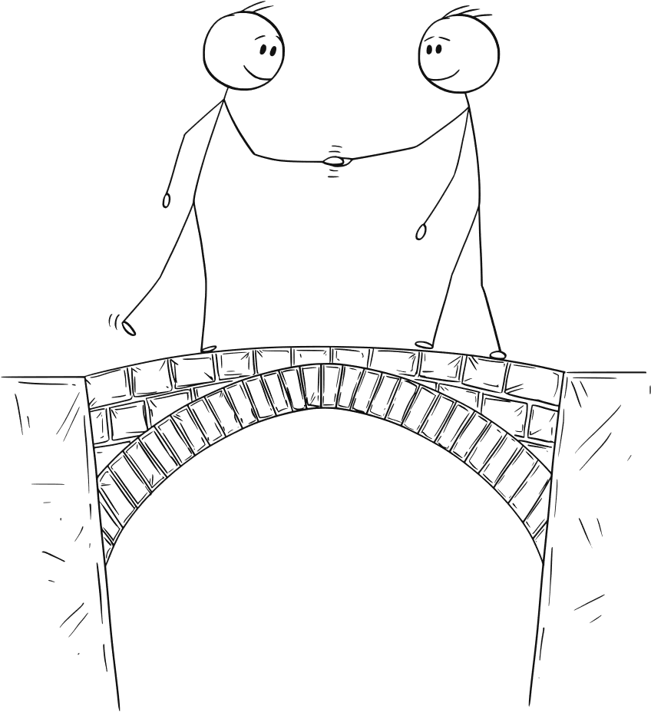
FOOD
BANK
Call to action
Listen to Connors story here and then reflect as a group on the questions.
What can be the
positive outcomes of forgiveness?
Why might some people not want to show forgiveness?
What does forgiveness mean to you?

