Slide 1

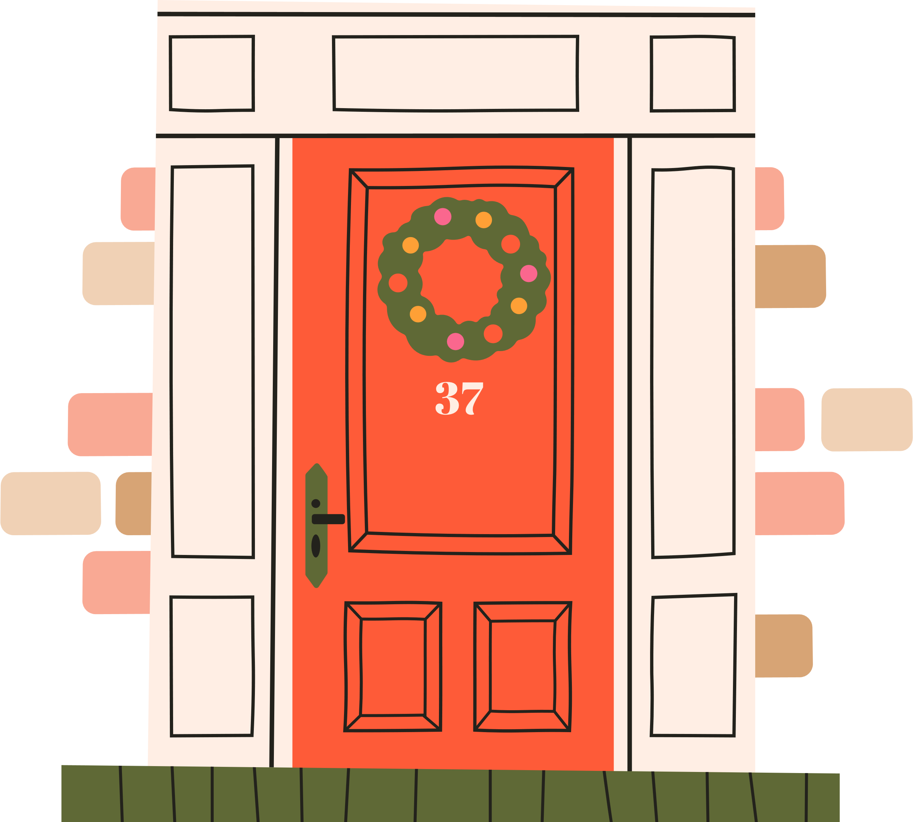




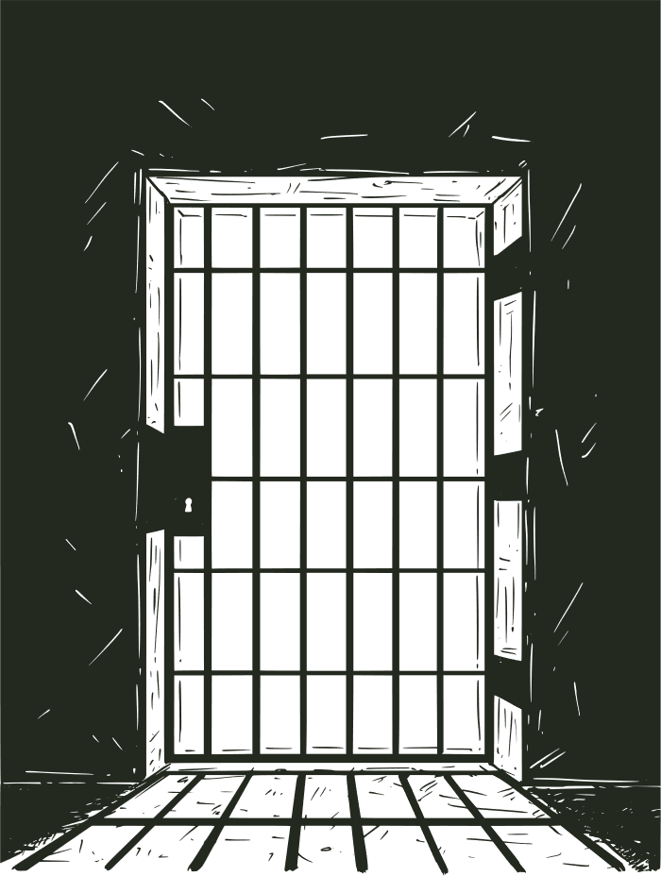




FOOD
BANK

Slide 2
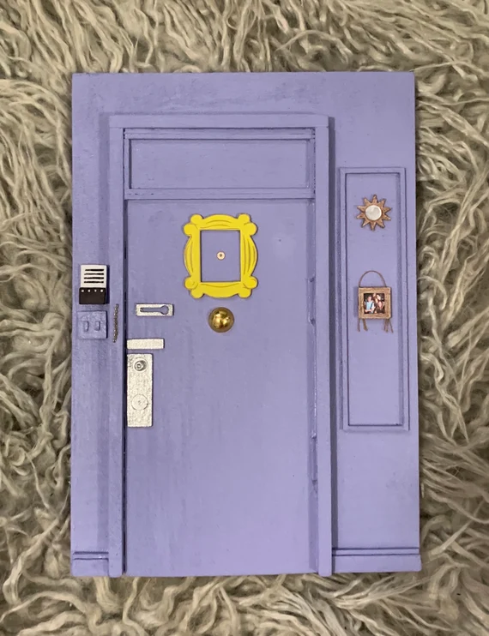
FOOD
BANK
door belong?
WHERE DOES THIS

Slide 3

FOOD
BANK

Slide 4
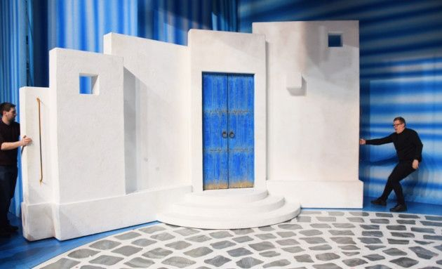
FOOD
BANK
door belong?
WHERE DOES THIS

Slide 5
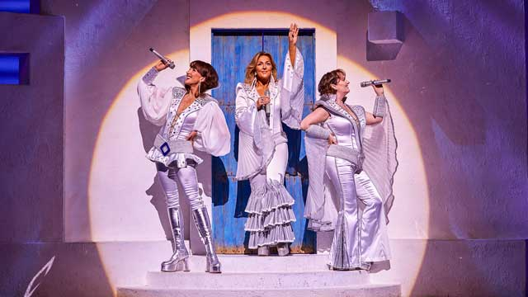
FOOD
BANK
Mamma Mia

Slide 6
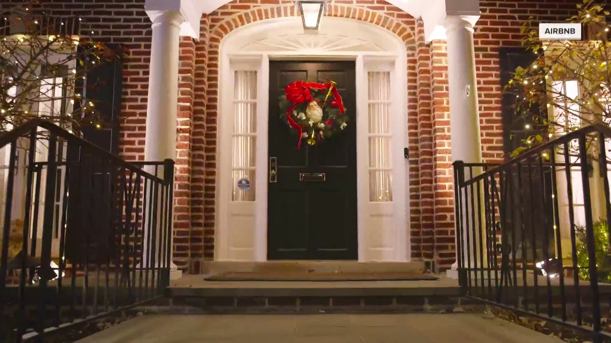
FOOD
BANK
door belong?
WHERE DOES THIS

Slide 7
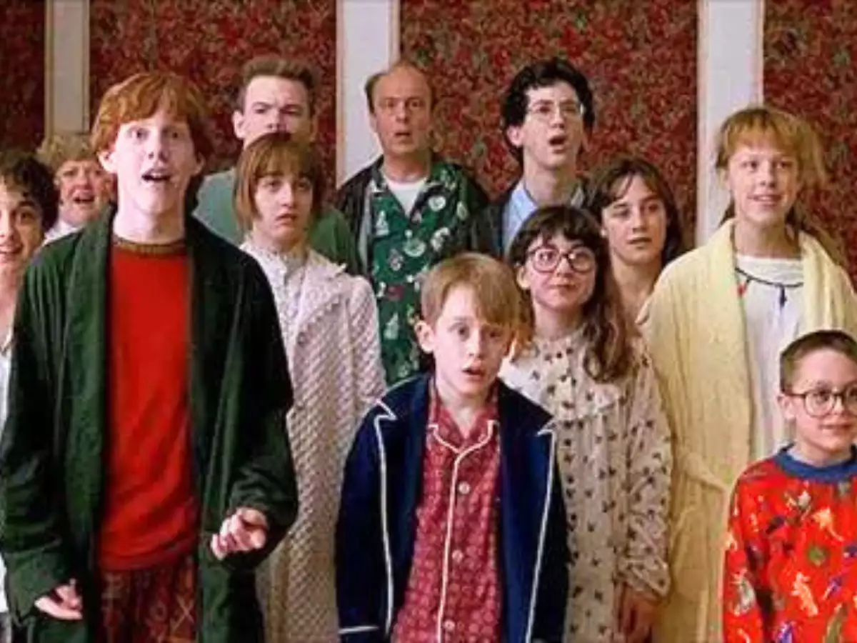
FOOD
BANK
The McCallisters (Home Alone)

Slide 8
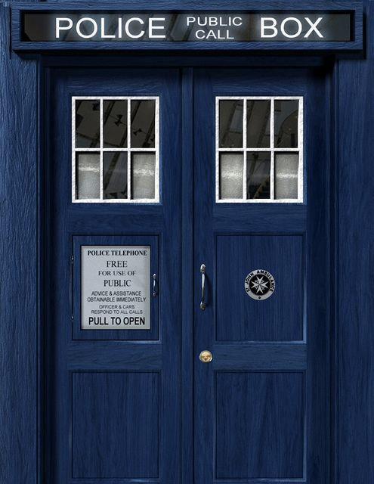
FOOD
BANK
door belong?
WHERE DOES THIS

Slide 9


FOOD
BANK
The Doctor

Slide 10
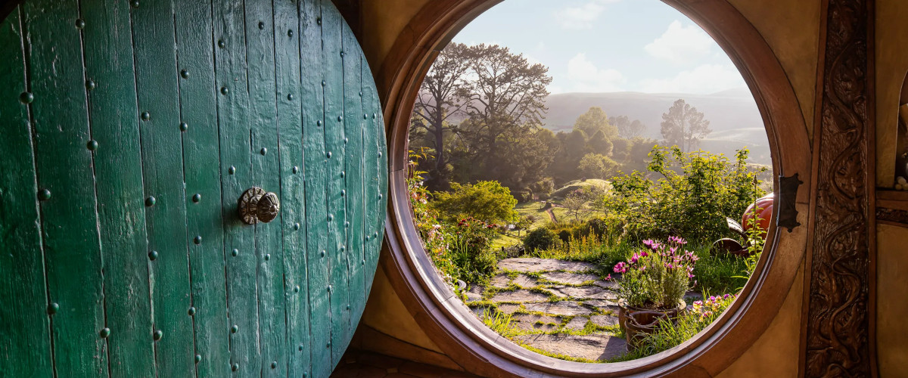
FOOD
BANK
door belong?
WHERE DOES THIS

Slide 11
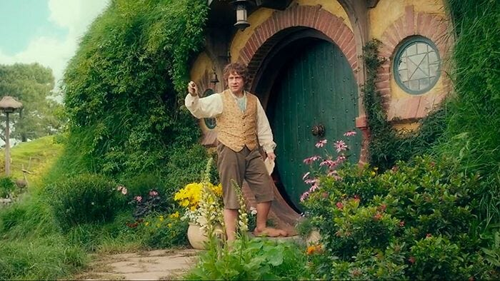
FOOD
BANK
Bilbo Baggins

Slide 12

FOOD
BANK
door belong?
WHERE DOES THIS

Slide 13
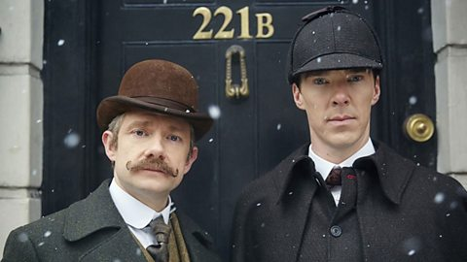
FOOD
BANK
Sherlock

Slide 14

FOOD
BANK
door belong?
WHERE DOES THIS

Slide 15
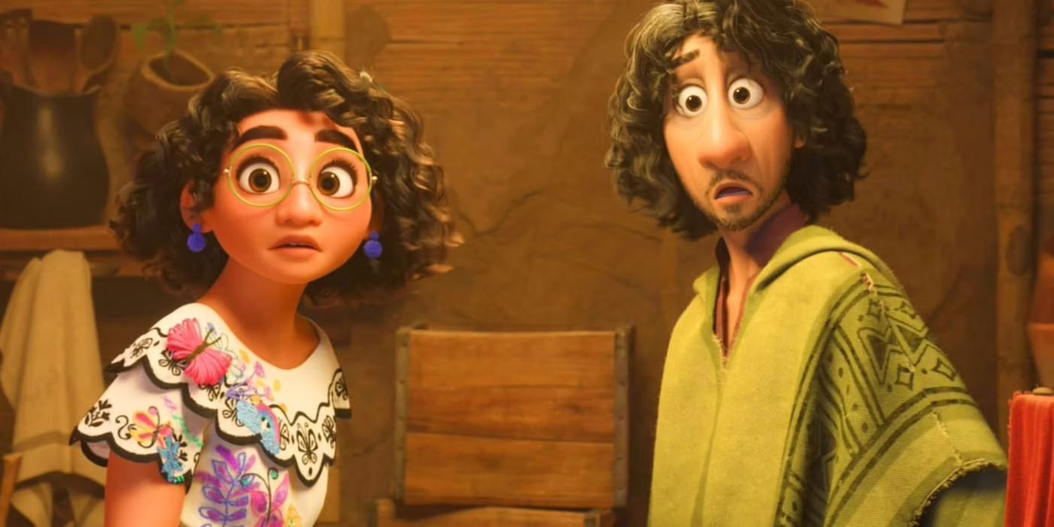
FOOD
BANK
Encanto

Slide 16
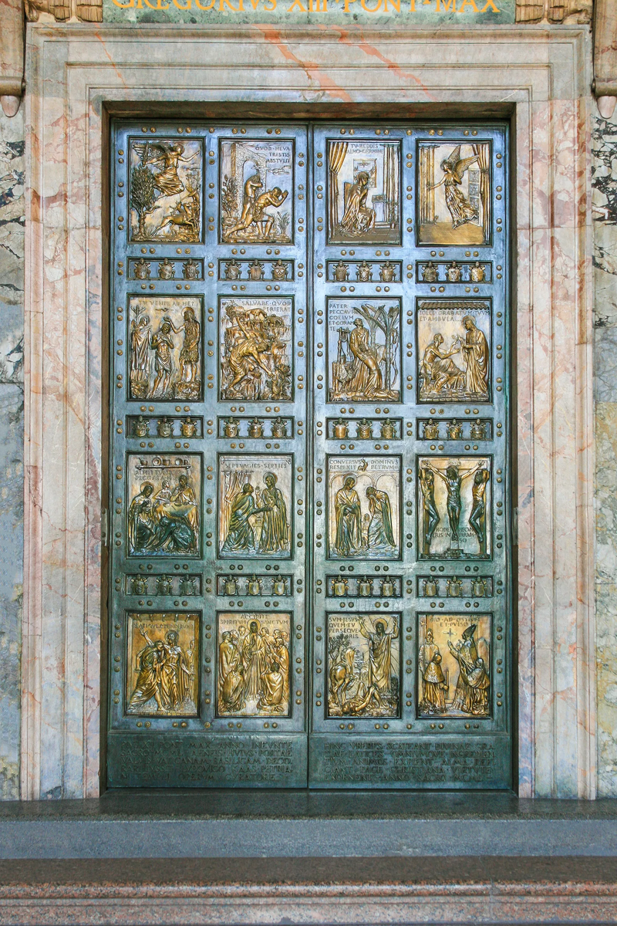
FOOD
BANK
door belong?
WHERE DOES THIS

Slide 17
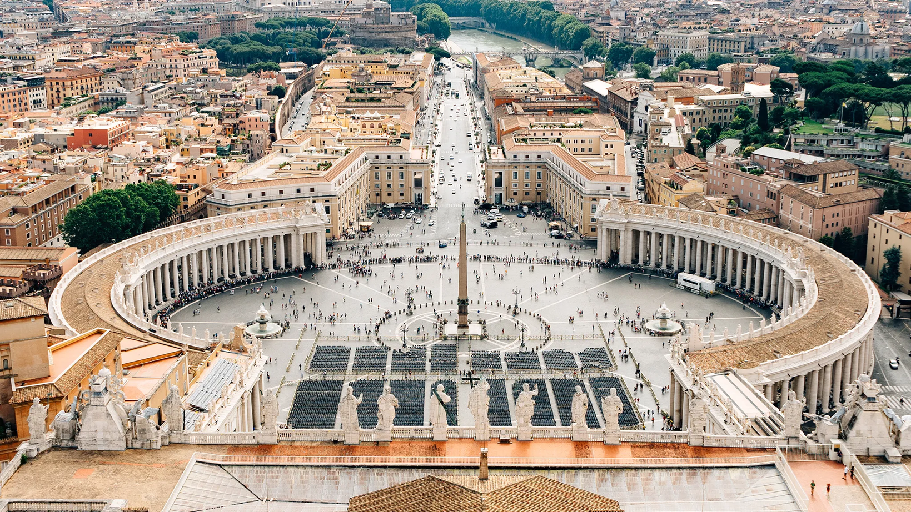
FOOD
BANK
St Peters, Rome

Slide 18



FOOD
BANK
Every 25 years the people of God are invited to deepen their faith, and to ask forgiveness for the times they have moved away from God through an extra ordinary Year of Jubilee.
We are all invited to take part in this Jubilee Year, not just for ourselves, but for others and all of Creation.

Slide 19
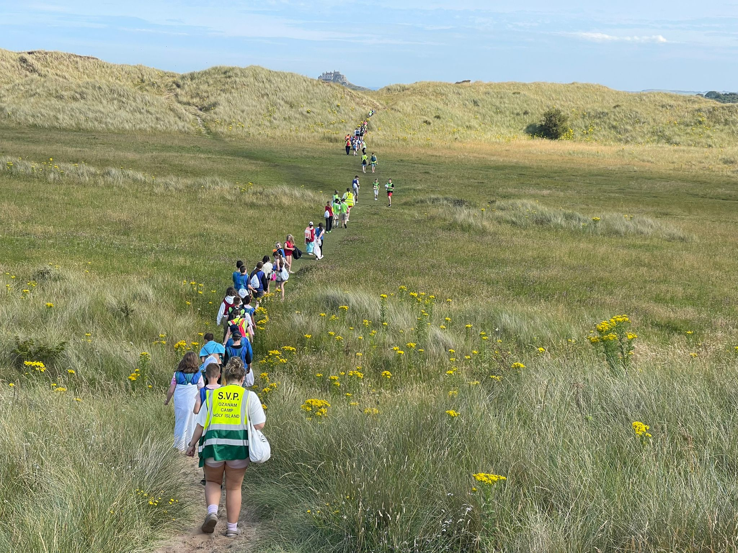
FOOD
BANK
Pope Francis has named this Year of Jubilee ‘Pilgrims of Hope’. A pilgrimage is a journey with purpose.
Those who set out on it, (Pilgrims) expect that it will lead to an encounter with God.
On Christmas Eve, the Pope will open the Holy Door in Rome and invite people to journey through it in the Jubilee year.

Slide 20
FOOD
BANK
This year, the doors we open in our everyday lives can also be Holy doors and doors of hope.
This year, let’s expect to meet God behind them and be ready to share that love with others.

Slide 21
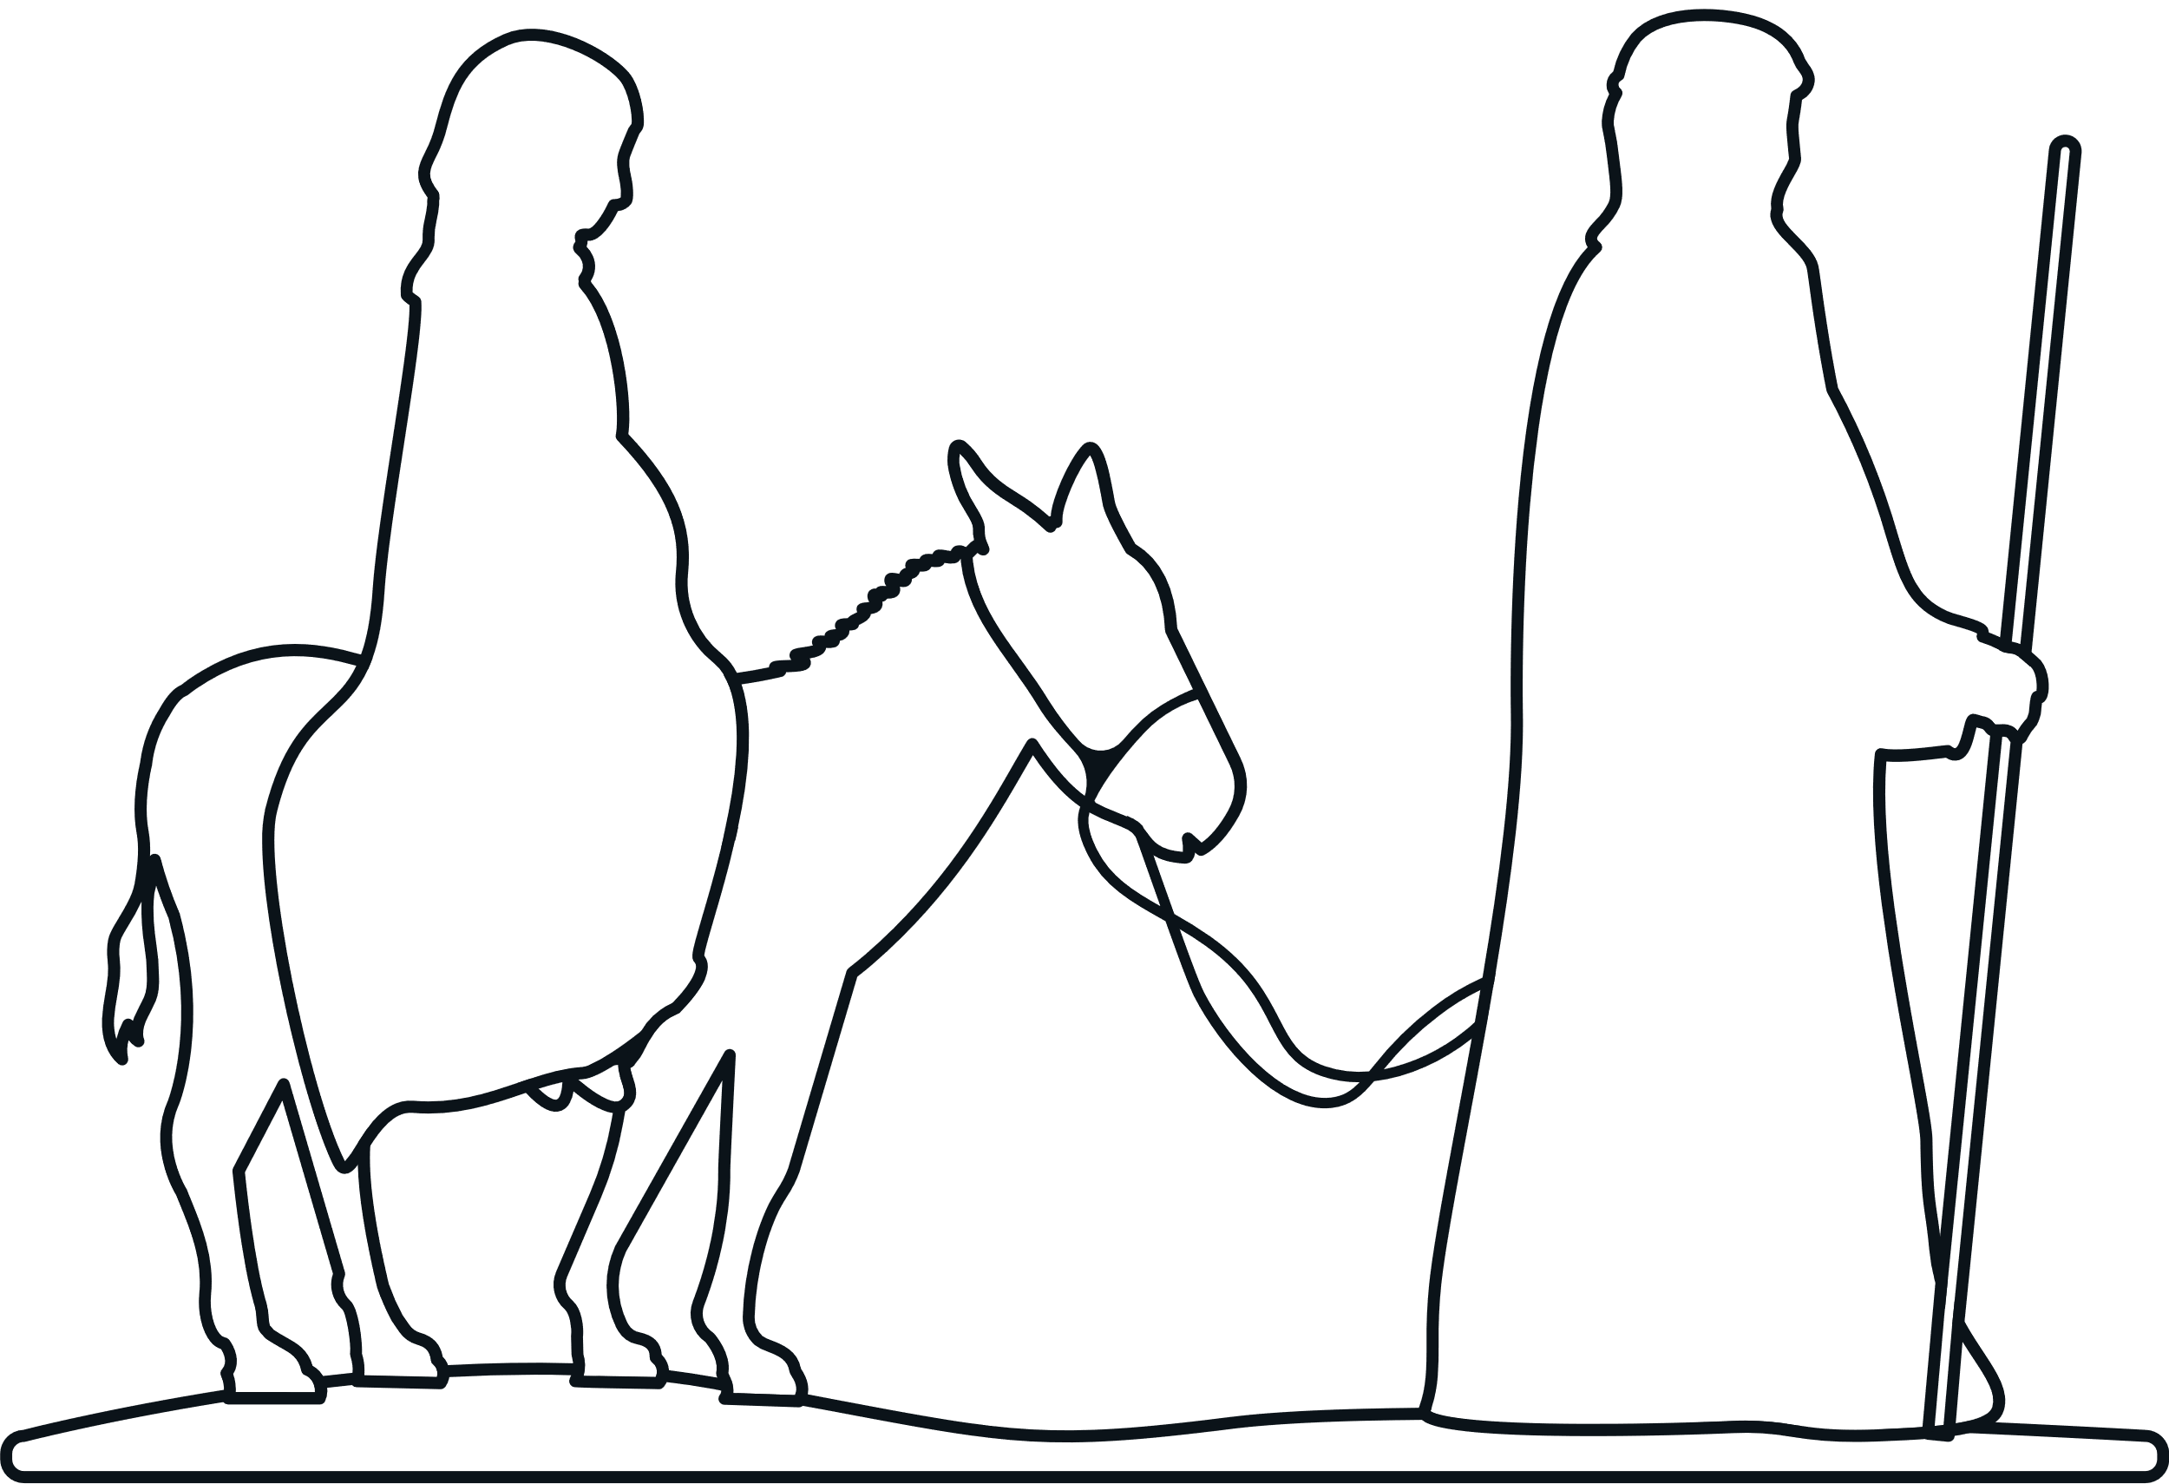
FOOD
BANK
So we pause for a moment of prayer as we prepare to begin our pilgrimage year.

Slide 22


Slide 23
FOOD
BANK
Now faith is the assurance of things hoped for,
the conviction of things not seen.
Hebrews 11:1

Slide 24




FOOD
BANK
OUR COMMUNITY
OURSELVES
Now faith is the assurance of things hoped for,
the conviction of things not seen.
Hebrews 11:1
OUR
WORLD
OUR
LOVED ONES

Slide 25


