Slide 1

Treasurer Training
Qubra Bibi – Membership Finance Manager
Updated: March 2025

Slide 2

Purpose
To help members in their role as Treasurer
Record Keeping
How to complete a workbook
Understanding Support charges
Restricted / Unrestricted
Use of Conference Funds
Gift Aid
NatWest Banking
Q&A

Slide 3


Section 1 Meet the Team

Slide 4
National Finance Team
SENIOR MANAGEMENT
CHRISTOPHER LUCAS STEPHEN JOHNSON
Director of Finance Head Of Finance
TRANSACTIONAL TEAM
JOSHELA GNANASEKAR MAJID HUSSAIN
Senior Management Accountant Assistant Management Accountant
HASNAIN ALI ERIC CLIFFORD
Finance Officer Accounts Receivable Finance Officer
ERIN TOWRISS JUSTYNA BADACH-MALINOWSKA
Accounts Payable Finance Officer Twinning Finance Officer
Membership finance TEAM
QUBRA BIBI ALSU BAIRAMOVA KAREN O’KANE SUPRIYA PATIL
Membership Finance Membership Finance Membership Finance Gift Aid Finance
Manager Officer Assistant Officer

Slide 5
Membership Finance Team, Gift Aid, Banking & Twinning contact details
Membership Finance Team
quarterlyreturn@svp.org.uk
Banking
banking@svp.org.uk
Gift Aid
giftaid@svp.org.uk
Twinning
twinningfinance@svp.org.uk
Phone: 01274 513045 (Option 1)
Address: SVP Finance, Allenby House, Rees Way, Bradford, BD3 0DZ

Slide 6
Section 2 Role of the Conference Treasurer

Slide 7
Role & Tasks of Treasurer
Role
Task
Assist the President in the smooth, effective running of the Conference
Attend Meetings as regularly as possible
Maintain accurate and reconciled records of all Conference financial activity
Ensure the Conference is compliant with the Society’s financial policies & legal obligations
Spend funds on the SVP beneficiaries
Update knowledge & skills by attending relevant training events for Treasurers
Inform us if Conferences are merging or going into Abeyance. Abeyance process to be completed.
To maintain the income and expenditure account
To receive, record and bank any income.
To distribute expenses to members
To ensure that any bills are properly checked and paid.
To report on the financial position to each meeting of the Conference
To submit quarterly financial returns in a timely fashion
To prepare an income and expenditure plan, as appropriate to the circumstances of the Conference.
Additional resource: Members Guidance Manual

Slide 8

Section 3 Record keeping and Quarterly Financial Returns

Slide 9

Record keeping
All Prime accounting documents should be kept for all income & expenditure (including petty cash items) for the current year and the last 6 years. This is a legal requirement.
Keep correspondence, invoices, expense claims, vouchers, etc. organised and filed. There is no right or wrong way to do this, provided you can summon up the relevant backing document upon request.
SUGGESTION: A4 folder with a clear plastic wallet for each month or quarter. Staple small receipts and notes to an A4 page to keep them organised. Keep in date order. Separate wallets for petty cash receipts. Alternatively go paper-free and scan the documents and keep them in folders on your Computer.
If there are no backing documents for a particular transaction, then write up a short note and file that in its place. All cash & cheque expenditures should be accompanied with a chit/voucher to keep a clear record.

Slide 10
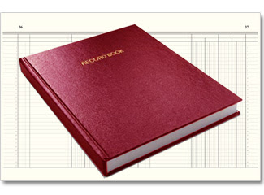
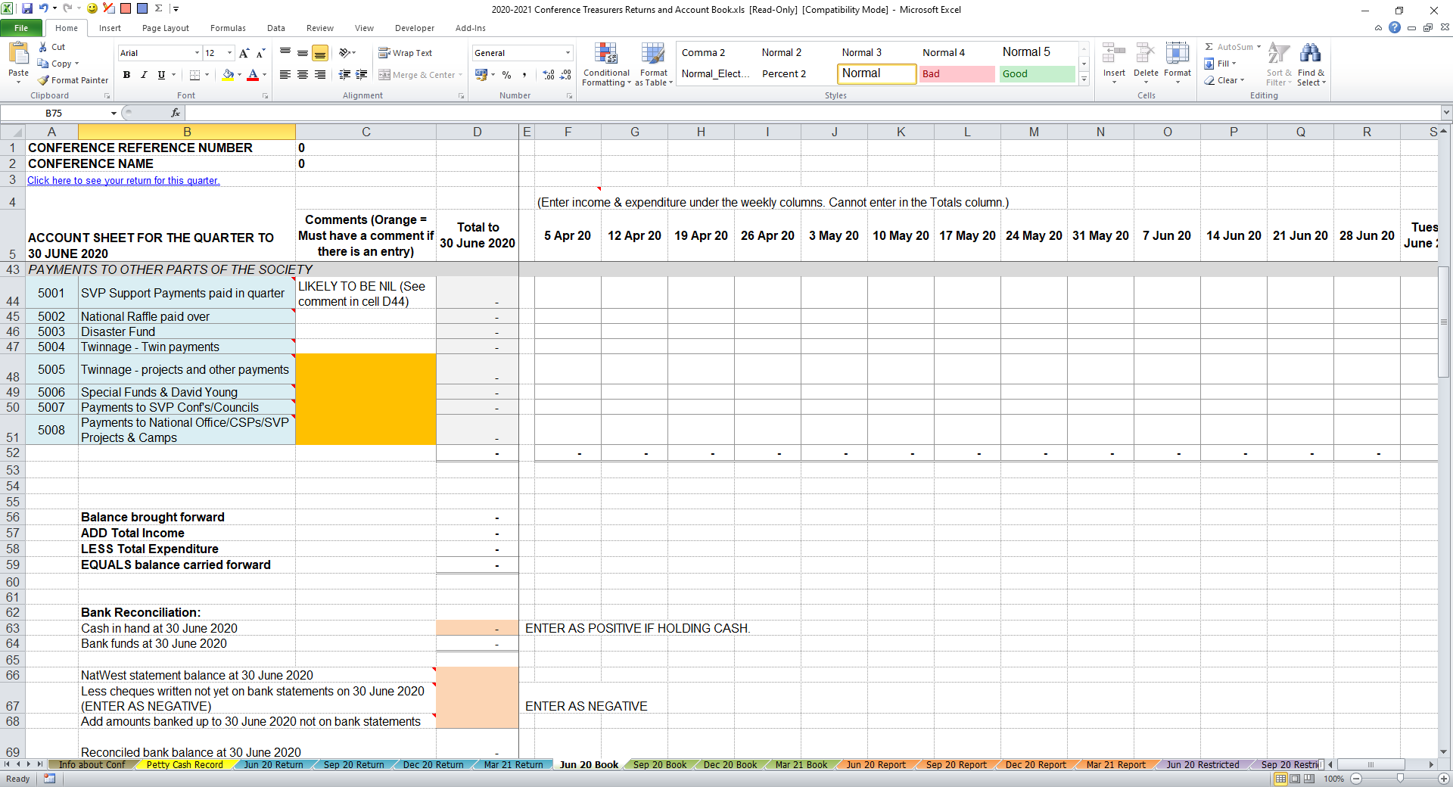
Treasurers Return & Account Book
Whether you use a paper workbook or an electronic workbook the principle is the same:
You are recording all income and expenditure and reconciling your balance to the amount of money held in the bank or as cash.
Update regularly rather than leaving until the quarter end.
The combined totals will go into the Quarterly Finance Return.
Additional resource: ‘HOW TO GUIDE – TREASURERS WORKBOOK’
Additional resource: Workbook available to download from members area / financial returns of the SVP Website

Slide 11
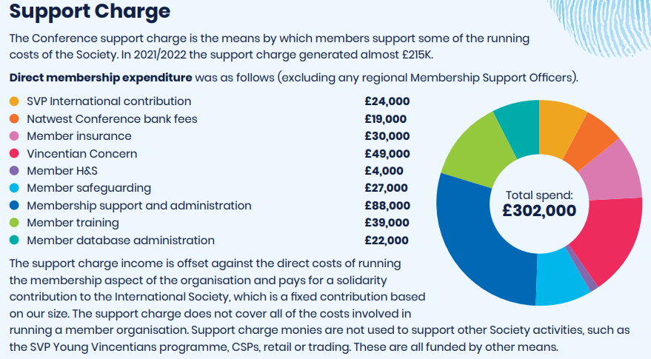
SVP Support Charges Active Conferences
All Conferences with an Active status on CiVi will be charged the support charge for each quarter.
NATIONAL ELEMENT 10% support charge £12.50 per quarter
CC ELEMENT Ranges between 0%-14% on income, set by the Central Council may be split with DC.

Slide 12
Use of conference funds
Whilst it is the Conference decision as to how and where money is spent, there are Society and Charity Commission rules which must be followed.
Monies given to the Society must be spent by the Society on Society matters - this is the view of the Charity Commissioners and they put the onus on the Trustees to ensure that monies are spent in accordance with the legal Objects of the Charity.
Councils/Conferences may not give monetary donations to other Charities, whether National or Local (see SVP National Statutes 4.28).
Decisions on spending Conference or Council funds are made jointly by members and officers at their regular meetings.
Where funds spent outside of the SVP policy, Conference or Council will need to confirm in writing they have been made aware of the policy and the oversight will not be repeated.

Slide 13
Use of Conference funds (1)
Spending location | Yes or no | Guidance
Foodbanks | Correct use of funds | There must be direct involvement of the Conference or collaboration with another Charity or foodbank. The beneficiaries must be aware the SVP have assisted: this could involve Conference information handed out with the food packs to let them know how else we can help.
 | Check before releasing payment | SVP monies or food cannot be given directly to another foodbank to use or distribute.
Schools | Correct use of funds | Payments to parents and children in need, introduced by the school and met by a member at least once. Payments directly to a school towards a direct cost for a child with a set time frame e.g., lunch, school trip. Use of SVP School Outreach Scheme (more information available here).
 | Check before releasing payment | Payments via schools where we do not know who has been helped.

Slide 14
Use of Conference funds (2)
Spending location | Yes or no | Guidance
Special Activity/Works or Other Charities | Correct use of funds | Contributing towards a special works and/or another Charity will depend on: amount, appropriate approval, a member of the Society must be actively involved, the other project or Special Activity has proper accounts in place to justify making the payment. e.g., regularly visiting and/or helping beneficiaries of that body and the activities of that body complement those of the Conference or Council. Full details available in the Members guidance manual, ‘use of funds’ section.
 | Check before releasing payment | Ordinarily, Councils/Conferences may not give monetary donations to other Charities, whether National or Local (See Nat. Statutes 4.28). Other charities will be providing excellent services, but donors have chosen the SVP to spend their donation.
Other Parts of The Society | Correct use of funds | Monies paid to another Conference / Council, CSP's such as SVP Camps, support centres and retail shops, overseas twinning payments, or payments to National general funds or special funds such as Cost of living, young family or offender fund.
 | Check before releasing payment | Cheque payments would generally be made payable to 'SVP', bank transfers would have a sort code of '606004'. Remember to reference the project/fund.

Slide 15
Use of restricted income
Restricted income is money given to your Conference/ Council for a specific purpose. We have a legal obligation to spend restricted income in line with the restrictions placed on it.
The donor makes this restriction through a letter accompanying the gift, or you fundraise for something specific and inform donors in your fundraising materials exactly how you will spend their money.
Backing documents must be kept - this should in include either written instructions from the donor or the fundraising materials with details of the restriction. E.g., Letter from donor, church notice sheet, newsletter, etc.
A separate record of a Quarterly Restricted Income Return should be completed for all restricted income and expenditure.
If possible, it is better to avoid restricted donations. We are part of an International Society and as such can and do give support to many aspects of need.

Slide 16
Restricted income
Does it clearly show the donor details and demonstrates the specific intention of the donor?
YES
Enter total income in 1010 on the main return
Complete the restricted income form
Attach a copy of the written instructions (backing document) with the return
YES
Do you have written instructions from the Donor?
NO
Restricted income is received
NO
Cannot be classed as restricted

Slide 17
Centralised banking
All Conferences should have a Centralised NatWest account as their one and only bank account.
We can update the account details and release the funds.
It is a requirement of our auditors.
Makes administration easier and cheaper for SVP
Conferences may not hold a bank account if there is only one active member
Certain Trustees and senior staff are global bank signatories, with access to conference and council funds.
Conferences and Councils need one Trustee to sign cheques or online bank payments over £5,000.

Slide 18
Centralised Banking - NatWest
All Conferences should have a centralised NatWest account as their one and only bank account.
Accounts outside the centralised system get forgotten, particularly if a Conference goes into abeyance without emptying and closing the account
Depositing cash at NW branches, Post Offices and RBS* branches
Withdrawal of cash at NW and RBS* branches via Cheque
Banking stationery /monthly statements sent to correspondent
All Members details should be on CiVi (SVP database)
Bank signatories for all SVP bank accounts or any changes of signatories to these accounts need to be arranged via National Office
Access Bankline
Minimum 2 Users – must be existing signatories
Access the account at any time, check the balance, transfer funds, make payments and set up direct debits and standing orders
Apply for Conference Credit Card

Slide 19
Banking Arrangements
We require Conferences/Councils to bank within the Society’s centralised banking scheme with The NatWest Bank.
All funds must be deposited within the approved centralised banking system and never in a personal or a Parish bank account for any reason.
All charges are met nationally
Please have a minimum of 3 signatories on your bank account. At least two signatories are required for all bank transactions and cheque signing on the Conference/Council bank account(s) and Bankline access.
Only one SVP member per family/household can be a signatory to an individual Conference or Council bank account at any one time
A cheque signatory should never sign a cheque or online payments made payable to themselves – for instance for reimbursement of expenses.
Where you intend to claim a Gift Aid refund on any total amount of money over £50 at any one time, please ensure that the amount relating to the claim is banked and separately identifiable on the bank statement in order to provide an audit trail for HMRC.
The Treasurer is to carry out regular bank reconciliations, at least once a quarter, but preferably once a month. Unfortunately, banks do make mistakes. Resolve any discrepancy without delay.
Additional resource: Members Guidance Manual – Finance Policy - Banking Procedure

Slide 20
Gift Aid – Reclaim 25% back
Gift Aid is a government scheme that allows charities to reclaim the tax that you have already paid on your donations through UK income Tax or Capital Gains Tax. It is a really easy way for every conference to boost their funds by 25%.
All individual donations (excluding those made through the Charities Aid Foundation, which are already subject to tax relief) are eligible for the scheme – including regular gifts such as Standing Orders and Direct Debits. Our Fundraising Team will be able to help with setting up Standing order or direct debit.
Information Required to Gift Aid Claim
- First Name/Initial
- Last Name
- House Number/Name
- Post Code
- Date Of Donation /last in series of donation
- Amount of donation(s)-For gift aid envelopes this will be noted when counting takes place.

Slide 21
Gift Aid – Reclaim 25%
Gift Aid is a really easy way for every conference to boost their funds by 25%.
It’s free money.
For every £1 donated, you can claim an extra 25p
Donor must be eligible
MUST have signed a Gift Aid Declaration
MUST be able to trace the donation to the bank statement
Request Gift Aid envelopes from fundraising@svp.org.uk
Make a plea that those able to Gift Aid complete & use the envelopes
Take the money out of the envelope, count it and write the amount on the envelope.
Bank the money collected in 2 lots
Gift-Aided donations
Non-Gift-Aided donations.
Complete the Claim Form in your Financial workbook and email with your quarterly return.
Information / Documents Required
Conference number
Completed Gift Aid Claim Form – Please ensure that all relevant information is completed
Fully completed Gift Aid Declaration form(s) for all new donors during the quarter
Gift Aid envelopes relating to a fund-raising event (The total on the claim must agree to the balances on the envelopes)
Copies of bank statements, clearly showing the gift aid receipts that have been paid into the account

Slide 22

Please contact the Membership Finance Team at: Email: quarterlyreturn@svp.org.uk Tel: 01274 513045 (option 1) Banking queries: banking@svp.org.uk
Any questions?

Slide 23
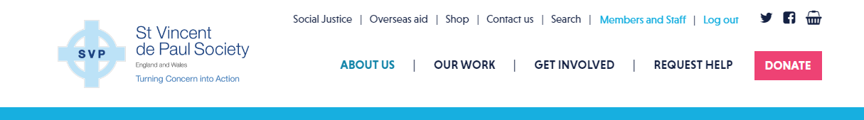
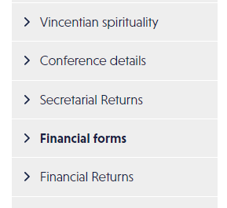
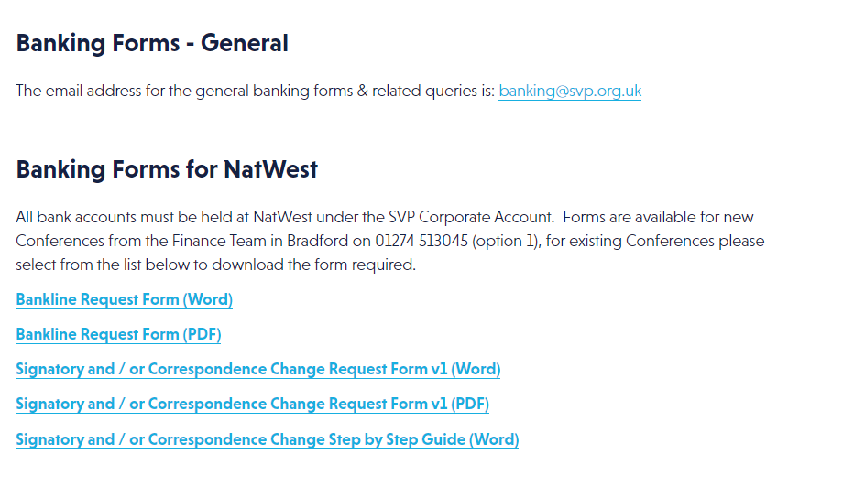
Resources and important documents
You can find all relevant forms and important documentation on the “Finance forms” page in the SVP Members Area (www.svp.org.uk/user).

Slide 24
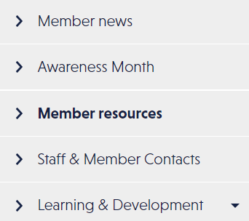
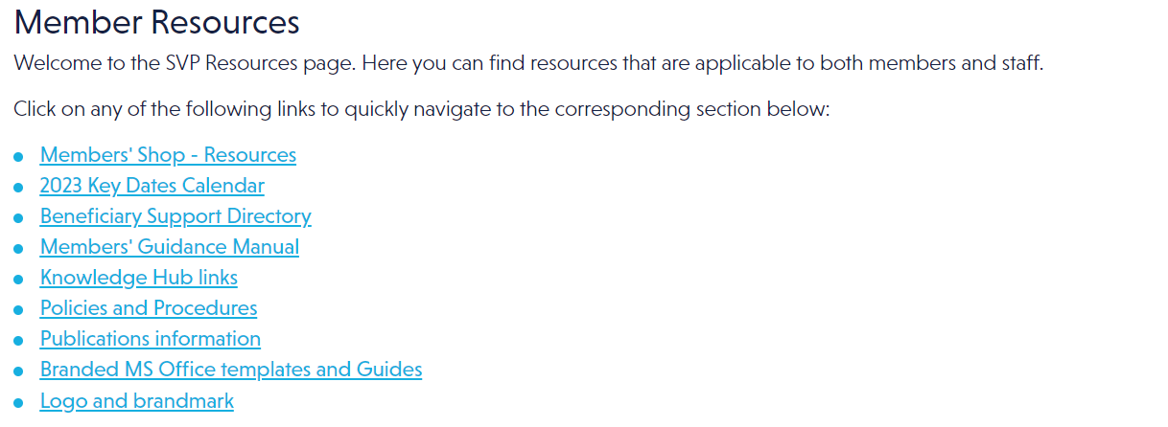
Resources and important documents
You can find all relevant forms and important documentation on the “Finance forms” page in the SVP Members Area (www.svp.org.uk/user).

Slide 25
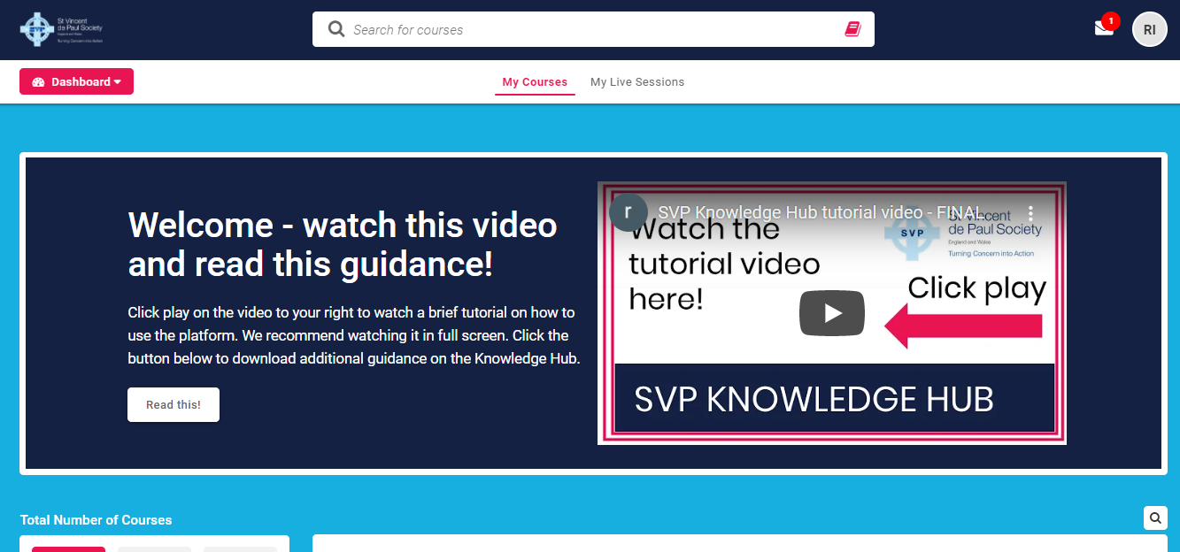
Knowledge Hub and other training
Book training
Complete courses
Download resources
Any questions? Email:
Knowledge@svp.org.uk
https://membersknowledgehub.svp.org.uk
Notes:
Be sure to visit the Knowledge Hub to view further training or book courses. Click the link above to log in. Any questions, please email rebeccam@svp.org.uk.

