Slide 1


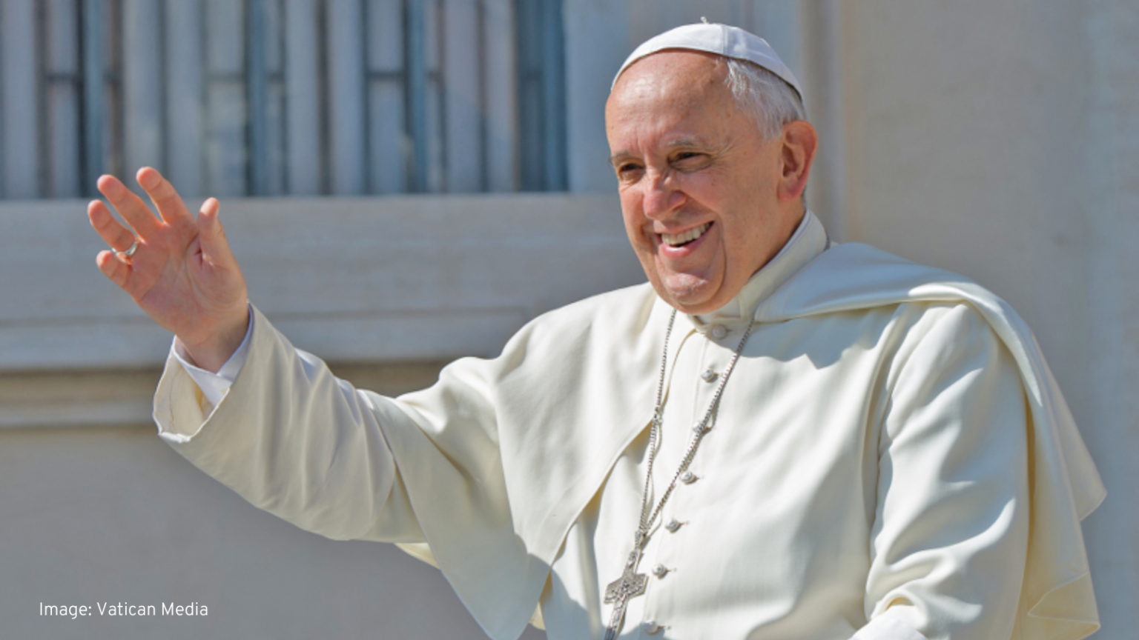

Prayers for Pope Francis
-Pope Francis-
1936 - 2025

Slide 2
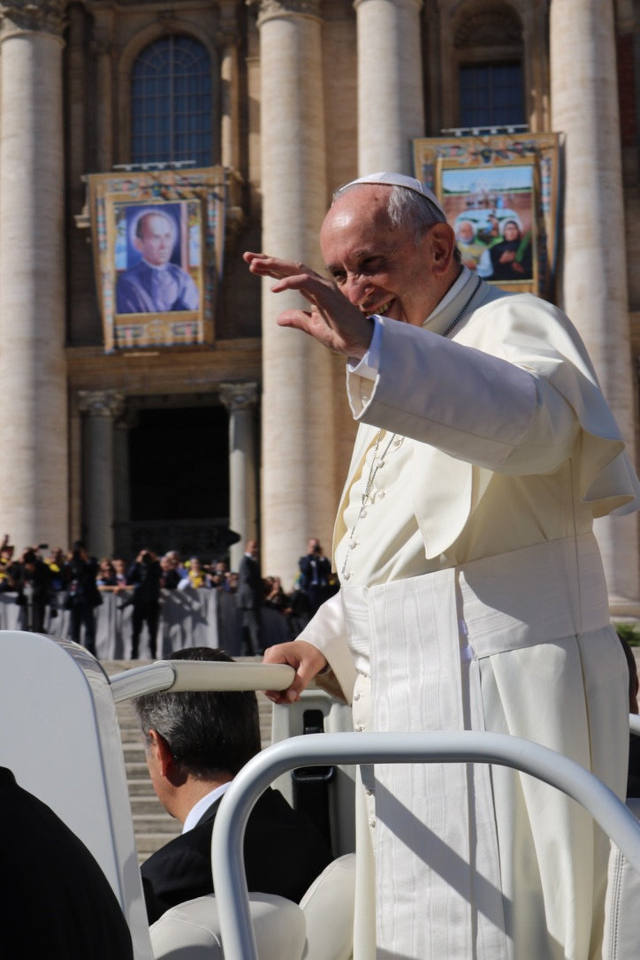

When Pope Francis met with the SVP
A few years ago, Pope Francis met with Vincentians from around the world. He said that we should find in Jesus ‘the joy of coming out of yourself in order to go out to the world’.
Pope Francis blessing 7000 Vincentians

Slide 3
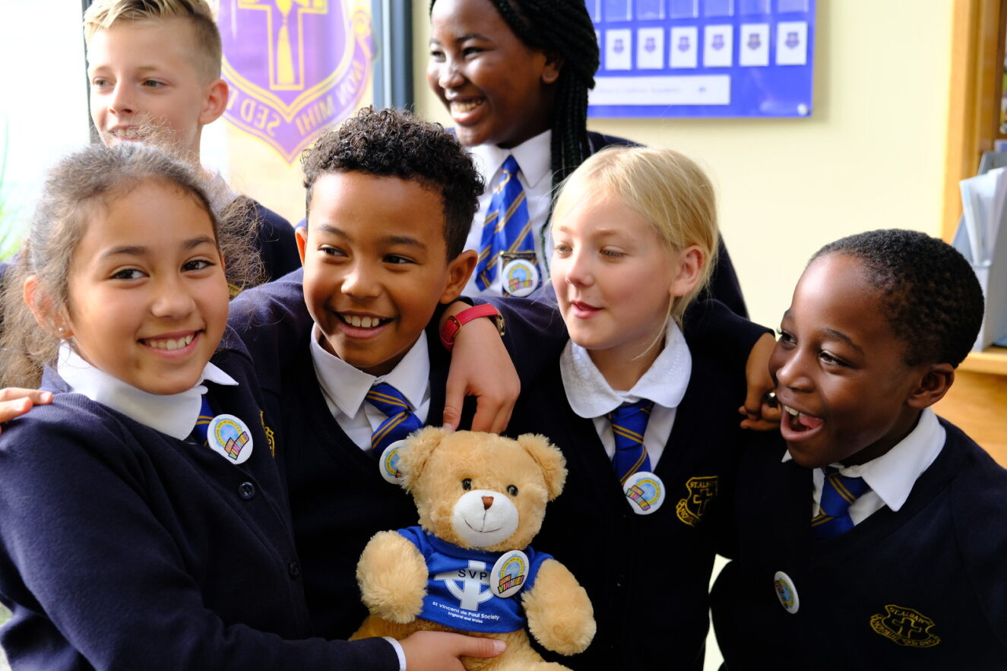
How Mini Vinnies should act
Pope Francis said that all Vincentians (including Mini Vinnies) should be confident in God and creative regarding the challenges of today and tomorrow because, as St Vincent said, “love is inventive to infinity”.

Slide 4
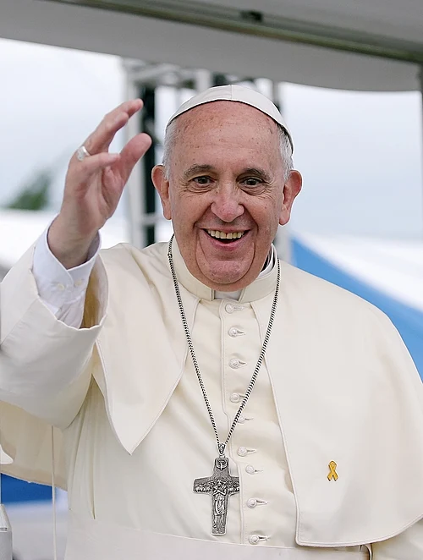
Prayers of thanks
Lord, we thank you for the guidance Pope Francis gave us to love one another, to strive for justice and work together for a better world.

Slide 5

Prayer for the SVP
We pray that, as Vincentians, we may continue to follow his example as we live out our mission to turn concern into action, and look to the future with hope.

Slide 6
Prayer for Pope Francis
Eternal rest grant unto him, O Lord, and let perpetual light shine upon him. May he rest in peace. Amen

Slide 7
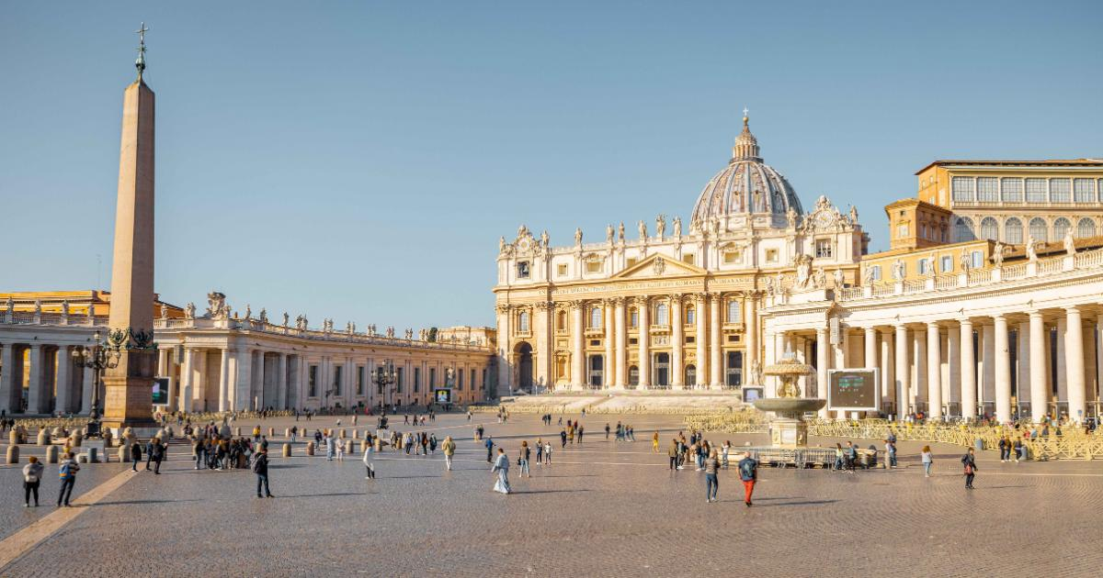
Prayer for the Conclave

Slide 8
Prayer for the Conclave
As our Church leaders gather for the Conclave - choosing the new Pope – we pray that the Holy Spirit may guide them in this decision.

Slide 9

Prayers for a new Pope
We pray that the new Pope will continue to guide the Church’s mission of peace, service to the poor and marginalised, and of spreading God’s love to all.

Slide 10



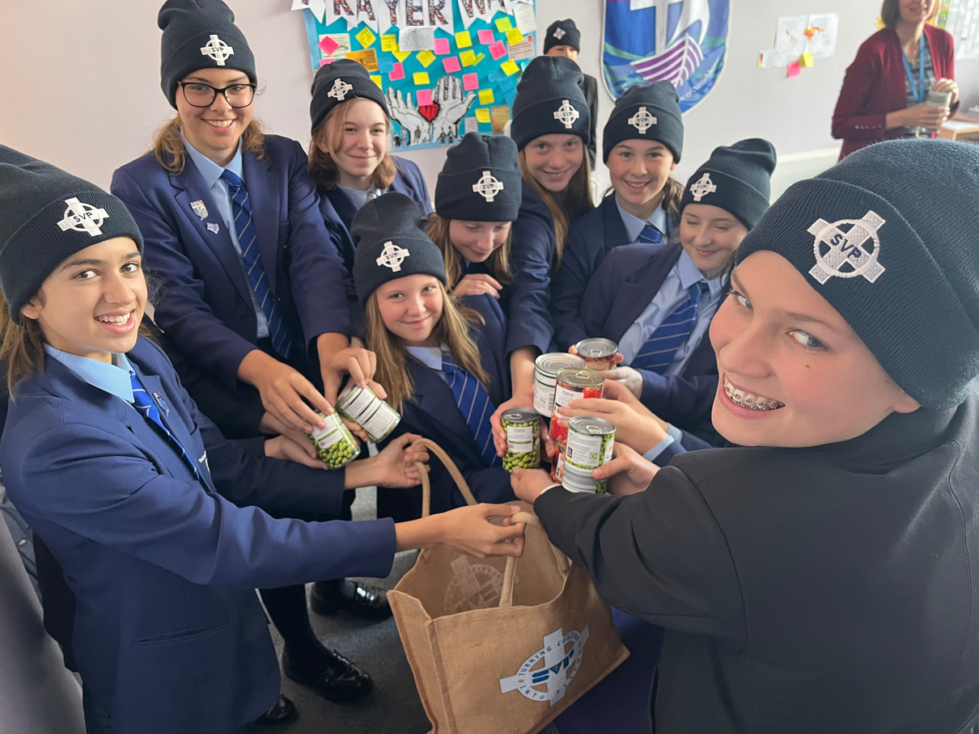
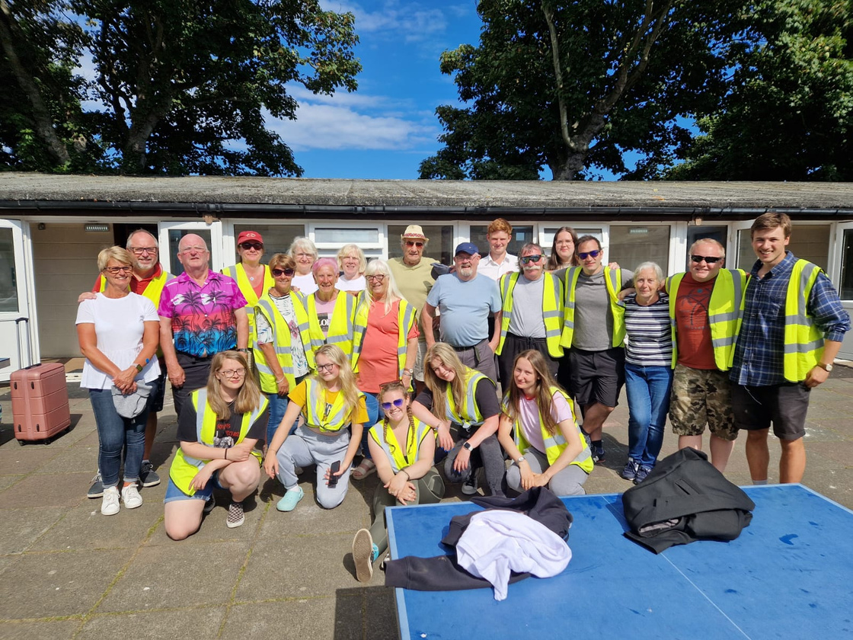







Prayers for a new Pope
May he inspire Vincentians around the world to continue their work of turning concern into action. Amen.
SEE
THINK
DO

