Slide 1

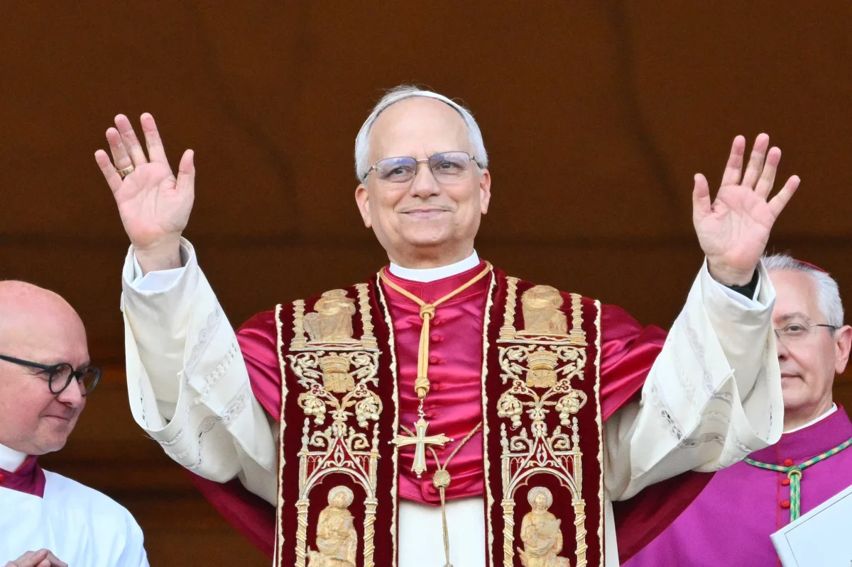
Prayer for Pope Leo XIV

Slide 2
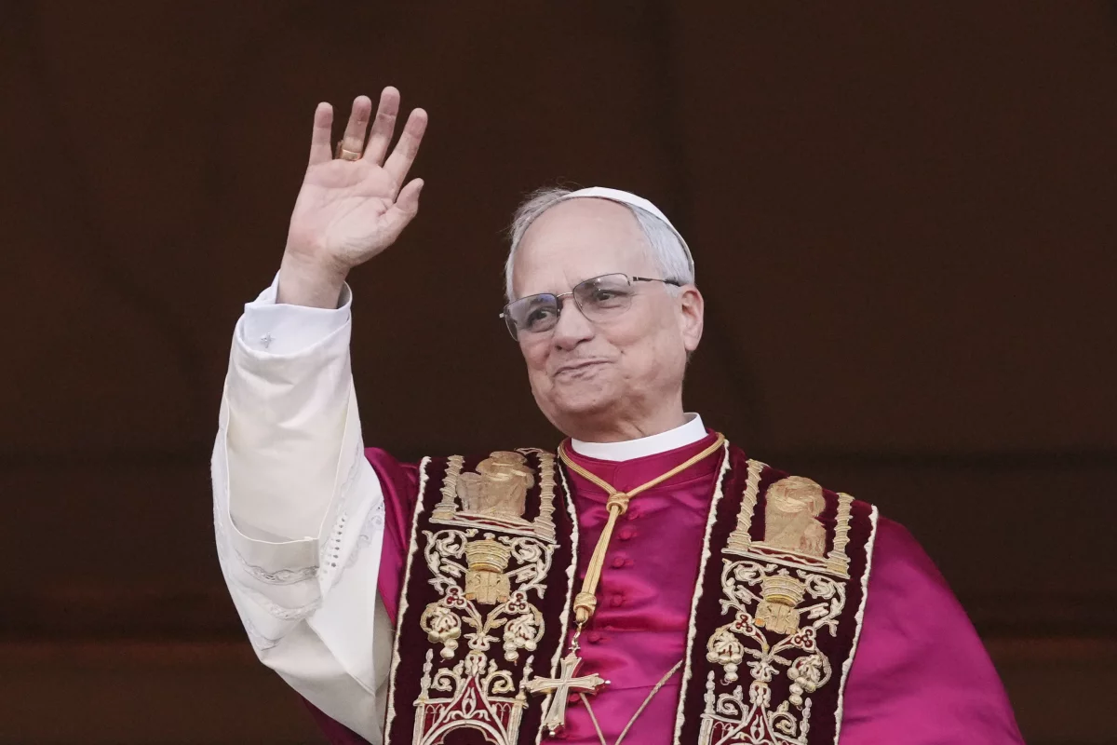
Pope Leo XIV
On 8th May 2025, the Church announced something historic:
Cardinal Robert Francis Prevost had been chosen as our new Pope.
He took the name Pope Leo XIV – the first-ever Pope from the USA and the first from the Augustinian order.

Slide 3
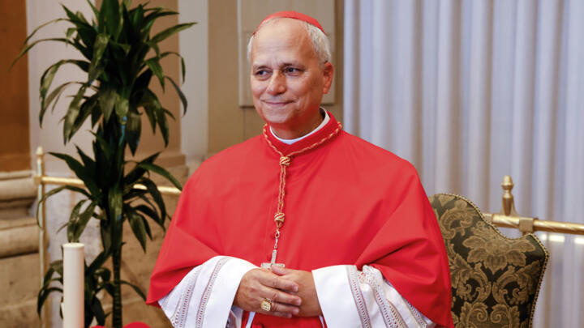
A Worldwide Church
Pope Leo was born in Chicago, USA, but spent many years living in Peru as a missionary, helping people in poor and remote communities
He speaks lots of different languages – English, Spanish, Italian, French and Portuguese!
Before becoming Pope, he worked closely with bishops around the world, helping them to lead with faith and justice.

Slide 4
Unity, Truth and Charity
Pope Leo XIV is the first-ever pope from the US to lead the Church, and the first pope from the Augustinian order.
The Augustinian order is a religious community that follows the teachings of St Augustine. Their main values are:
✨ Unity – living and working together
🕊️ Truth – searching for what’s real and right
💙 Charity – showing love, especially to those most in need

Slide 5
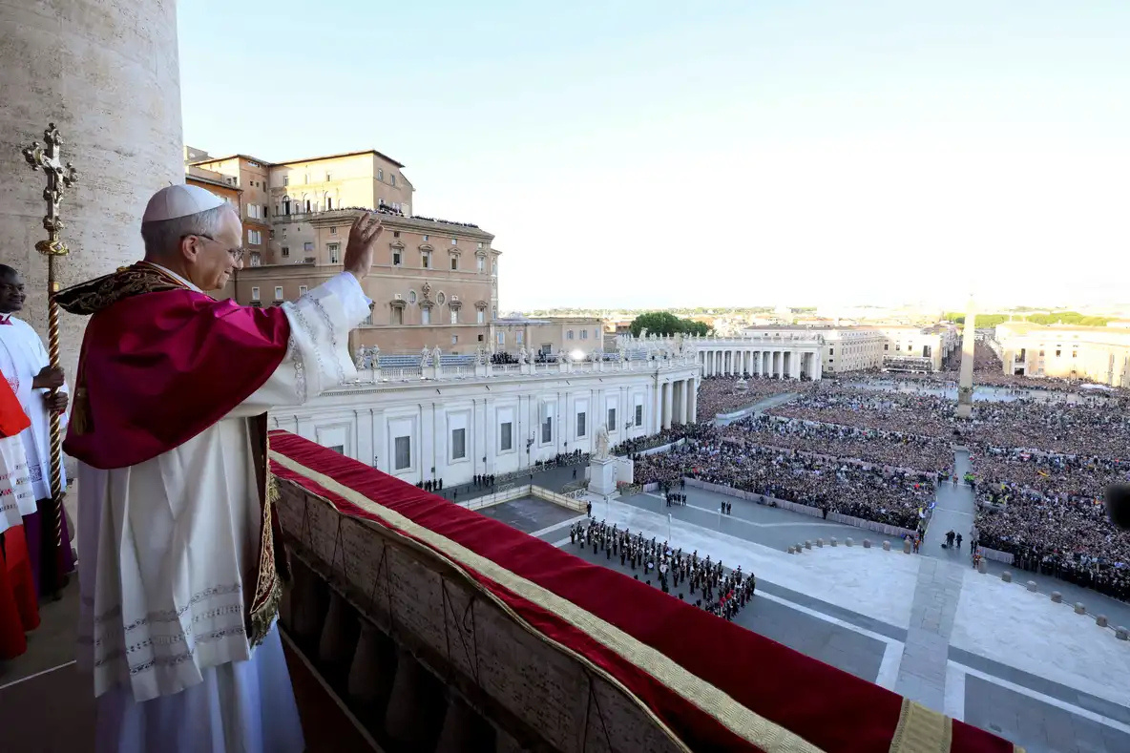

A prayer for the Church
In his first speech as Pope, he said:
A Church that always seeks peace, that always seeks charity, that always seeks to be close, especially to those who suffer.

Slide 6
A prayer for the Church
That sounds just like the Vincentian mission – being close to people in need, turning concern into action, and building peace through kindness and service.

Slide 7
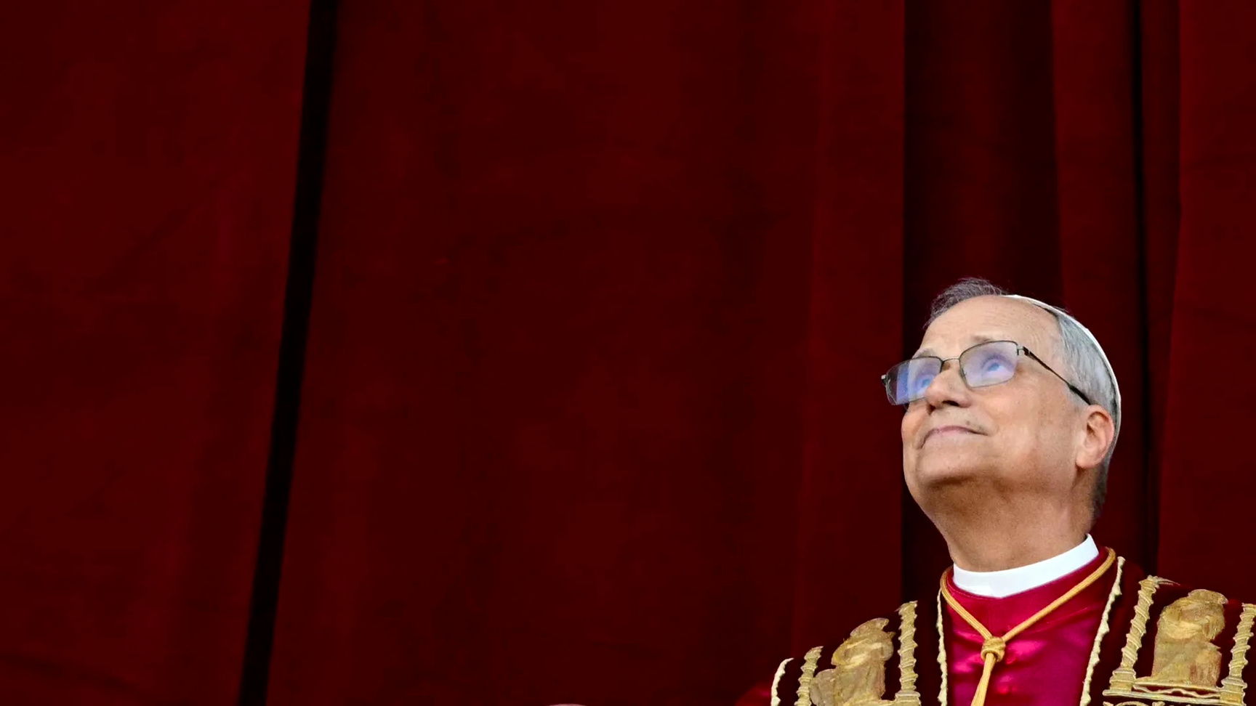
A prayer for the Church
Pope Leo XIV has already shown us that:
💭 Listening matters – He believes in listening deeply before making decisions, like we do when we meet people where they are.

Slide 8
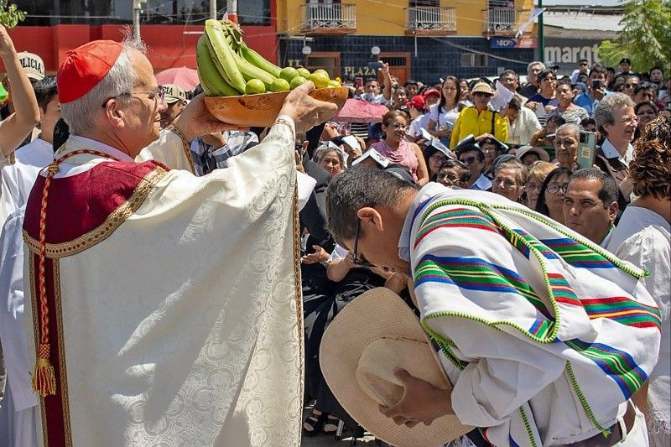
A prayer for the Church
✈️ Go where the need is – He left his home to serve others in Peru. That’s Vincentian!

Slide 9
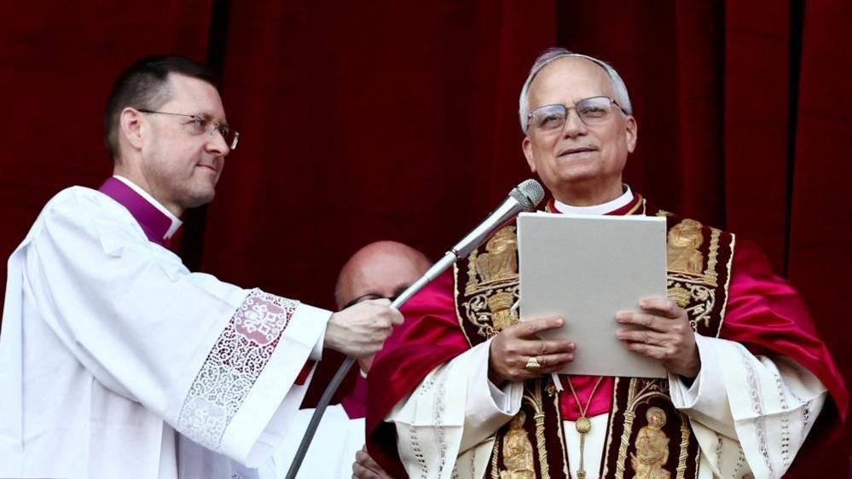
A prayer for the Church
💬 Speak up for the poor – His whole life has been about standing with people who are suffering

Slide 10
A prayer for the Church
🫶 Lead with love – Even as Pope, he wants to stay close to the people
Pope Leo reminds us that being a Vincentian isn't just for one place or time — it’s a way of life, wherever we are.

Slide 11

Let us pray...
Creator God,
You surprise us again and again. You see not as the world sees.
Where we look for power, You look for hearts ready to serve.
Where we value titles, You honour compassion.

Slide 12
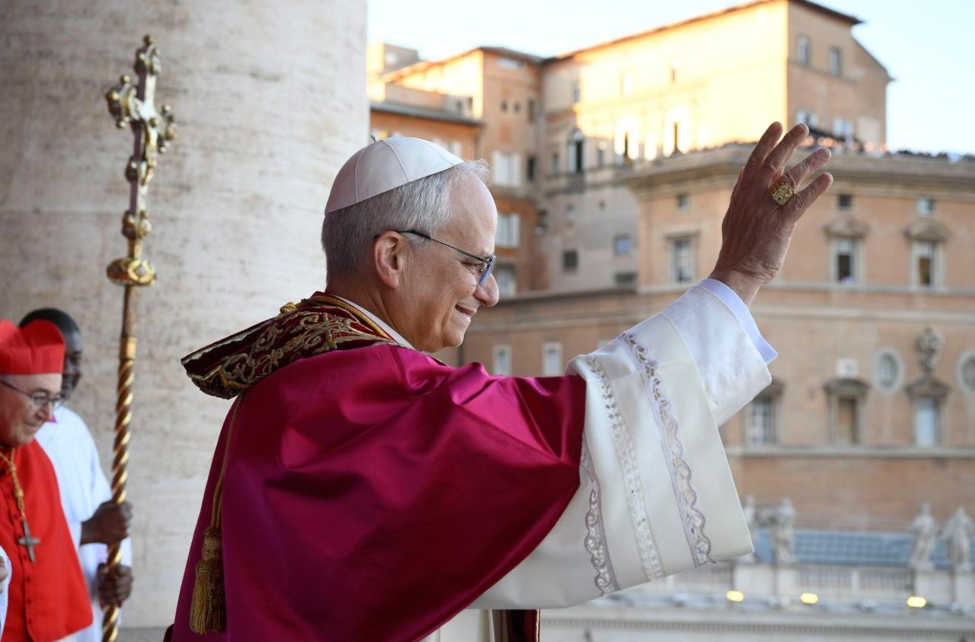
Let us pray...
This week, the Church welcomes a new shepherd — Pope Leo XIV.
His name wasn’t on anyone’s list. His past was quiet, his path unexpected.
And yet—You saw his heart. You called him forward to lead with love.

Slide 13
Let us pray...
As Vincentians, we are reminded:
You call us not because we are great, but because we are willing.
You work through listening hearts and generous hands.
You are found in the poor, the hidden, the overlooked.

Slide 14
Let us pray...
Lord, help us see as You see.
Stretch our sight. Slow our hearts.
Teach us to trust Your way—
and to serve, like Pope Leo, with humility and courage.
Amen

