Slide 1




Slide 2


Loving God,
You are the light that breaks through the darkness,
The strength that carries us when we feel weak,
The hope that holds steady when life feels uncertain.

Slide 3


We bring You
Our stories
Our challenges,
Our worries,
Our dreams,
and the desire to make a difference.
In this moment, we pause...
to be still, to listen,
and to remember You are with us.

Slide 4

Renew in us the gift of hope:
HOPE that rises when we feel weary.
HOPE that trusts You even when the future is unclear.
HOPE that inspires us to love, to serve, and to stay faithful.

Slide 5

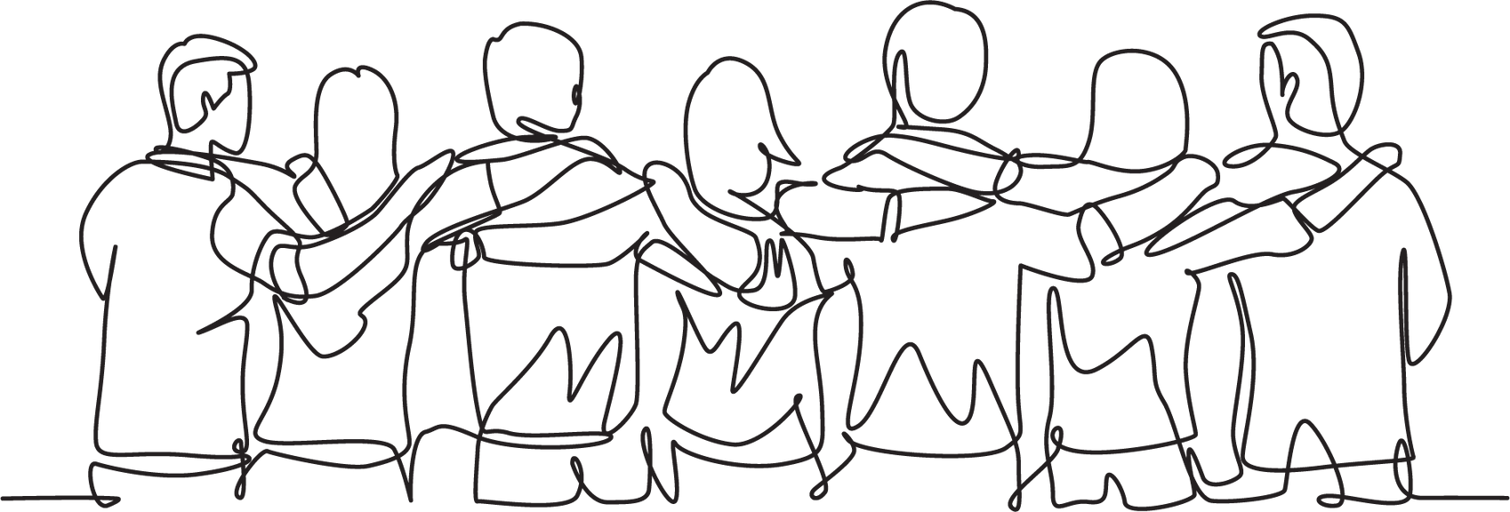
Remind us, God, that we are never alone.
That Your Spirit is with us in the corridors we walk, in the words we share, and in the hearts of those we learn and work alongside.

Slide 6


Anchor us again, Lord
Not in marks or achievements,
but in Your faithful love.
Not in pressure to succeed,
but in knowing we are held by You.
We place all we carry into Your hands,
trusting You to hold what we cannot.
Amen

Slide 7

MATT 25:35

Slide 8

When Jesus says, “I was hungry, I was thirsty, I was a stranger…,” what feelings or images come to mind, and how do they challenge the way I see those in need around me?
Think of a time someone met a need of yours, big or small. How did that impact you, and how might I offer that same care to others this week?
What is one concrete, realistic way I can respond to this verse in the next week, and how might doing so draw me closer to Jesus?

Slide 9
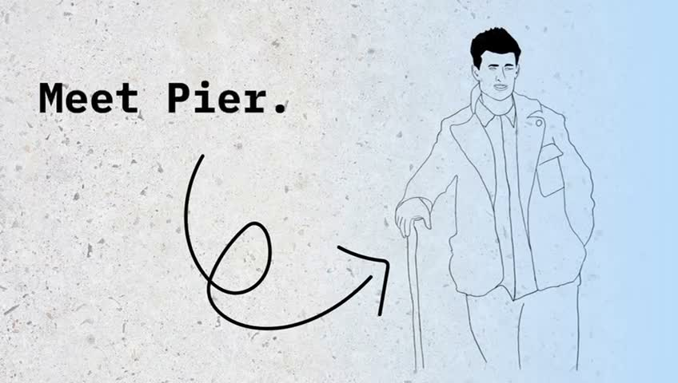

Slide 10

When you hear the word leader, what picture comes to mind? What does our world understand of the word?

Slide 11
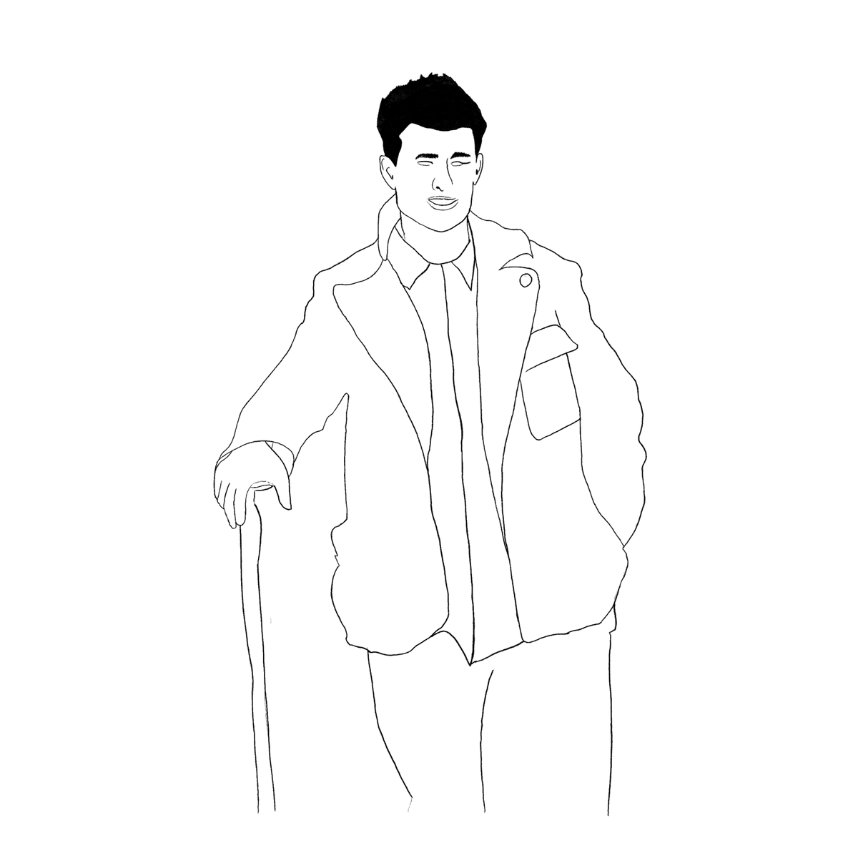
When you hear the word leader, what picture comes to mind? What does our world understand of the word?
The Vincentian way — and the example of Blessed Pier Giorgio Frassati — flips that world picture upside down. Leadership isn’t about being above others; it’s about getting low enough to serve.

Slide 12

Pier Giorgio was a student, a climber, a bit of a joker. But here’s the remarkable thing: he gave his bus fare to someone poorer, then ran home so he wouldn’t be late.
Turn to the person next to you and finish this sentence:
If I had to run home because I gave my money away,
I would feel ______.

Slide 13

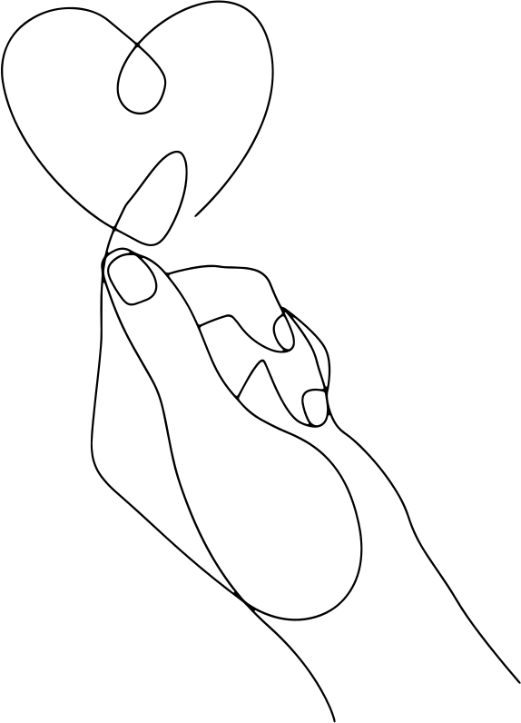
Pier gives us a perfect example of leadership: seeing Christ in the poor and acting quietly, not for attention, but through small, hidden choices made with real love.

Slide 14

Think for a moment:
Have you ever invited someone to share in something good—maybe a prayer, a walk, or a meal?
Have you given your time, your money, or your energy to help someone?
Have you reached out to include the person who often gets left out?

Slide 15
Pier Giorgio didn’t command or instruct. He simply said, “Come with me.” His leadership was quiet, full of joy, and built on invitation.
Real leadership isn’t about making people follow; it’s about opening a door and walking through it together.

Slide 16

Pier Giorgio’s motto was
“to the heights”. True leadership doesn’t push people down; it lifts them up toward joy and Christ.

Slide 17


Loving God,
You set mountains before us—peaks that call us upward, trails that challenge us, and views that take our breath away.
Remind us that true leadership is not standing above, but walking alongside, lifting others toward joy, kindness, and Your love.

Slide 18
Give us eyes to see You in those around us,
hands ready to serve,
and hearts brave enough to take the first
step on paths of compassion.
When the climb feels steep, anchor us in Your presence.
When the journey feels long, fill us with hope that rises like the morning sun.

Slide 19

May we always remember: to lift another is to rise ourselves, to act with love is to walk closer to You.
We place our steps,
our choices,
our hearts into Your hands,
trusting You to guide us
Verso l’alto — to the heights.
Amen

