Slide 1



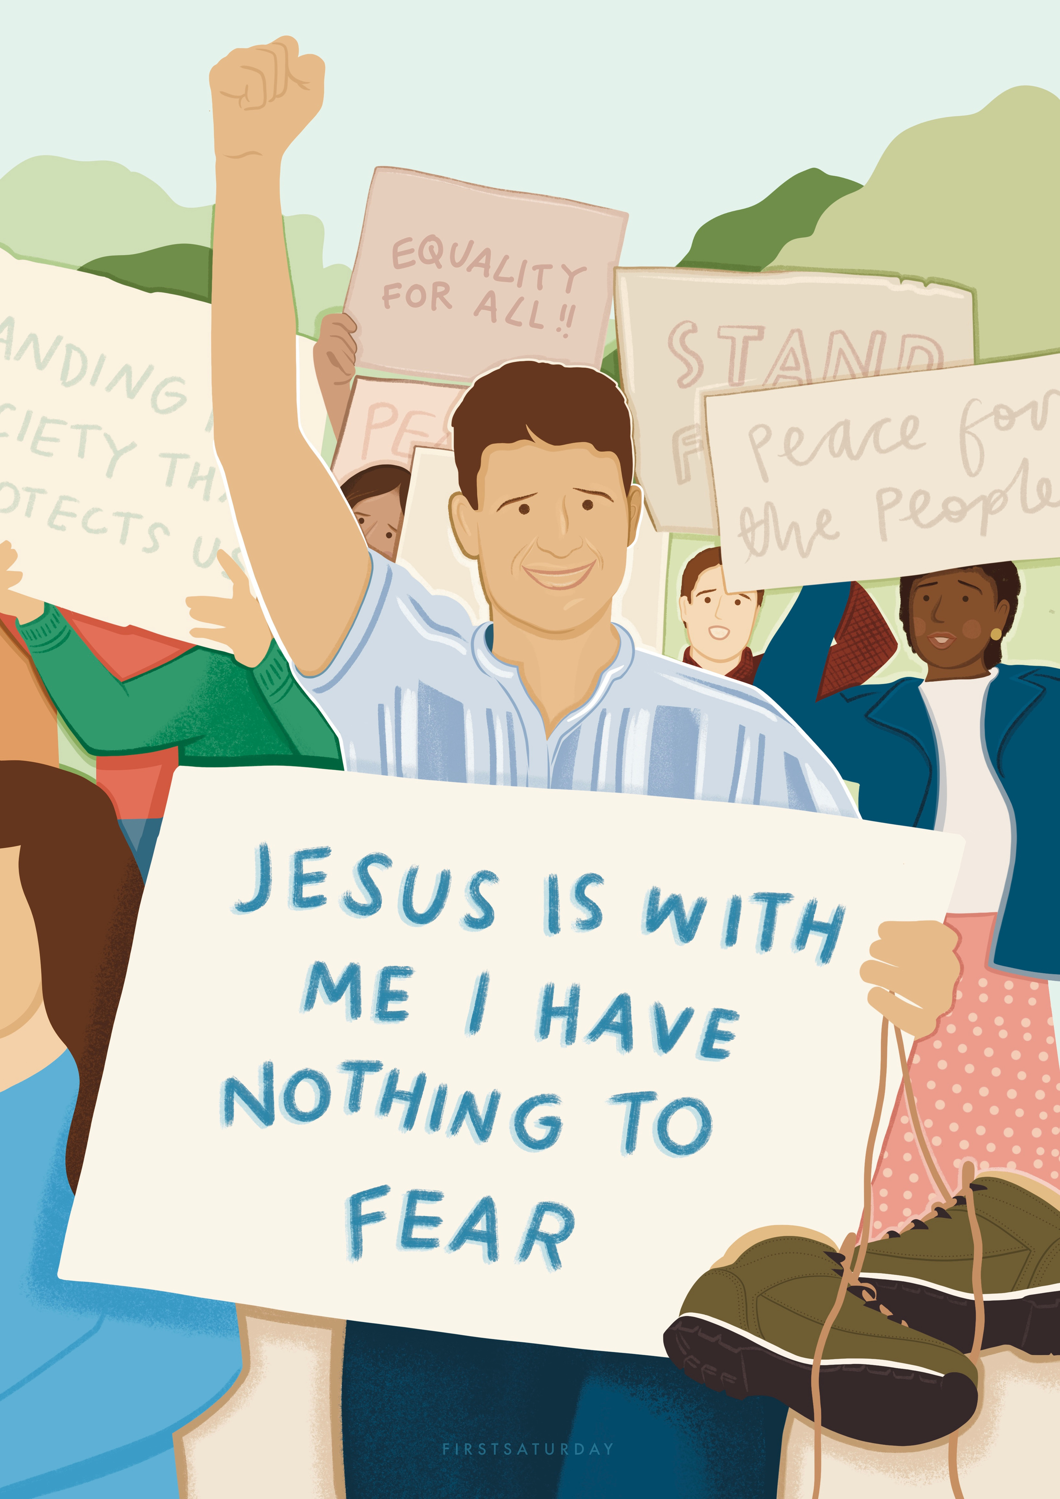
St Pier Giorgio Frassati
  What do you see happening here?
  Which details catch your attention?
  If you had to describe Pier Giorgio in one word based on this poster, what would it be?
St. Pier Giorgio Frassati

Slide 2
Can you see any signs of faith in this poster?
St. Pier Giorgio Frassati

Slide 3

The protest signs
St Pier joined rallies and protests calling for equality, peace, and justice. Christ is present here in the call to defend the poor and oppressed.
St. Pier Giorgio Frassati

Slide 4
The central sign “Jesus is with me, I have nothing to fear.” Christ is present in Pier Giorgio’s faith, the source of his courage.
St. Pier Giorgio Frassati

Slide 5
The Boots
St Pier loved mountain climbing, but these boots point to a time when he gave his own away to someone in need - a living sign of Christ’s love in action.
St. Pier Giorgio Frassati

Slide 6
The raised arm
A gesture of hope and leadership. Christ is present in Pier Giorgio’s willingness to lead others towards justice and truth.
St. Pier Giorgio Frassati

Slide 7
The crowd
A reminder that God is found in community, and that we are called to walk together, not alone.
St. Pier Giorgio Frassati

Slide 8
  If Pier Giorgio were alive today, what issues would he be standing up for with Christ by his side?
  Where do you see Christ at work in the world right now?
  How does this image challenge us to recognise Christ in unexpected places?
St. Pier Giorgio Frassati

Slide 9

A POSTER OF YOU
If someone were to create a poster of you, what would they include to show what you stand for? What symbols, words, or actions would reveal where Christ is in your life?

Slide 10
St Pier Giorgio Frassati
Take paper and pens.
Sketch or write:
  Objects that show your values (like Pier Giorgio’s boots).
  Words/quotes that capture your faith or hope.
  Gestures/actions that reflect how you live.
  A background/setting where Christ is visible (school, family, parish, online).
  Remember: it’s not about artistic skill — it’s about showing Christ in you.

Slide 11
St Pier Giorgio Frassati
  Where can others see Christ in how we live?
  How can we make God more visible in what we stand for?
St. Pier Giorgio Frassati

Slide 12
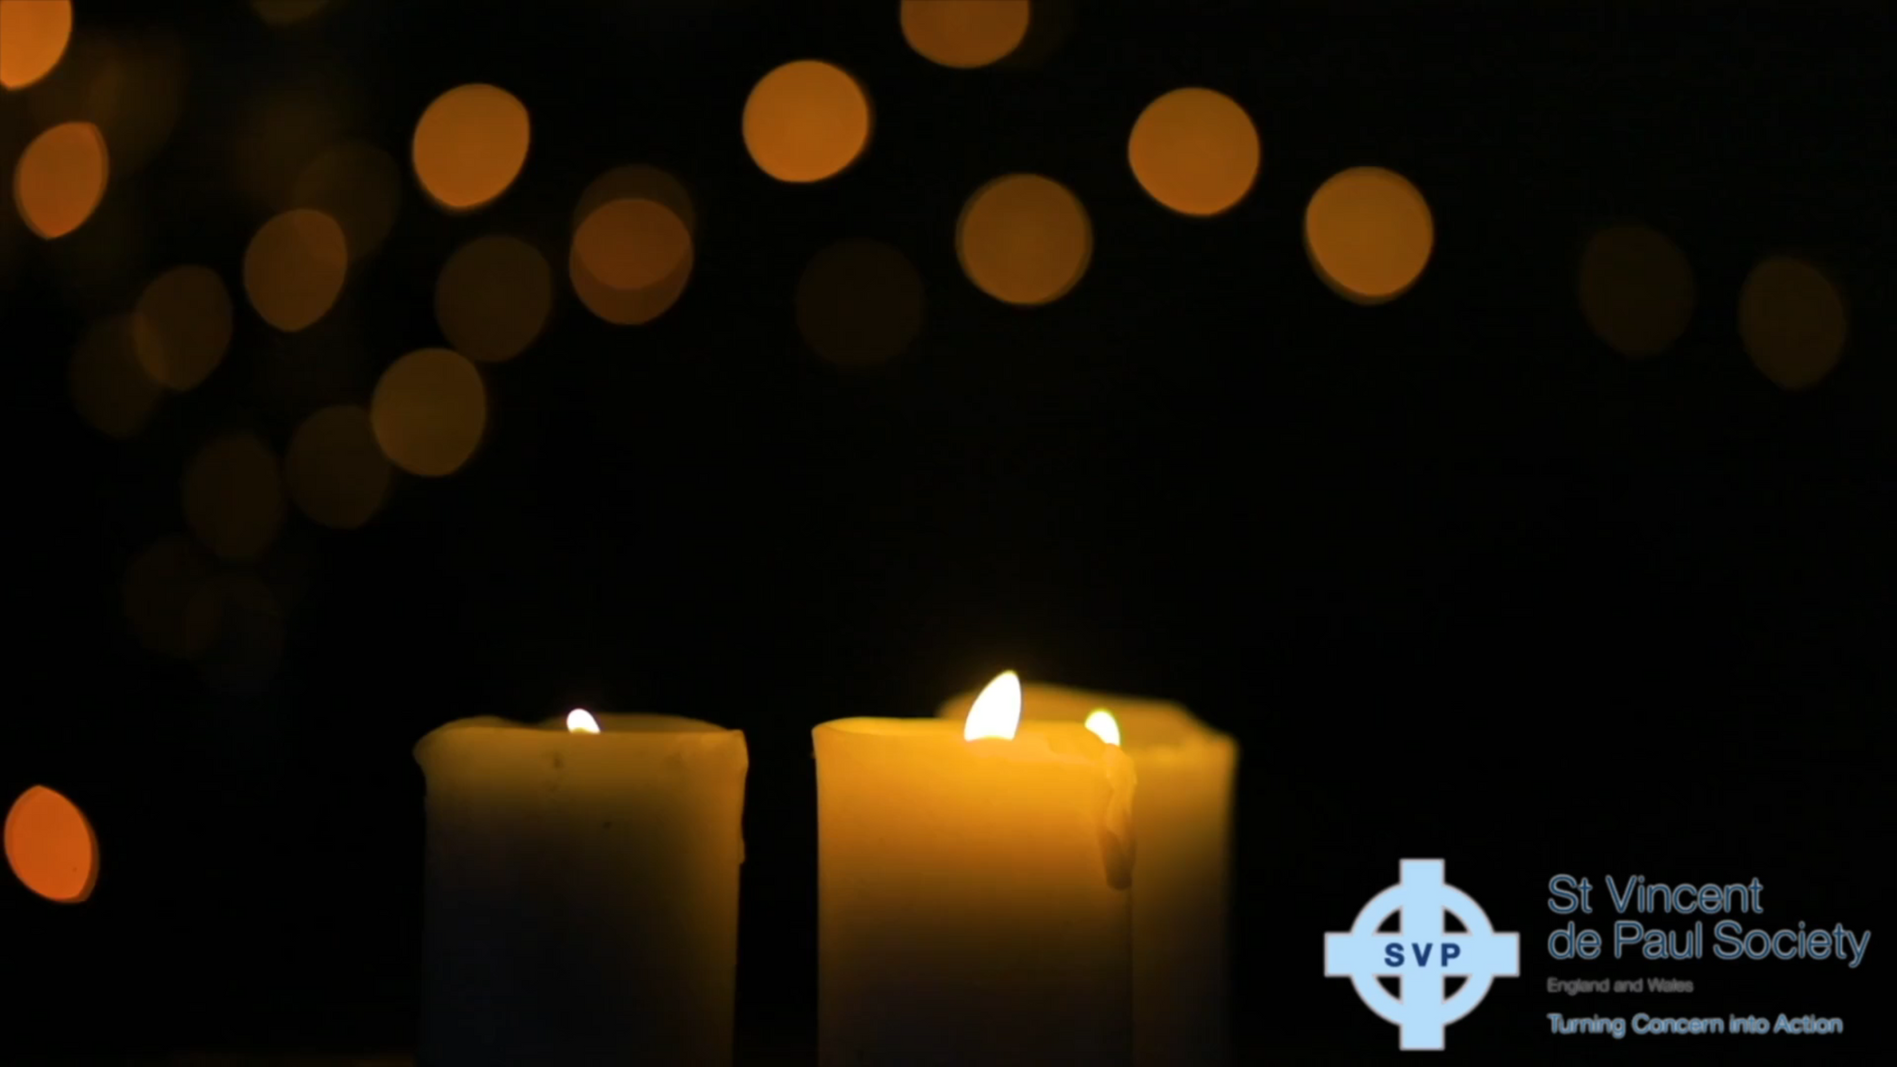
CLOSING PRAYER
Loving God,
Thank You for the life of Pier Giorgio Frassati,
who saw Your presence in the simple, everyday moments.
Help us to open our eyes and hearts, to recognise You in the ordinary around us, and to walk each day with joy, hope, and love.
Amen.

