Slide 1


SVP WORK
REFLECTIONS
REACHING OUT
Remember me
Notes:
A call to radical love
A call to merciful love

Slide 2




AN INTRODUCTION
Who are the SVP
Our mission is both simple and meaningful: to seek out and support those in need, to offer help with a spirit of justice, and to tackle the root causes of poverty wherever possible.
Notes:
The St Vincent de Paul Society is dedicated to serving those in need with compassion, generosity, and practical help.
Our mission is simple: we seek out and support those in need, whoever they are, wherever they are.
This October (2025), we mark Prisoners’ Week with the theme:
Jesus looked at him and loved him (Mark 10:21), and he looks at you and loves you too.

Slide 3
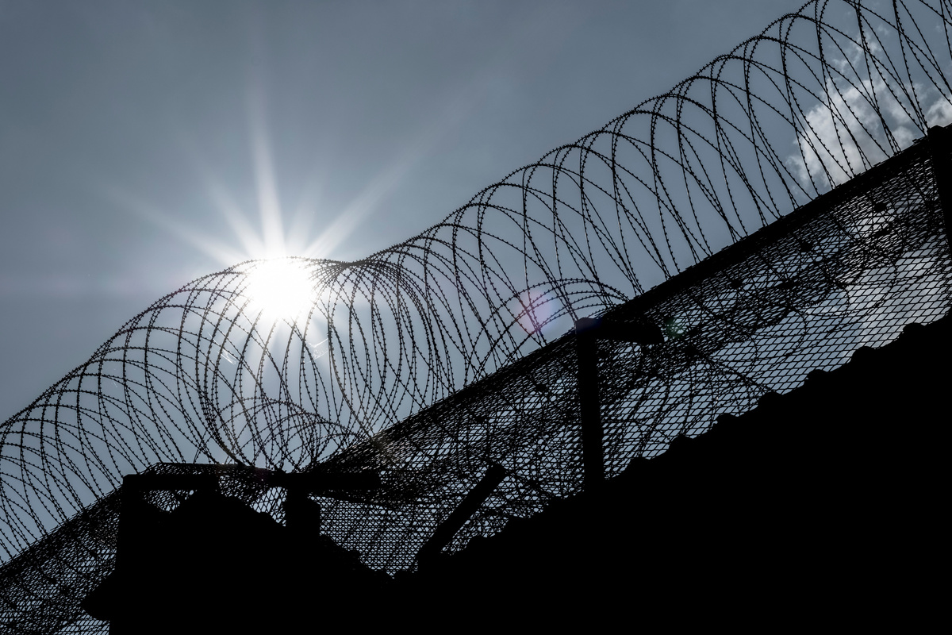





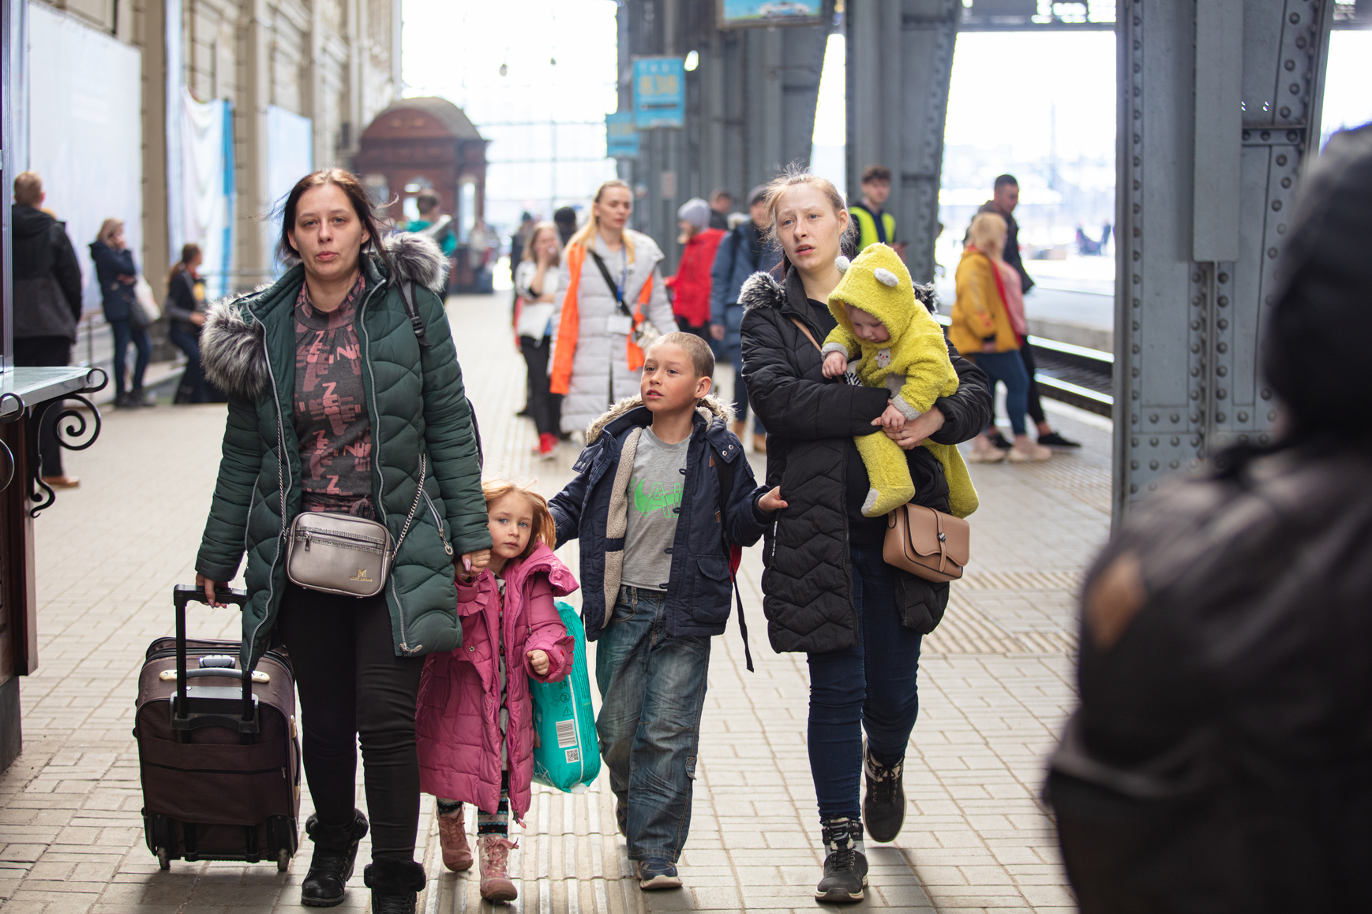
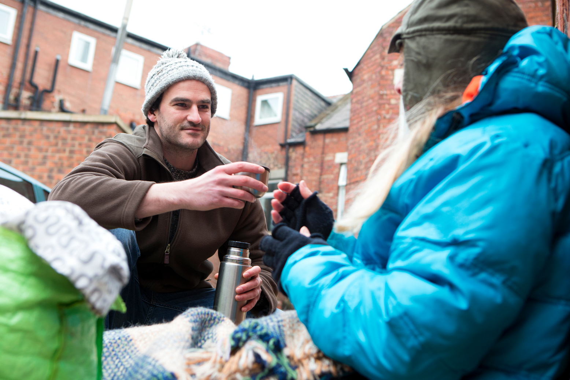

Some
of
the
work
we do
Reaching out to those in prison and their families: offering support and friendship
Practical and financial gifts to help people back on their feet
Visiting those who are lonely or in need of support
Debt advice and Support
Supporting families and schools
Welcoming and helping asylum seekers and refugees
Working with the Homeless
Notes:
The Range of Work the SVP Does
Remembering our mission: to seek out and support anyone in need.
The SVP helps in many ways, including:
Supporting people experiencing homelessness
Visiting the lonely and isolated
Offering debt advice and practical support
Supporting prisoners and their families

Slide 4








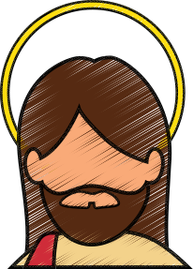

Responsive
Generous
Accountable
By supporting prisoners, members of the SVP reflect Christ’s example by offering their time, resources, and love without expecting anything in return,
just as Christ
gave Himself for us.
Being accountable in the work we do with prisons means using resources responsibly, advocating for fair treatment, and providing ongoing support for reintegration, while acting within our knowledge and skills.
VINCENTIAN VALUES
Whether its the need for clothing in prisons, visits, or journeying with those who are sick in prison, members respond quickly to these needs, because it’s what Jesus asks of us.
The SVP is called to serve those who are often marginalised or forgotten. Prisoners, frequently isolated by society, are prime examples of those in need of compassion.
We need
change
Our Vincentian Values
Compassion
Confidential
Respectful
The SVP maintains confidentiality by keeping prisoners' information private, fostering trust and a safe space for communication, sharing details only when necessary for safety.
Christ
Centred
We acknowledge and recognise that in all we do and experience Jesus is present.
Treating prisoners with dignity, listening to them, and supporting their rehabilitation with compassion.
Notes:
A question we often hear: “Why would you work with prisoners?”
The answer is simple: our Vincentian values call us to it.
We believe no one is beyond God’s love or mercy.
Supporting prisoners is part of our mission to seek out and serve those in need — wherever they are.
Prison work is a core call of the SVP, following the example of St Vincent de Paul and Blessed Frédéric Ozanam.

Slide 5

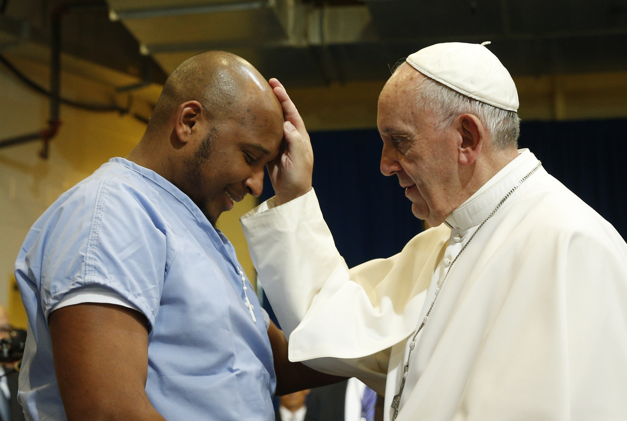
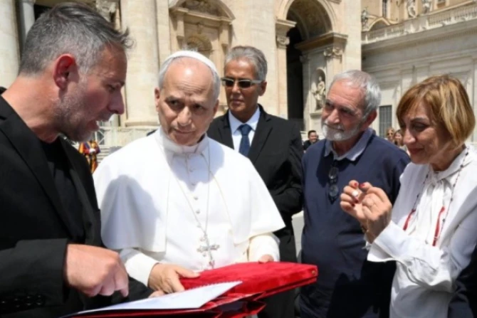


FAITH
VALUES
“Christians and people of good will” to “work for the improvement of prison conditions, out of respect for the human dignity of persons deprived of their freedom”
Pope Francis
“We can all be called by the Lord at some point in life; even in the worst moments when we feel most inadequate, the Lord always comes to meet us.”
Pope Leo XIV, June 2025
Notes:
Backed up by the brilliant examples we have had in Church leadership...
Pope Francis showed how we should reach out with compassion:
Visited prisoners during the Jubilee Year of Mercy
Celebrated Mass in prisons
Washed prisoners’ feet on Holy Thursday
Shared words of dignity and hope, reminding the world no one is defined by their mistakes
Gave out ice creams as a simple gesture of joy
Pope Leo followed in these footsteps:
In June 2025, invited two inmates from a Rome prison to attend his Papal Audience
Shared words that deeply moved his prison guests
Received a silver cross handmade by them in prison as a token of gratitude

Slide 6
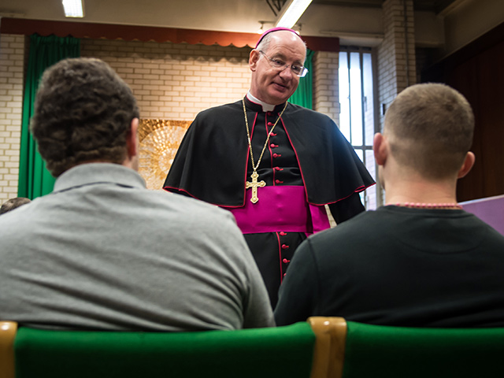
FAITH
VALUES
God always loves us, even when we make the wrong choices and do the wrong thing. Pray to always see the presence of God in others, whoever they may be, and reach out to them with understanding.
Bishop Richard Moth
Notes:
Backed up by the brilliant examples we have had in Church leadership...
Pope Francis showed how we should reach out with compassion:
Visited prisoners during the Jubilee Year of Mercy
Celebrated Mass in prisons
Washed prisoners’ feet on Holy Thursday
Shared words of dignity and hope, reminding the world no one is defined by their mistakes
Gave out ice creams as a simple gesture of joy
Pope Leo followed in these footsteps:
In June 2025, invited two inmates from a Rome prison to attend his Papal Audience
Shared words that deeply moved his prison guests
Received a silver cross handmade by them in prison as a token of gratitude

Slide 7




Discussion Point
What are the main purposes of the criminal justice and prison system?
Why do they exist?
What do we expect our prisons to do?
Notes:
In your groups (or smaller groups), discuss and answer:
What is the main purpose of criminal justice and the prison system?
Why do they exist?
What do we expect our prisons to do?
Write your thoughts on post-it notes and add them to the board.

Slide 8

Key reasons for prisons
UK Government expectations
Public Protection: Prisons protect society by holding those convicted or awaiting trial and preventing them during this time from reoffending.
​
Punishment: Serving as a consequence for criminal actions, prisons punish those who break the law, carrying out the penalties set by the courts as part of the justice system.​
Rehabilitation: Beyond punishment, prisons should offer programmes like education and job training to help offenders move forward positively, reduce future reoffending, and support their ability to re-join society as law-abiding citizens.
Deterrence: Prisons exist as a visible reminder of the consequences
of those who might be potential offenders.
Notes:
Key purposes of prisons (as outlined by government)
Public protection – Keep society safe by securely holding those convicted of crimes.
Punishment – Enforce penalties set by the courts as a consequence of crime.
Rehabilitation – Help offenders change through education, training, and support to reduce reoffending.
Deterrence – Discourage crime by showing the consequences of criminal behaviour.

Slide 9
UK Government expectations
Public Protection: Prisons protect society by holding those convicted or awaiting trial and preventing them during this time from reoffending.
​
Punishment: Serving as a consequence for criminal actions, Prisons punish those who break the law, carrying out the penalties set by the courts as part of the justice system.​
Rehabilitation: Beyond punishment, prisons should offer programs like education and job training to help offenders move forward positively, reduce future reoffending, and support their ability to rejoin society as law-abiding citizens.
Deterrence: Prisons exist as a visible reminder of the consequences
of those who might be potential offenders.
Notes:
Common Views on Punishment in Prisons
Many people strongly believe that prisons should focus on punishment.
The idea is that offenders “shouldn’t have nice things” or an easy time while incarcerated.
There is a widespread feeling that prisoners need to pay fully for what they have done.
This perspective emphasises retribution and justice—making sure consequences fit the crime.
Some worry that too much comfort or support might undermine accountability or the seriousness of the offence.
But we know that the majority of those in our prisons will one day be released....

Slide 10
UK Government expectations
Public Protection: Prisons protect society by holding those convicted or awaiting trial and preventing them during this time from reoffending.
​
Punishment: Serving as a consequence for criminal actions, Prisons punish those who break the law, carrying out the penalties set by the courts as part of the justice system.​
Rehabilitation: Beyond punishment, prisons should offer programs like education and job training to help offenders move forward positively, reduce future reoffending, and support their ability to rejoin society as law-abiding citizens.
Deterrence: Prisons exist as a visible reminder of the consequences
of those who might be potential offenders.
Notes:
Rehabilitation: The Goal Beyond Punishment
The aim: help prisoners become better people who won’t offend again.
Prisons must offer opportunities for education, skill-building, and personal growth.
Rehabilitation requires dignity, respect, and hope—not as a treat, but as a necessity.
This helps people rejoin society with a real chance to avoid falling back into crime.
Breaking the cycle of offending reduces harm and protects the wider community.

Slide 11



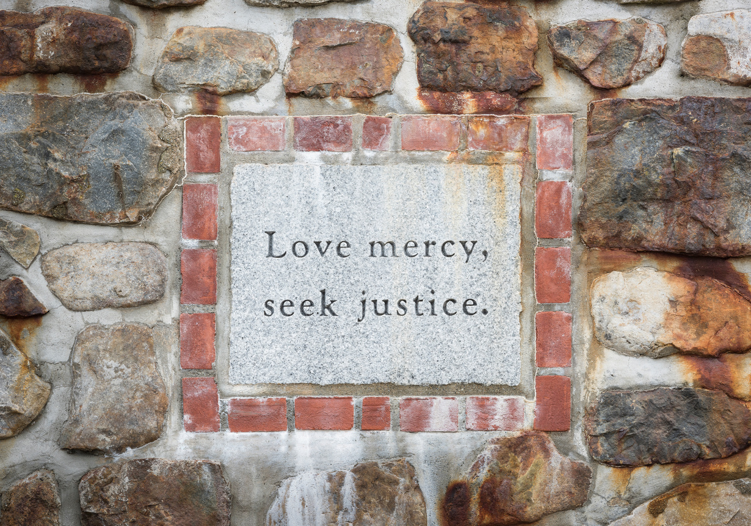



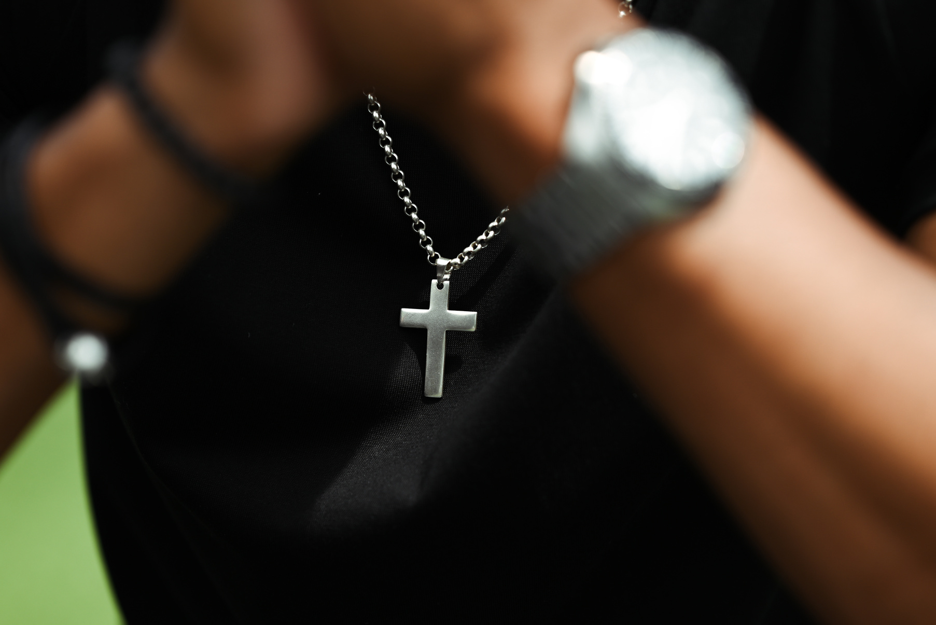
MATCH THE CARDS
Notes:
Examples of Catholic Social Teaching in Action
Hand out cards to groups (a set per group or 1–2 cards per small group/pair).
Give groups 10 minutes to:
Match their card to a picture.
Answer the questions on their card.
Allow time for each group to:
Summarise their story or quote.
Share their reflections with everyone.

Slide 12

Let’s talk numbers!
Notes:
Living in prison isn’t easy, conditions aren't ideal, with overcrowding being prominent (you may have seen this on the news) and people being at various points in their rehabilitation journey. Data from Gov 24/25.
In your groups, you have 5 minutes to match the statistic to the statement... Printable cards hand out numbers

Slide 13

123
The number of prisons in England and Wales.
50%
The percentage of people who gain employment after release.
The percentage of people who secure a shelter for the first night following release.
63%
7,000
The number of people who will remain in prison for life.
The percentage of people who live in overcrowded prison accommodation.
The amount of money given to people on release as a ‘discharge grant’
25%
£76
The number of people in prison system.
£6.85 billion
The amount of money the UK government spends on the prison system.
88,000
Notes:
Group feedback- Which statistics are most surprising/shocking/ upsetting and why? Did anyone match them all correctly?

Slide 14
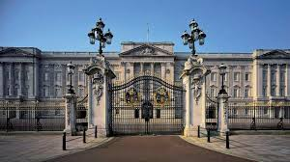
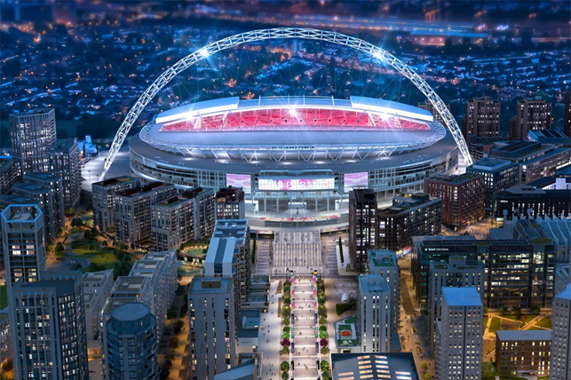

81000
WILL GET OUT AT SOME POINT
Notes:
Challenges and Reflection
The prison system is complex, with many challenges — from overcrowding to high costs.
These aren’t just statistics; they represent real people with dignity and worth.
We are called to reflect on how we treat all individuals, especially the most vulnerable.
Everyone deserves opportunities for rehabilitation, dignity, and a second chance.
⚠️ Key facts to consider
88,000 people in prison in the UK — enough to fill Wembley Stadium. 81,000 will be released at some point and aren't in for life.
50% of people find employment after release — showing many can be a force for good with the right support.
25% of prisoners live in overcrowded conditions — that’s like 110 trains packed together.
The prison system costs £6.85 billion a year — enough to buy Buckingham Palace twice or Cover free school meals for every eligible child in the UK for nearly 10 years
❓ Questions for reflection or group discussion
Is this money being spent in ways that focus on rehabilitation and dignity?
How can we balance justice with compassion in how we approach prison and punishment?

Slide 15



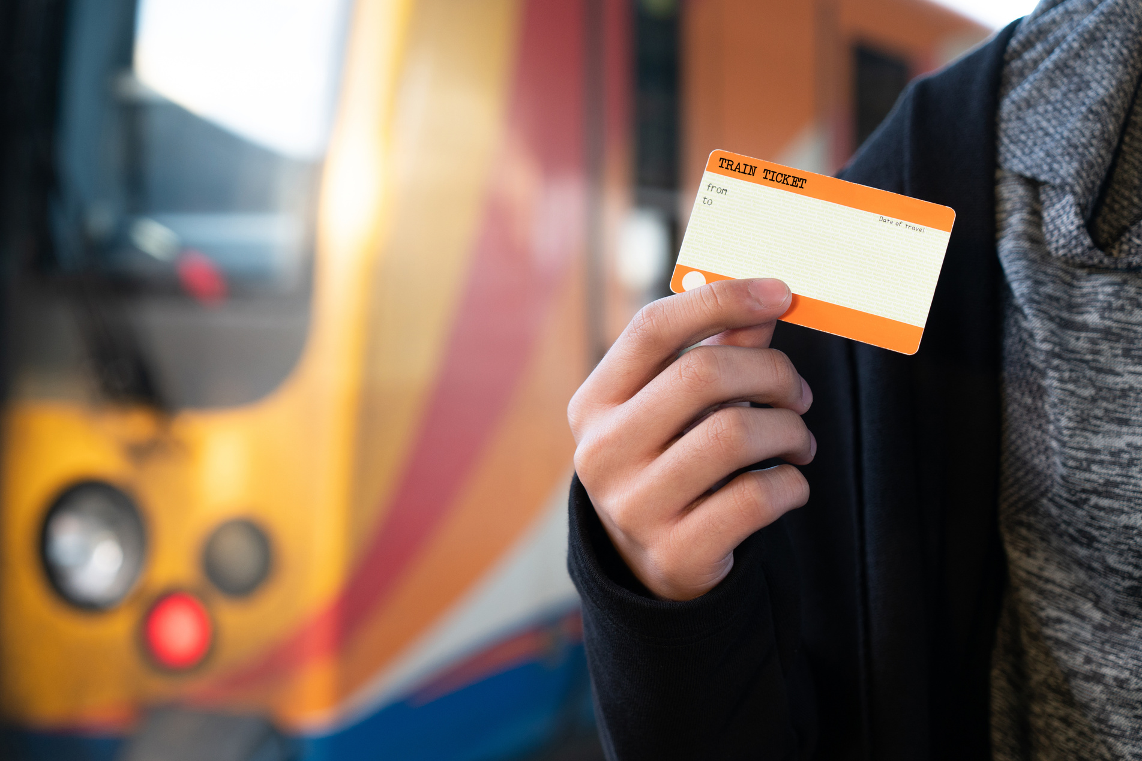


Notes:
Let’s think about how we can be part of the solution in supporting positive change in our communities.
Our SVP members and Conferences support the prison community is many ways:
•Clothes, books, musical instruments
• Paying for families to visit loved ones
•Christmas cards
• Easter eggs
• Spiritual accompaniment
•Visiting

Slide 16


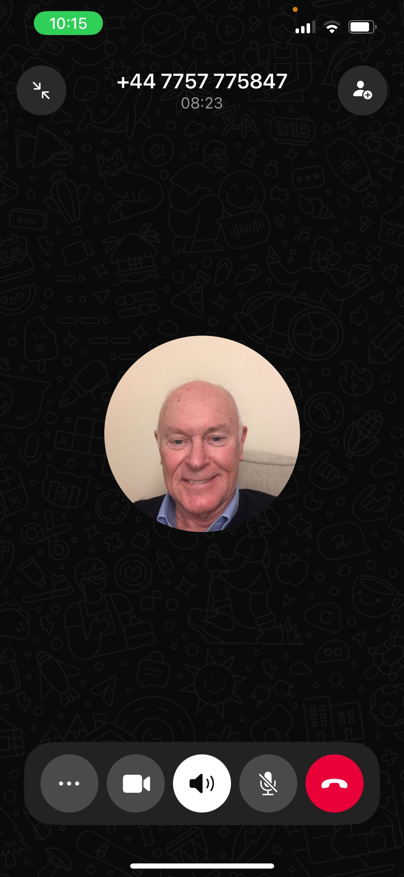
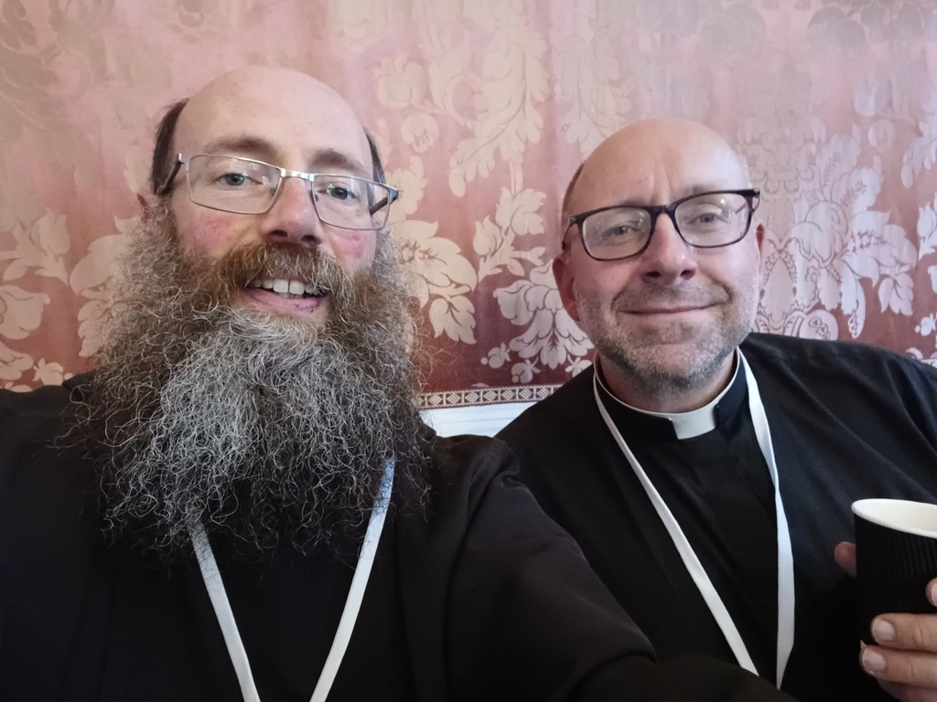
The SVP
I feel called to accompany and journey with all our community.
As Vincentians we are called to show radical love in our words and actions.
Visiting and chatting to people is the joy of my week.
Taking the time to not judge and look past someone’s mistakes.
“I’ve been with the SVP since I was 14, over 60 years now, and I’ve always been inspired by the chance to help those less fortunate. From taking part in acts of charity at school and hospital visiting to now supporting prison ministry, I’ve seen how simple acts — Mass, music, a chat about faith or football can build trust and friendship. It’s become part of my life, keeping me grateful for my own blessings and always mindful of those who have had fewer.” Des - an SVP member in the North East
“How I would sum up what I do? Prisoners can't go to church, so church has to come to them.” Brother Paul - a prison chaplain
Notes:
SVP Case Studies

Slide 17

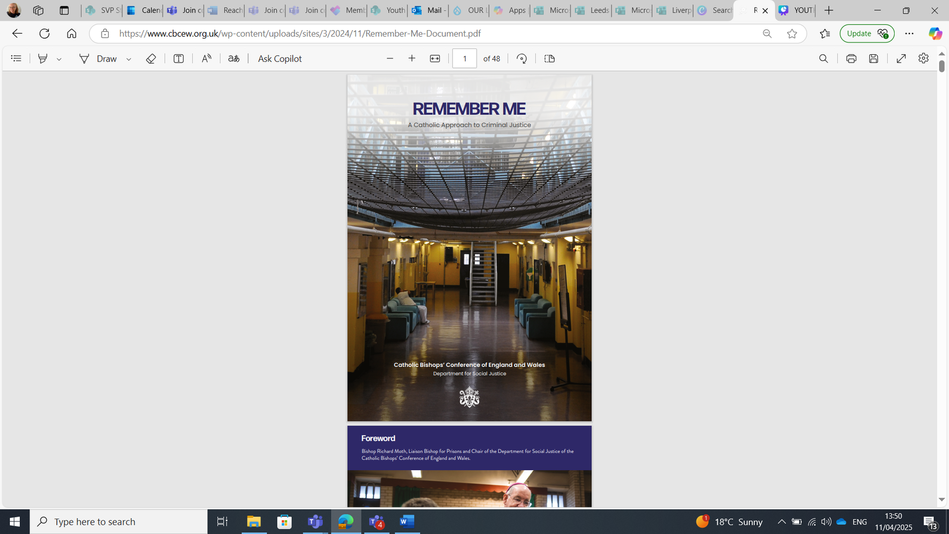

The Call to action
I feel called to accompany and journey with all our community.
As Vincentians we are called to show radical love in our words and actions.
Visiting and chatting to people is the joy of my week.
Taking the time to not judge and look past someone’s mistakes.
  Could your parish take some time to discern whether registering with the ‘Welcome Directory’ is something you cold be part of?
  Could you be called to visit prisoners or attend services like prison Mass or the Christmas Carol Service (with social time after)?"
  Mini Vinnies and Youth SVP could you be involved by collecting Christmas card fronts to remake cards for the SVP’s Christmas Cards for Prisoners project?
  Start a conversation and break the stigma of imprisonment — use the ‘Remember Me’ resource from the Bishops’ Conference to guide you.
  Could you think up a fundraiser to help raise vital funds for the work the SVP do to support prisoners and their families?
  Organise a collection to support SVP groups helping prisoners — check what’s needed first.
  Most importantly if you want to get involved in any way - Reach out to your local Catholic prison chaplain and start a conversation around what might be helpful.

Slide 18


Prayer and Reflection
Luke 15:20-24
Notes:
Just to finish this time together a short reflection and then the final word and challenge will come from Raihan and Nathan.
The Father’s Heart — The Prodigal Son from the perspective of the Father
He came to me one morning —
eyes bright, voice steady,
asking for his portion,
as if my love was something to be measured out.
And though my heart broke
in that quiet way hearts do
when they know they must let go —
I opened my hands.
I watched him walk away.
The days passed.
The seasons turned.
Each sunrise, I scanned the road,
each sunset, I whispered his name into the night.
I heard stories.
Of coins wasted.
Of wild living, empty nights, silent mornings.
And still — I waited.
Until the day came —
dust rising on the horizon,
a figure, worn, small,
coming home.
Before he could speak shame,
before the weight of regret could fall from his lips,
I ran.
I ran like a man who had everything to lose —
and everything to gain.
Bring the robe. The ring. The sandals.
Tonight, we celebrate.
Because mercy isn’t earned.
It’s given.
Because love waits at the gate — always.
And when my eldest stood apart,
wounded by the joy he didn’t understand,
I called him close:
All I have is yours. But this — this is grace.
Your brother was lost, and now he’s found.
And that’s the story I keep telling —
to myself,
to my sons,
to the world:
Love waits.
Love runs.
Love welcomes home.

Slide 19
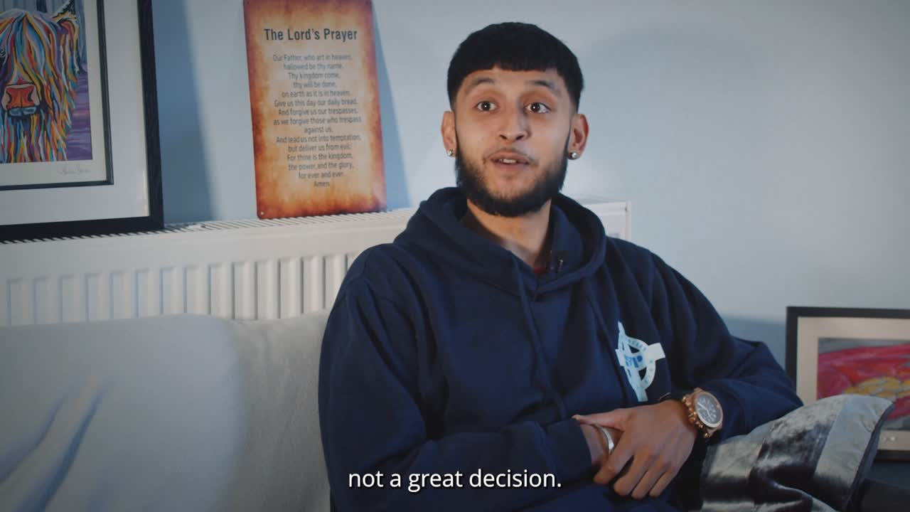

Slide 20
SVP WORK
REFLECTIONS
REACHING OUT
Remember me
Notes:
A call to radical love
A call to merciful love

