Slide 1



Slide 2



Slide 3

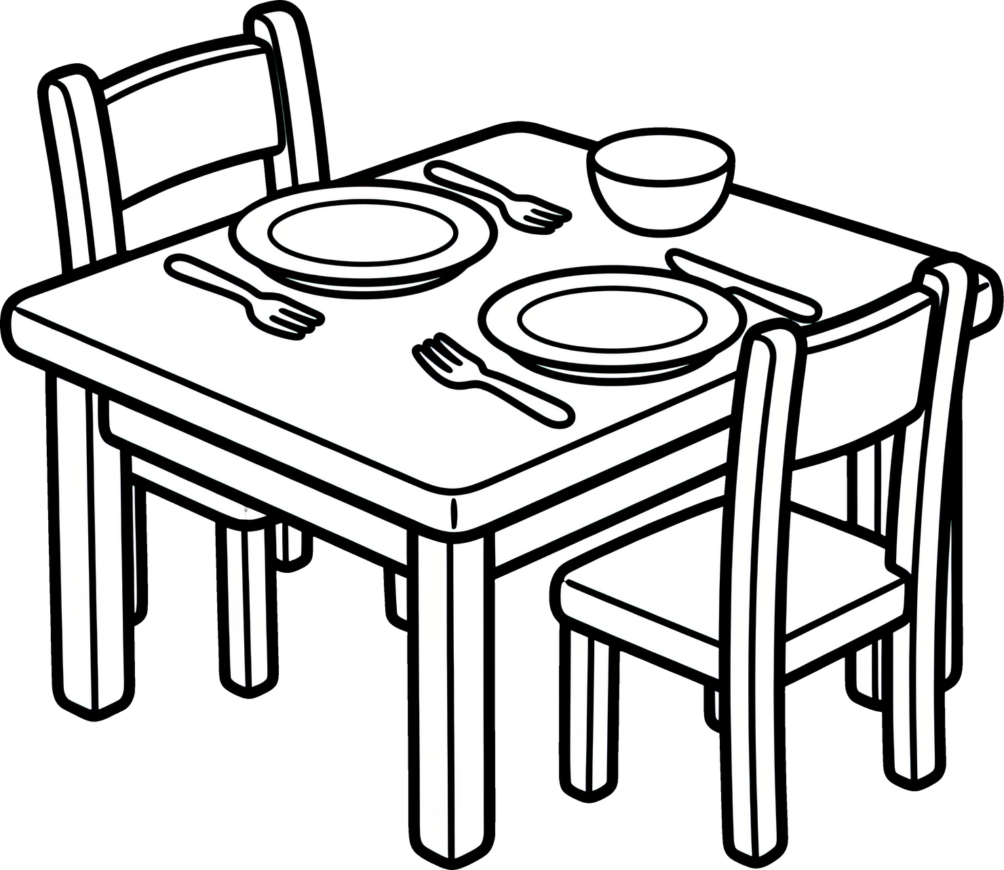

Slide 4

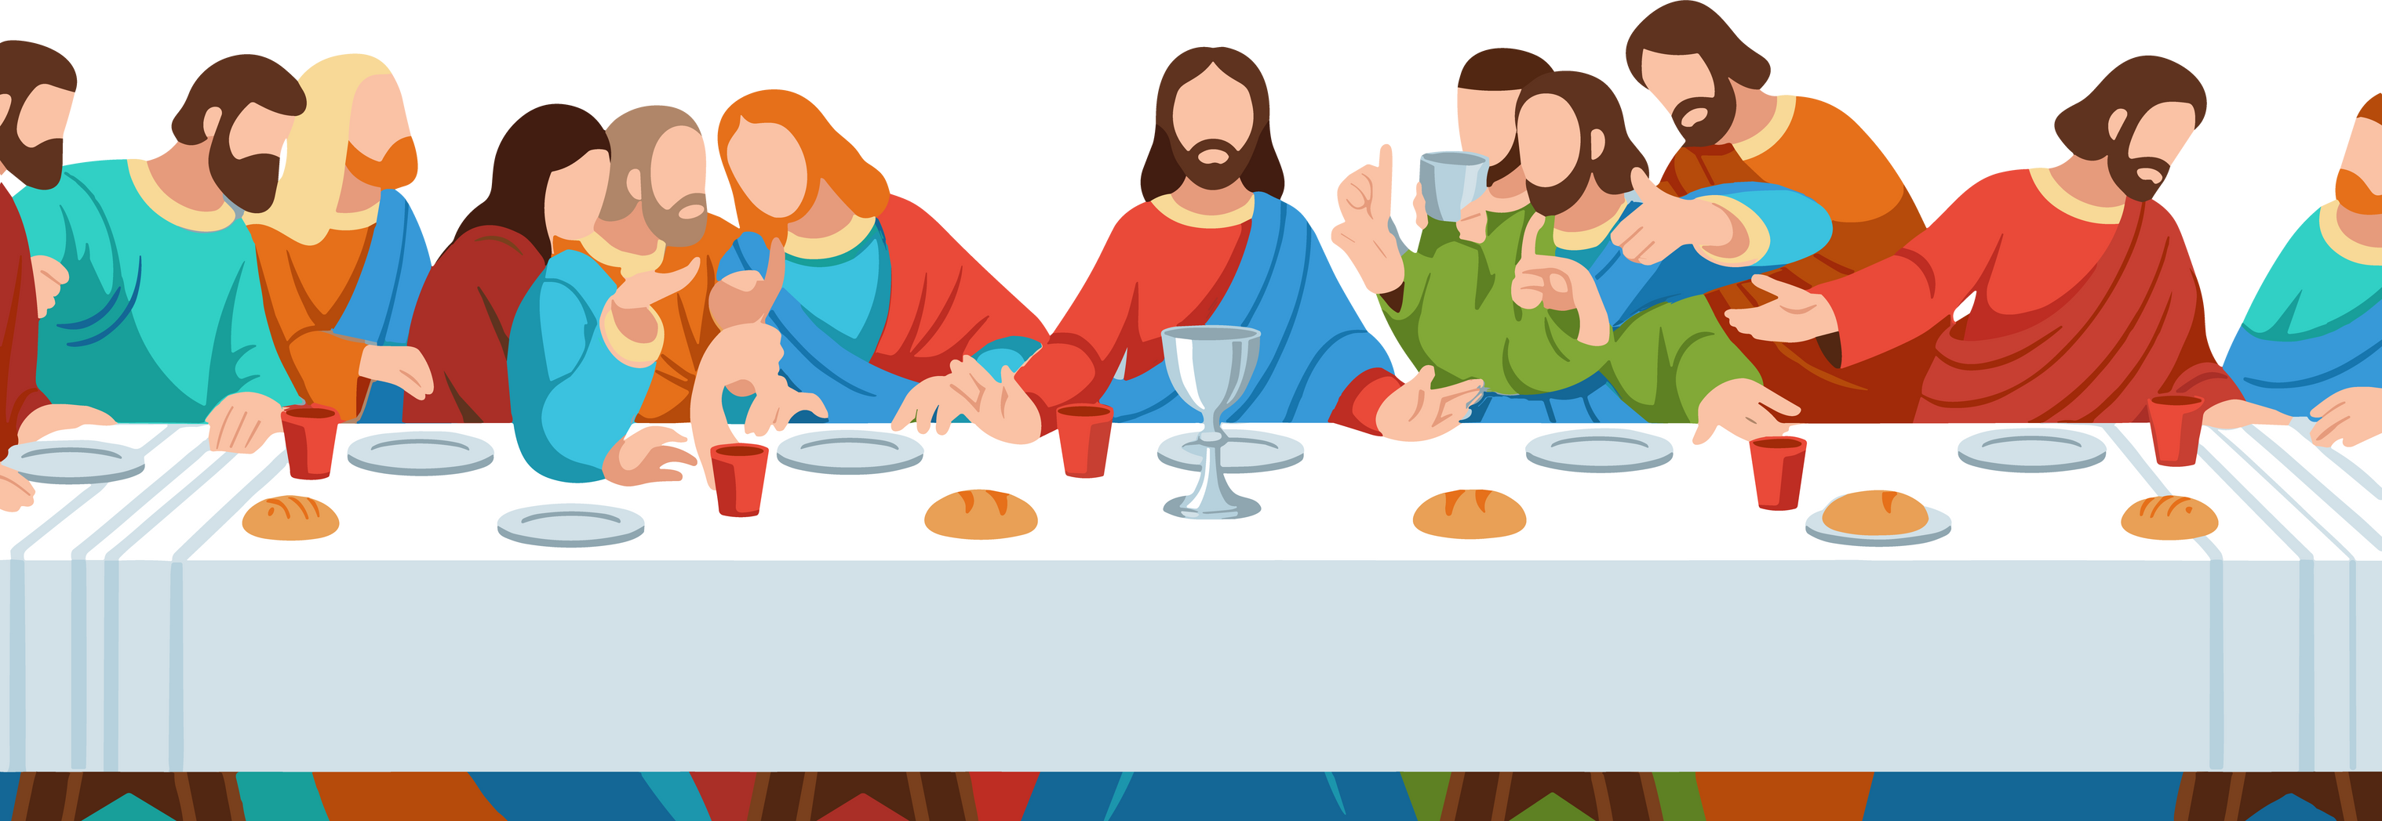

Slide 5

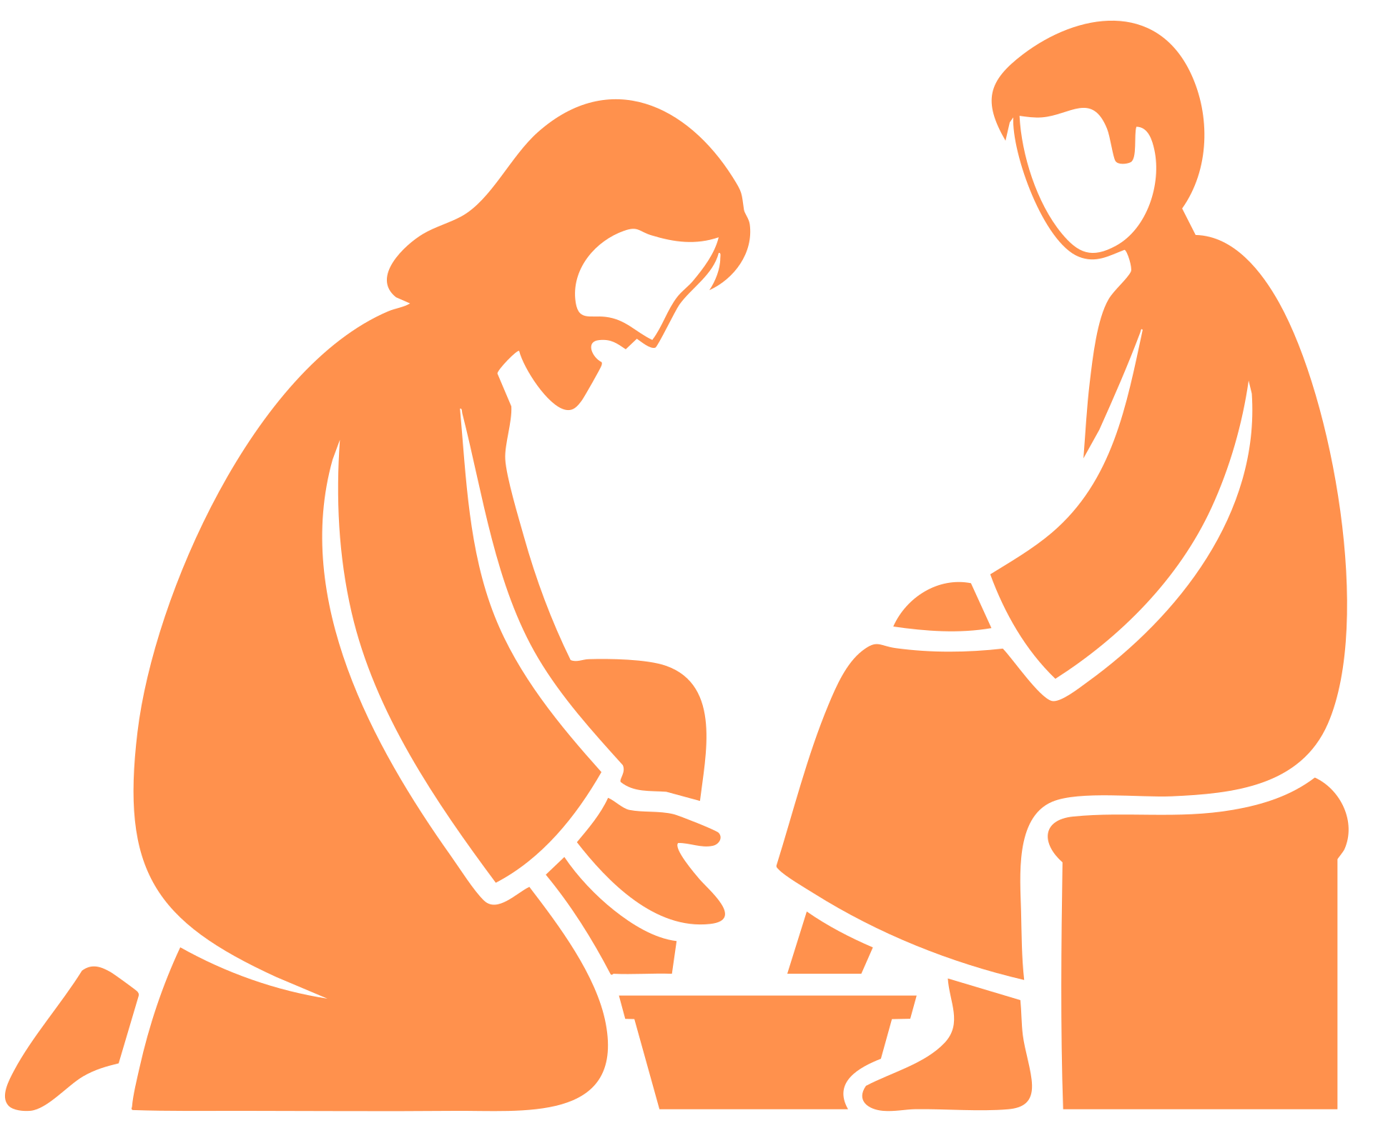

Slide 6




Slide 7

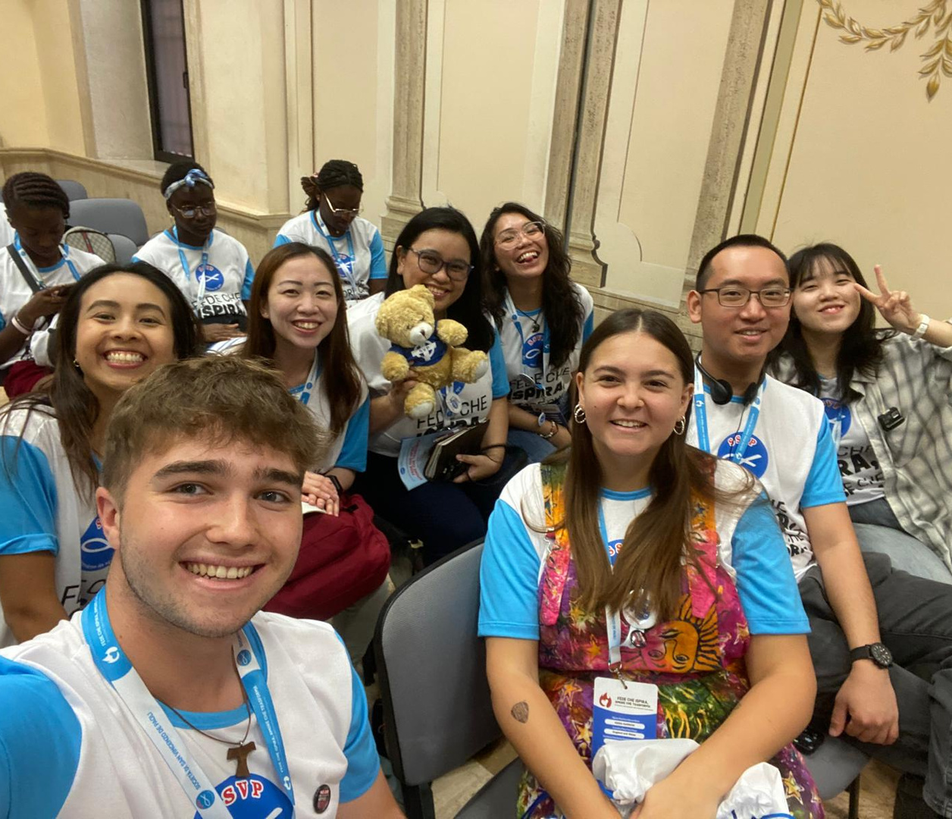
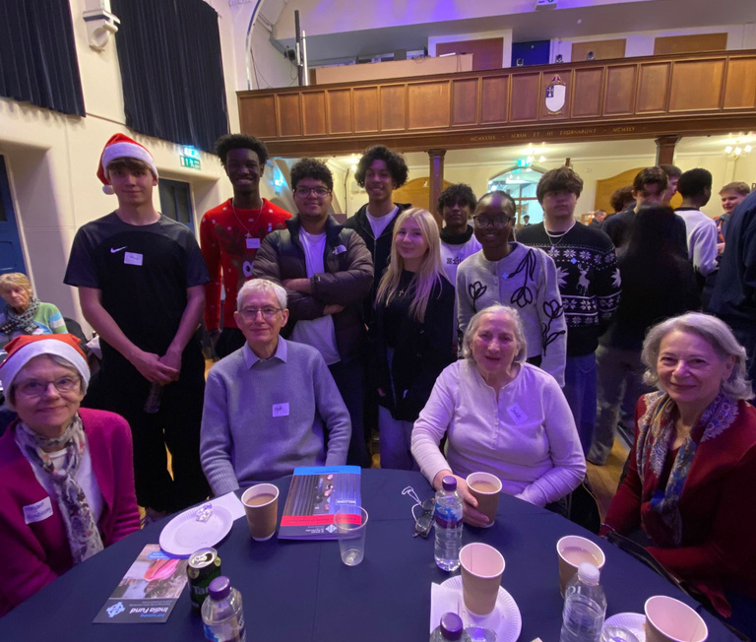

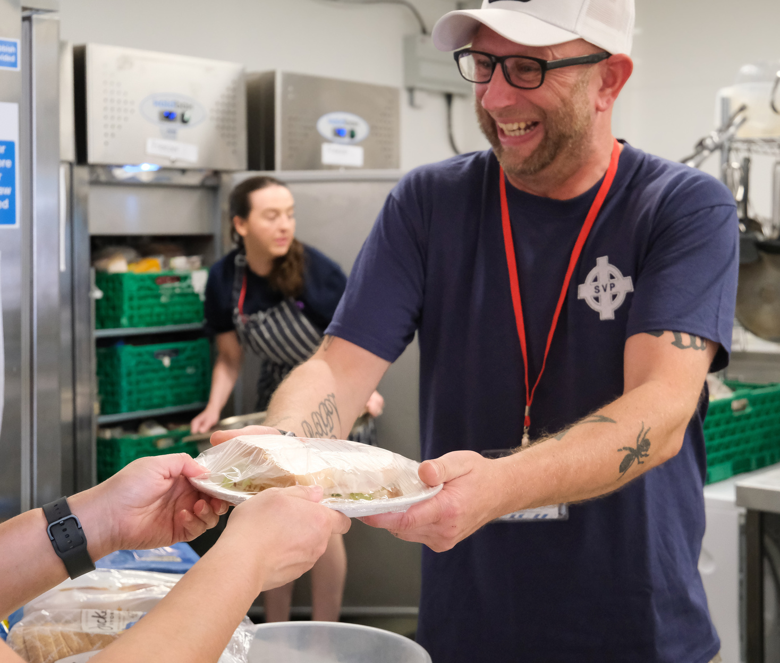

Slide 8

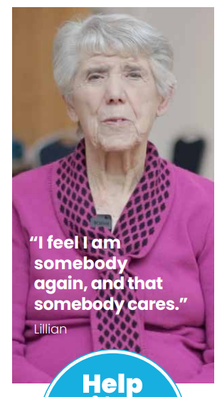

Slide 9
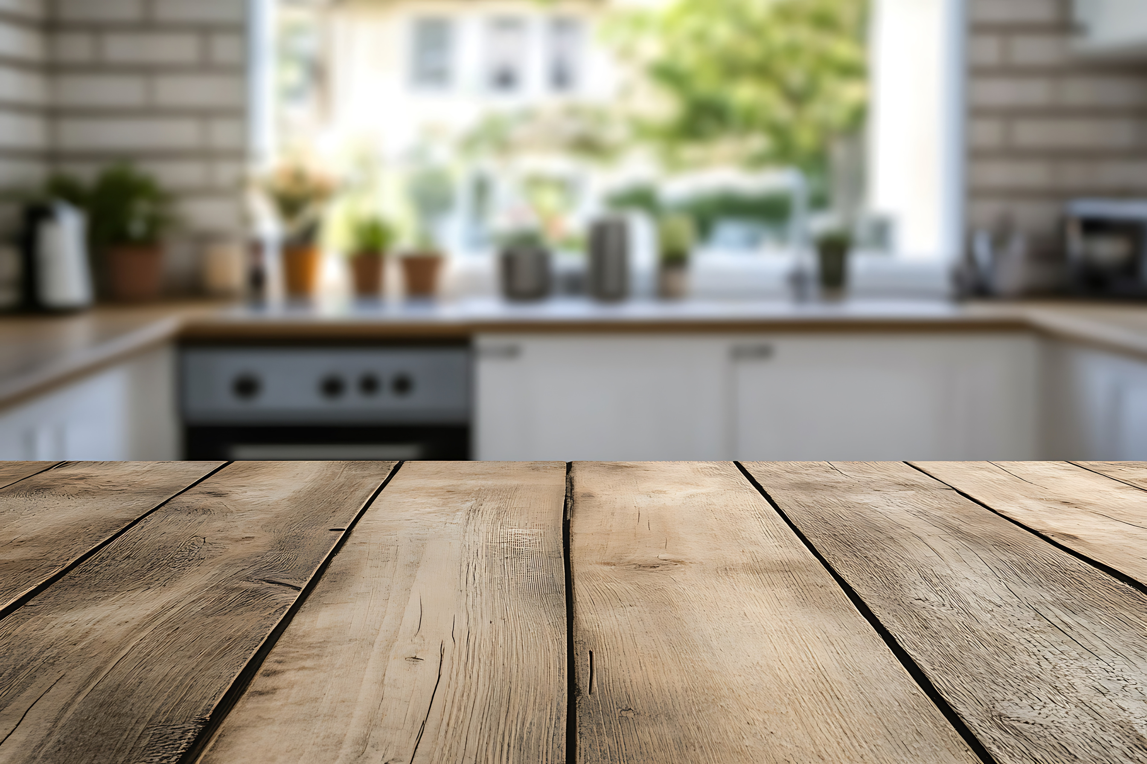
I’m the Talking Table.
I don’t belong to anyone, and yet I belong to everyone.
I’m not fancy. No polished wood, no frills. Just a table.
But I’ve got space. I’ve got room.
And there’s always room for more.

Slide 10
Come sit. Whenever you like. Pull up a chair.
Make yourself at home.
I’ve heard quiet stories shared across my surface.
I’ve felt laughter bounce off my edges.
I’ve held hands, shoulders, and hearts.
People talk, people listen, people just…are. And somehow, that’s enough.

Slide 11
Sometimes conversations get messy.
Sometimes people don’t know what to say. That’s okay.
The shared smiles, the quiet prayers, the courage of listening. I’m a place of hope, because hope grows when someone is seen. When someone is heard.
So come. Sit. Talk. Listen. Laugh. Pray.
Leave a little lighter, a little braver, a little more connected than when you arrived.
There’s always room at my table.

Slide 12


On the table you’ll find a stack of small cards.
Write the name of someone you would like to hold in your prayers this Lent. It might be someone at school, at home, or in your community.
Place the card on the table as a quiet way of saying: you matter.
You’ll also see a small pile of questions.
Choose one that speaks to you and share it with the people around the table.
Take time to listen, to notice, and to respond honestly.
There are no right or wrong answers. This is not a test. It’s simply a space to connect — heart to heart.

Slide 13
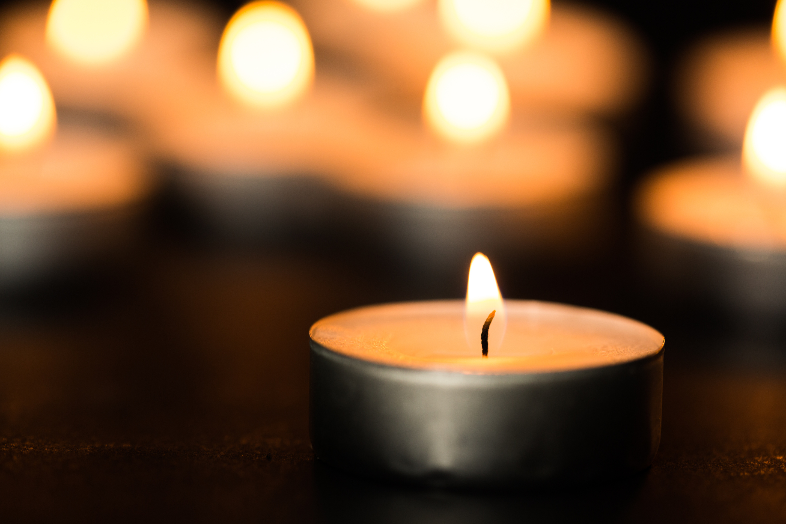


Slide 14


