Slide 1

How to use the
Conferences Treasurers Returns, Account Book & Gift Aid Claim Form
Membership Finance - Treasurer Training
Last updated: March 2025
Produced by: Qubra Bibi – Membership Finance Manager

Slide 2

How to use this Treasurers Book
We have tried to make these worksheets do as much of the work for you as possible.
The Conference Treasurer’s Returns, Account book (excel spreadsheet) is available for download in the Members & Staff area of the SVP website, within the “Financial Returns” tab.
This however means that there are a lot of linking cells and formulas. For people not familiar with accounts or excel, this can sometimes be a bit daunting.
These guidelines try to make the spreadsheets as easy to use as possible. When nothing goes wrong it should be fairly straightforward - once you have got the hang of it.
If something does go wrong and you just can't fix it, then please contact the Membership Finance Team and we will help you out.

Slide 3
Setting up this Treasurers Workbook for the first time
You can download a template of the Treasurer’s workbook in the Members Area of the SVP website
The first tab on the workbook titled ‘Guidance Notes’ has useful links to policies & training guidance on completing the quarterly returns and gift aid claim form.

Slide 4
Setting up this Treasurers Workbook for the first time
Step 1: Enter information about your conference
Step 2: Enter the opening balances
Step 3: Enter contact details
Enter the opening balances of your bank account and petty cash, If you're starting to use this book mid-year then enter the brought forward from the relevant quarter.
We have split out your NatWest central account from your petty cash. This is to help you ensure that all transactions (including cash transactions are recorded) and make the reconciliation easier.
The opening balance entered on 'Info about Conf' should be the same as your 'cleared' bank balance & cash held.
The grey tab in the workbook titled “Info about conf”.
Filling out your information here automatically fills out the main conference details on your returns & gift aid claim form.
Choosing your Central Council from the drop-down list provided will automatically calculate your Support Charge.
All fields with a yellow box need to be completed prior to submitting the return.
Enter Treasurer contact details and President name.
The details will automatically populate on the returns.

Slide 5
Completing the Treasurers Workbook

Slide 6
The Conference Treasurers Returns, Account book & Gift Aid Claim
The Conference Treasurer’s Returns, Account book (excel spreadsheet) is available for download in the Members & Staff area of the SVP website, within the “Financial Returns” tab.
This book is split into the following excel sheets:
This how-to-guide will cover each tab/sheet.
*Training notes/Policies are in Pink tabs to the back of the workbook and can also be selected by the links in the first tab ‘Guidance notes’
 |  |  | June 2025 |  |  |  | September 2025 |  |  |  | December 2025 |  |  |  | March 2026 |  |  |  | Report
Guidance Notes | Info about Conf | Petty Cash | Return | Book | Restricted Income | Gift Aid Claim Form | Return | Book | Restricted Income | Gift Aid Claim Form | Return | Book | Restricted Income | Gift Aid Claim Form | Return | Book | Restricted Income | Gift Aid Claim Form | June 2025 | Sept 2025 | Dec 2025 | Mar 2025
Notes:
Can seem like a lot of paperwork or legislation to comply with
For protection of yourself and the beneficiaries. Not the most exciting topics but very important.

Slide 7
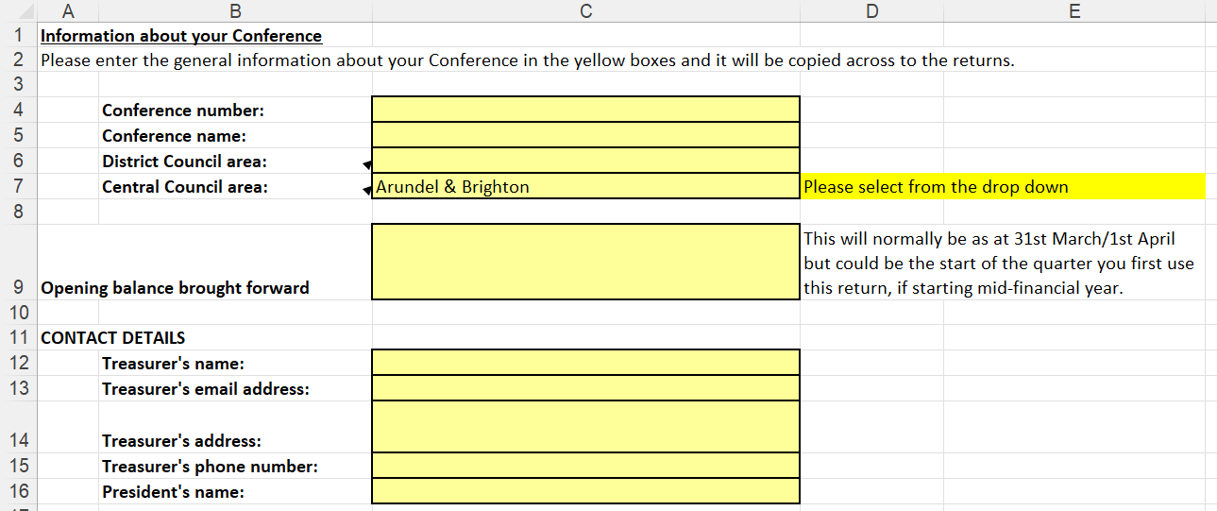
How to: “Info about Conf”
Enter your Conference details.
Choose your CC from the drop-down. This will determine your % of tithes.
When starting a new workbook enter the brought forward balance.
Please complete all boxes with your treasure’s details.
Relevant excel sheet is highlighted in a red box.
Notes:
Can seem like a lot of paperwork or legislation to comply with
For protection of yourself and the beneficiaries. Not the most exciting topics but very important.

Slide 8
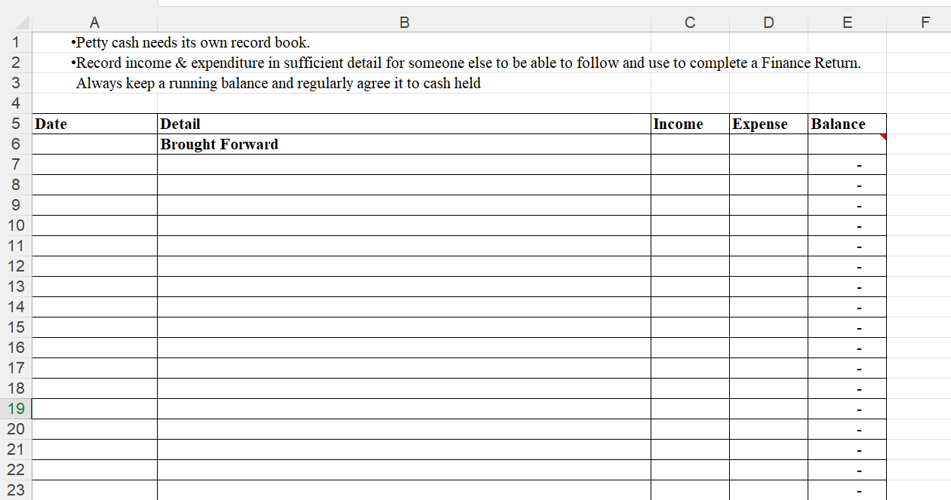
How to: “Petty cash record”
Enter start of quarter date.
Enter bought forward cash as the balance.
As cash ‘income’ and ‘expense’ is entered in each cell, the balance column will calculate the cash balance automatically.
Enter description of cash income and/or expenditure.
Running balance should agree with physical cash held.
Notes:
Can seem like a lot of paperwork or legislation to comply with
For protection of yourself and the beneficiaries. Not the most exciting topics but very important.

Slide 9
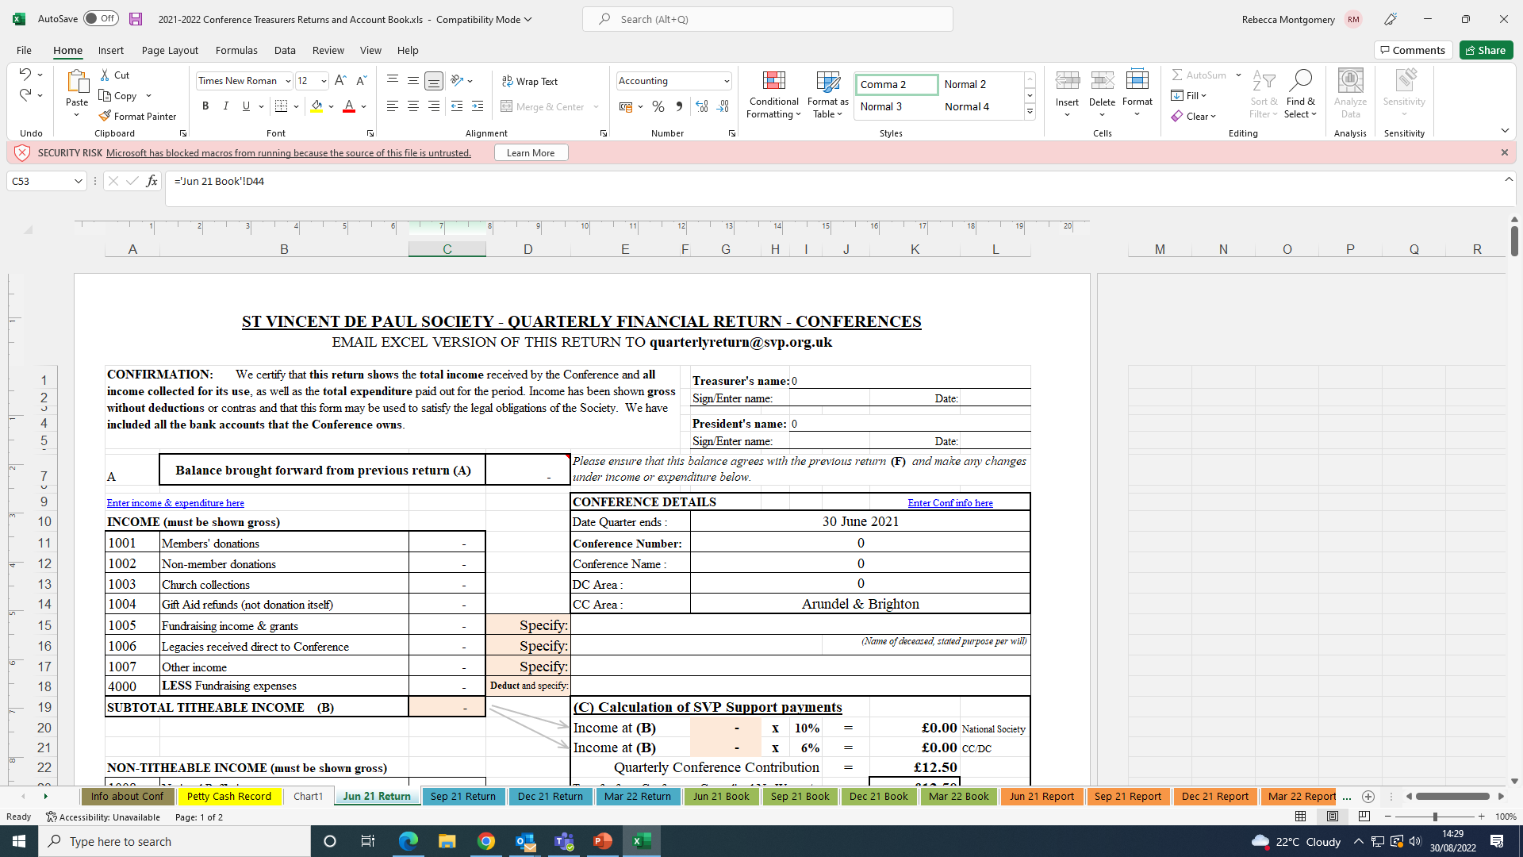
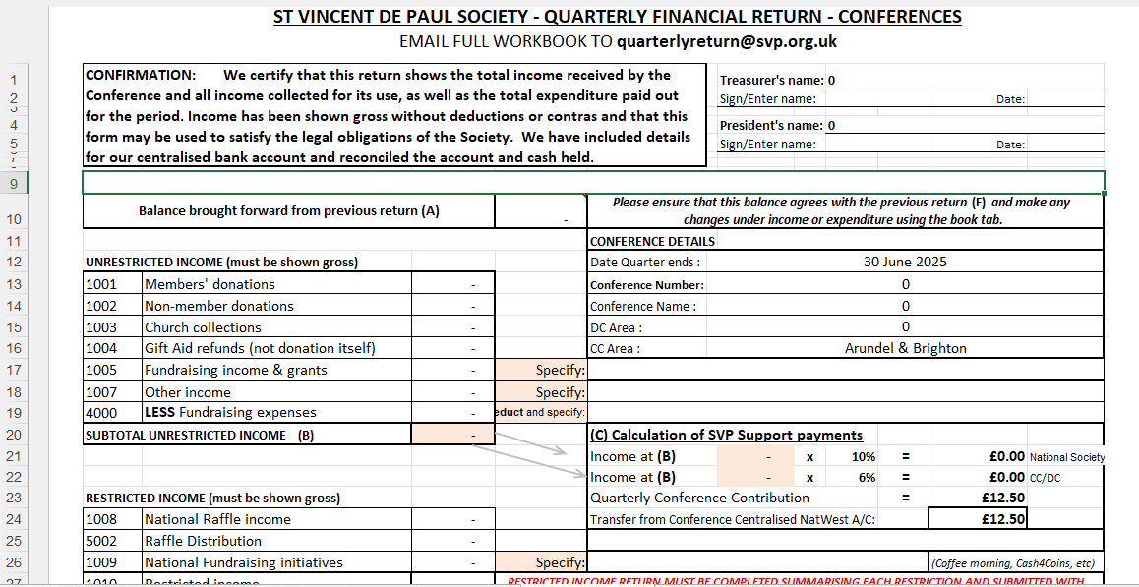
How to: “Quarterly return” (rows 1 – 31)
Treasurer & President info will automatically appear.
Balance bought forward, entered in the “Info about conf” tab, is automatically copied over.
Conference details will automatically appear.
Each CC individual % calculation will show here .
Income entries from ‘book’ tab will show in the income cells.
Total support charge due for current quarter.
Notes:
Can seem like a lot of paperwork or legislation to comply with
For protection of yourself and the beneficiaries. Not the most exciting topics but very important.

Slide 10
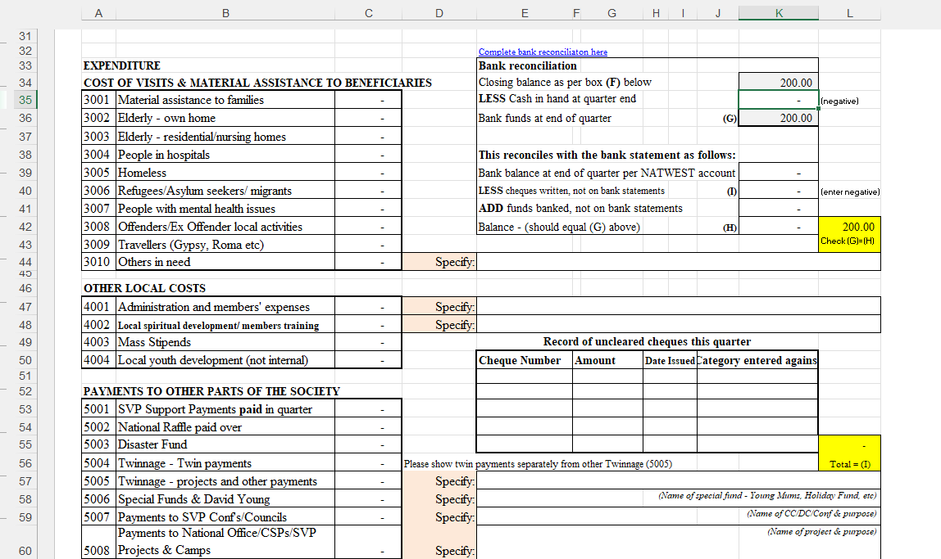
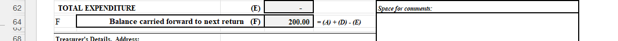
How to: Bank Reconciliation (part of the Quarterly Return tabs, rows 33 - 72)
Cash in hand will show as negative, this is deducted from closing balance and will show bank funds at end of quarter.
Expenditure entries from ‘book’ tab will show in expenditure cells.
End of quarter NatWest bank balance, any uncleared cheques and monies banked not cleared in quarter.
If bank rec does not balance, it will show you the difference here in yellow – this will prompt for you to check error.
Support payment paid will show here.
Any uncleared cheques issued in quarter can be entered here.
Comments section for treasurers.
Notes:
Can seem like a lot of paperwork or legislation to comply with
For protection of yourself and the beneficiaries. Not the most exciting topics but very important.

Slide 11
Let’s look at an example
Example extract
Last quarter's Finance Return Bank
Reconciliation was as follows:
What does this really mean?
Bank reconciliation
Closing balance as per box (F) below | 1,569.00
LESS Cash in hand at quarter end (counted) | - 224.00 | (negative)
Bank funds at end of quarter (G) | 1,345.00
This reconciles with the bank statement as follows:
Bank balance at end of quarter per NATWEST account | 1,295.00
LESS cheques/credit card expense, not on bank statements | - 50.00 | (enter negative)
ADD funds banked, not on bank statements | 100.00
Balance - (should equal (G) above) (H) | 1,345.00 | -
 |  | Check (G)=(H)
In the NatWest account there was £1295 per my bank statement, but I had banked a £100 donation just before the quarter end which wasn't on the statement.
I also issued a £50 Twinning cheque to National Office which they didn't take from my account until after the quarter end.
I also had £224 held as cash.

Slide 12
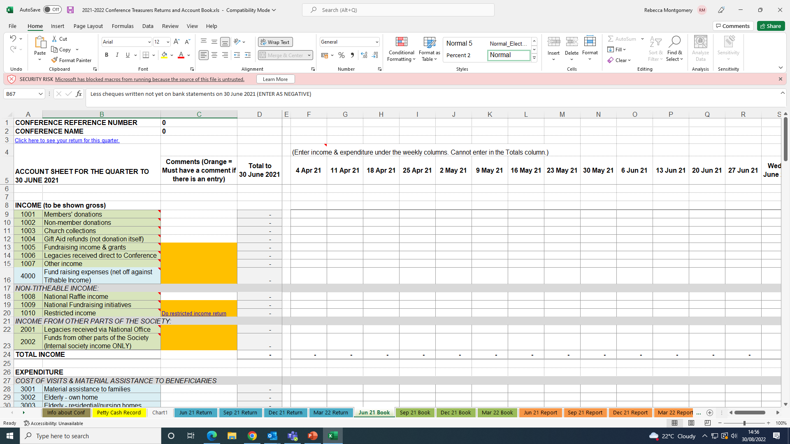
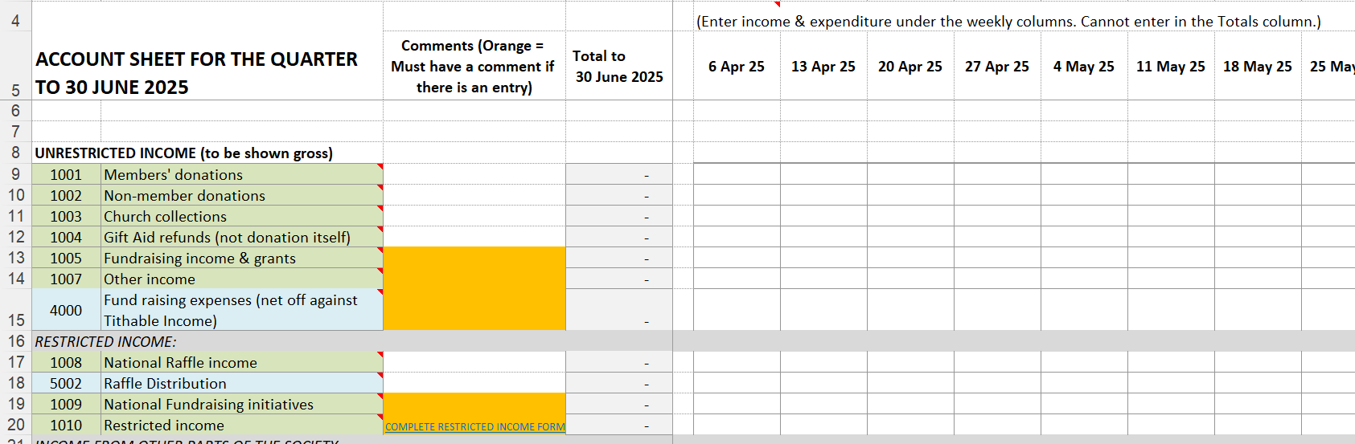
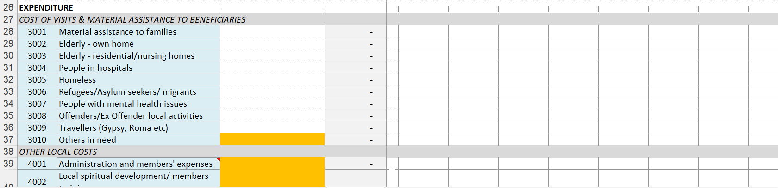
How to: “Book”
IMPORTANT: Yellow/orange boxes - these ‘specify’ that you must clearly identify source of income and expenditure to avoid double counting.
Enter income received in cells under weekly columns against nearest category row.
Hint: hover over the red triangle in the corner for category examples.
In these yellow/orange boxes, you must specify where income has come from - not what it is to be used for.
Enter expenditure in cells under weekly columns against nearest category row.
In these yellow/orange boxes, you must specify who the expenditure was paid to – not what it was paid for.
Notes:
Can seem like a lot of paperwork or legislation to comply with
For protection of yourself and the beneficiaries. Not the most exciting topics but very important.

Slide 13
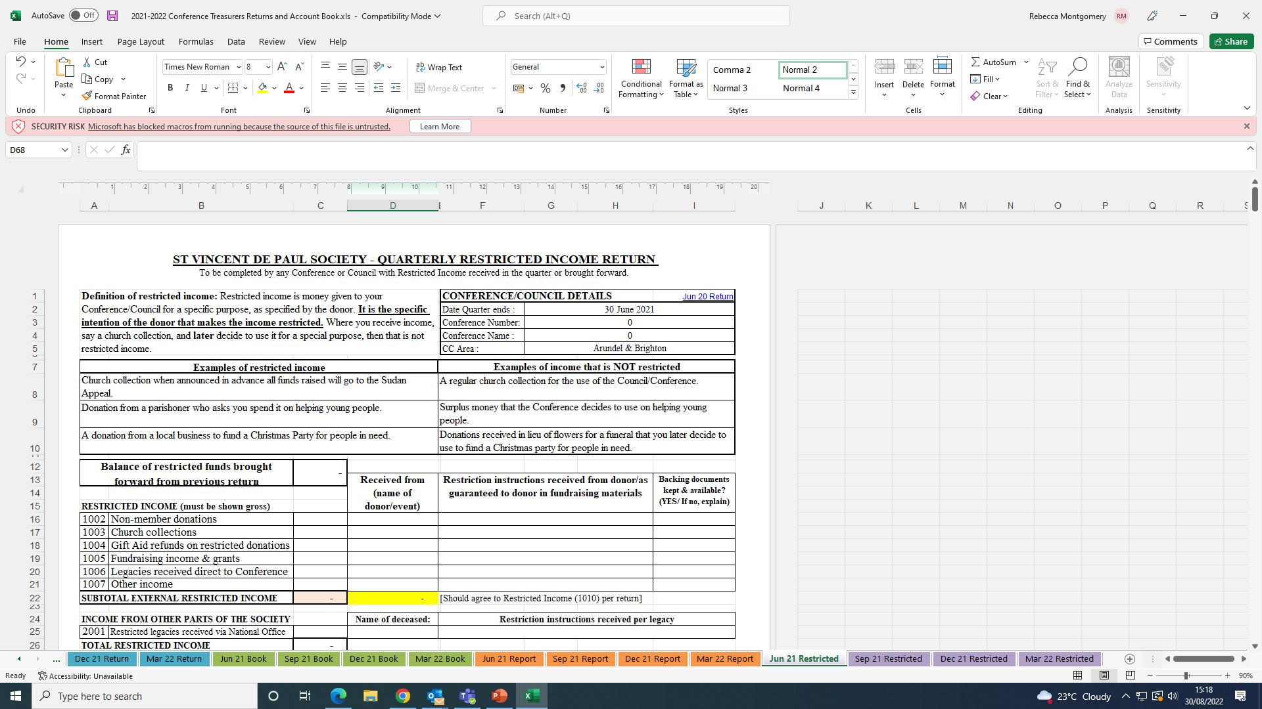
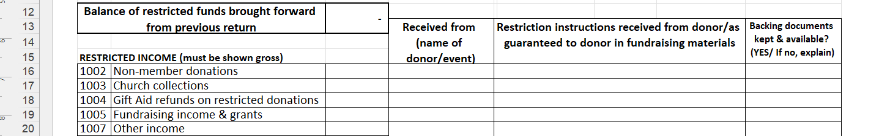
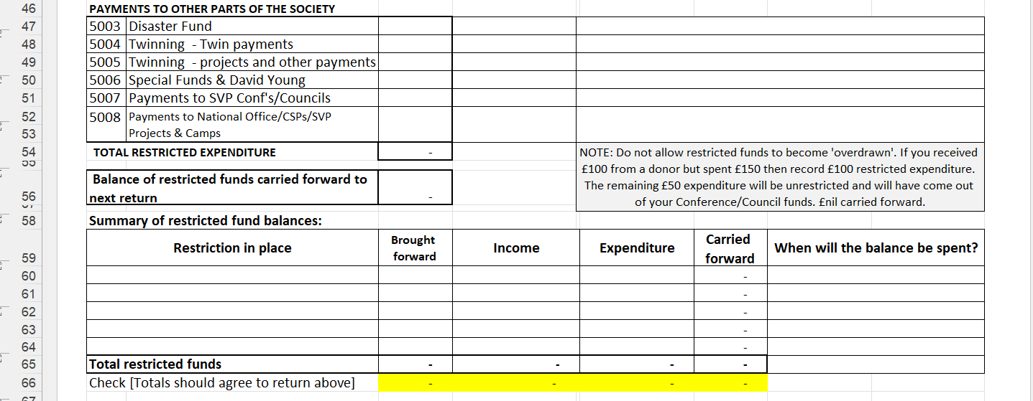
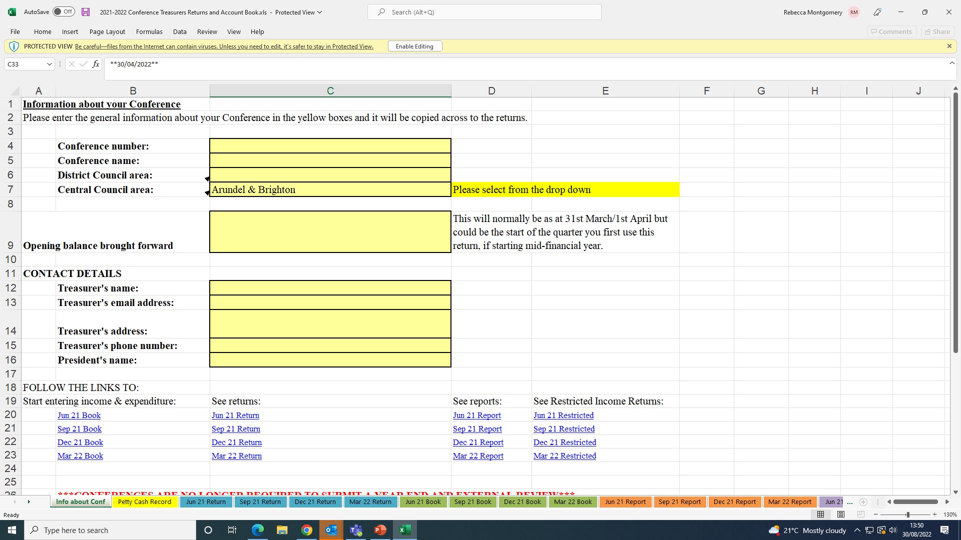
How to: “Restricted income”
Important: Restricted income form must be completed if any income is shown on ‘main return’ tabs in category ‘1010’.
You will need to enter the income against the nearest category, name event/donor, clearly identify the restricted instructions and whether you have written confirmation for how the funds are to spent.
Opening balance for any restricted income will need to be entered in the ‘June restricted’ tab here.
Only show restricted funds spent.
Show a breakdown for all restrictions in place - carry forward balance will move to the next quarter automatically – any unspent ‘restricted income’ will need to be accounted for.
Notes:
Can seem like a lot of paperwork or legislation to comply with
For protection of yourself and the beneficiaries. Not the most exciting topics but very important.

Slide 14
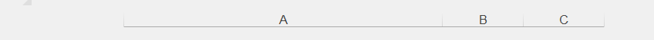
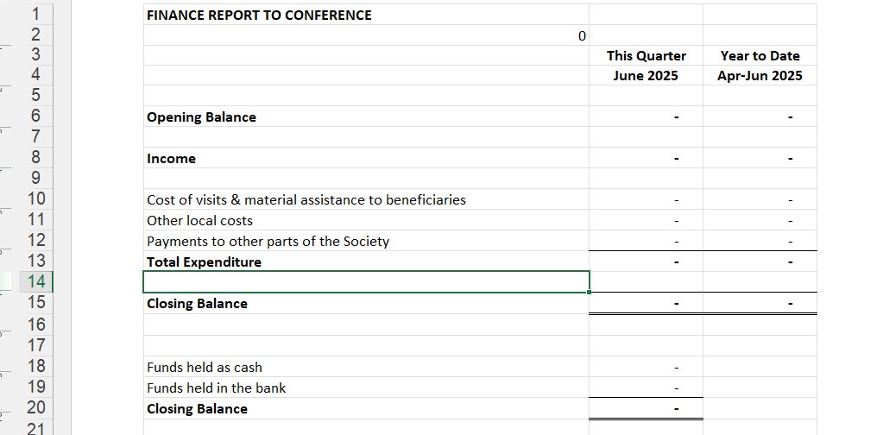
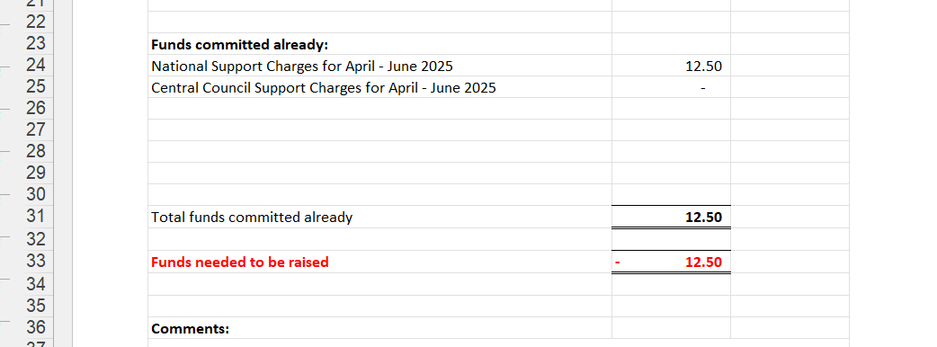
How to: “Report”
The ‘report’ tab will automatically bring forward your current quarter and financial year figures.
You can use this tab to report back the conference financial status at your meetings.
Any funds already committed, such as your support charges, will show so you can have an accurate figure of actual available funds.
Notes:
Can seem like a lot of paperwork or legislation to comply with
For protection of yourself and the beneficiaries. Not the most exciting topics but very important.

Slide 15
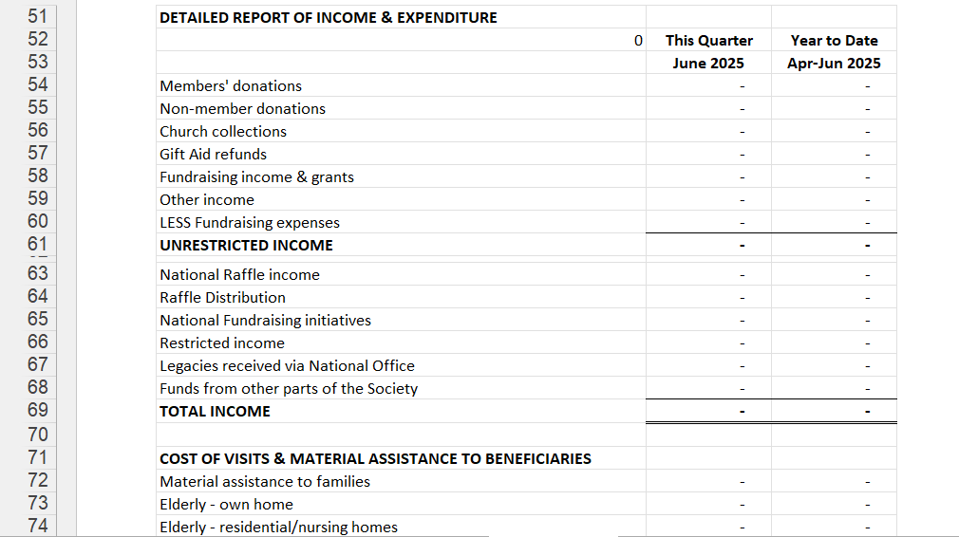
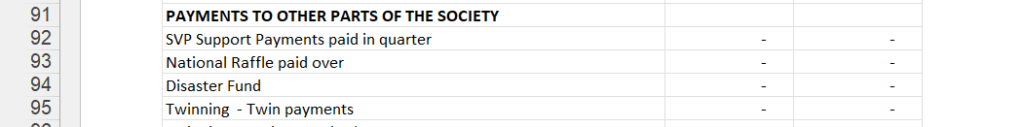
How to: “Report” (continued)
If you scroll down the ‘report’ tab page you can view a more detailed version of the income and expenditure to report back to the conference.
Notes:
Can seem like a lot of paperwork or legislation to comply with
For protection of yourself and the beneficiaries. Not the most exciting topics but very important.

Slide 16
Completing the Gift Aid Claim Form

Slide 17
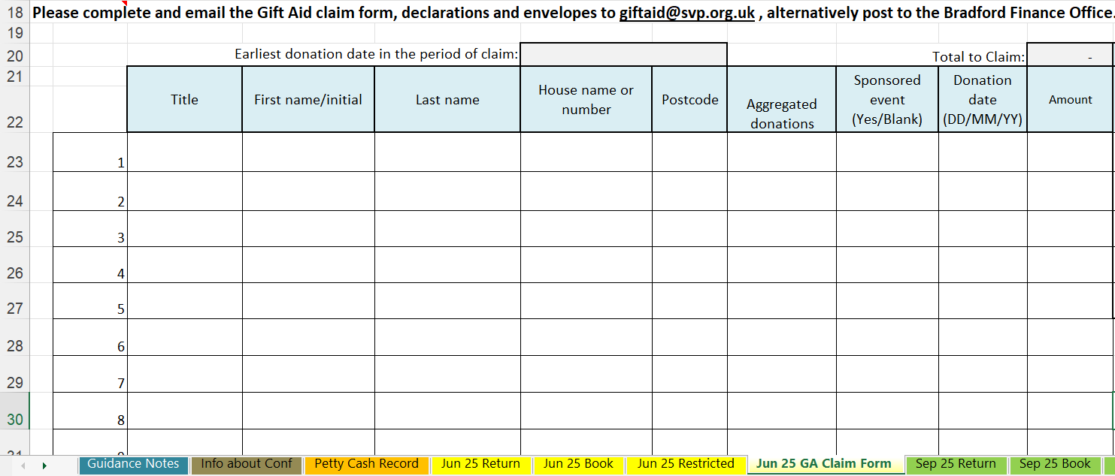
How to: “complete GA claim form”
UPPER CASE & include a space
Total will be calculated automatically
Enter earliest date of Donation here. (DD/MM/YY)
Enter the first name, or first initial if not known, no spaces before or after.
DON’T Use a £ Sign
(DD/MM/YY) DON’T use hyphens or full stops
Add a gift aided donor to the row against each heading, If any section isn't applicable leave it blank. Don't enter N/A or Nil.
Up to 35 Characters
Enter Yes or leave blank *see note below
Don't leave a blank row between donations.
DON’T enter Yes or Not Applicable *see note below
* Don't change the layout of the schedule or change the name of the worksheet.
* Don't include blank spaces or other characters at the start or end of boxes.
* Enter the house name or number and the postcode of all donors that live in the UK. For donors living abroad, enter their address and put X in the 'Postcode' column.
* Aggregated donations are donations under £20 from different people totalling less than £1000 per line. When you add together donations from the same donor, you must leave the aggregated donations column blank.
* For sponsored events enter the participant's name and address, the date collected, and the total amount raised. Don't include any donations over £500 – these must be shown separately as normal Gift Aid donations.

Slide 18
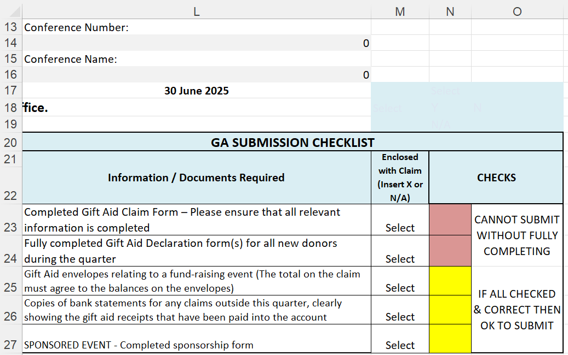
How to: “GA Checklist”
Conference number will populate automatically when entered in ‘info about Conf tab’
Select from the dropdown against the info box – Y/N
Colour coded box will change from red to green if all required documents are marked as submitted
Conference name will populate automatically when entered in ‘info about Conf tab’
If ‘red’ checks will show cannot submit – if ‘green’ ok to submit
If ‘yellow’ checks will show cannot submit – if ‘green’ ok to submit
Select from the dropdown against the info box Y-N/A

Slide 19
Our appreciation
Please accept the Society’s grateful appreciation for the dedication and hard work that each Treasurer puts into their service to the Society.

Slide 20

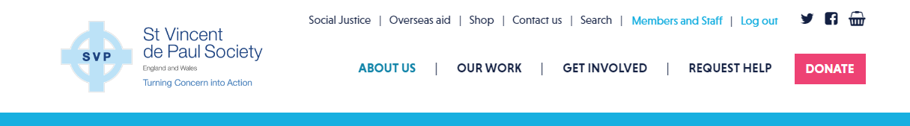
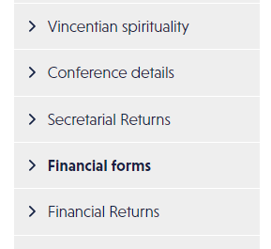
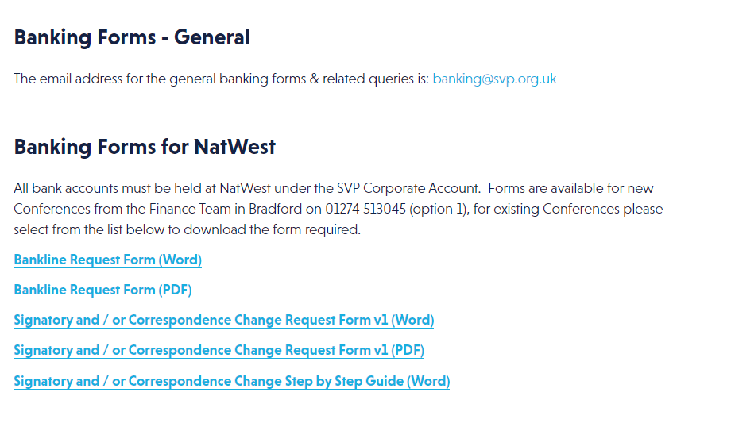
Resources and important documents
You can find all relevant forms and important documentation on the “Finance forms” and “Financial Returns” page in the SVP Members Area (www.svp.org.uk/user).

Slide 21
Live instructor-led training
Qubra Bibi (Membership Finance Manager) regularly delivers Conference Treasurer training over Zoom.
This live training provides an overview of the Conference Treasurer role, keeping accurate records, completing the electronic workbook, and the spending of funds. You can view a copy of the presentation here.
Members can book their place through the SVP Knowledge Hub.
Additional resources
The SVP Finance team has also produced multiple resources to support Conference Treasurers.
Being a treasurer: what every SVP Treasurer needs to know
Finance Guidelines summary for all Treasurers
NatWest banking - everything SVP treasurers need to know about NatWest and Bankline
Training & helpful documents

Slide 22
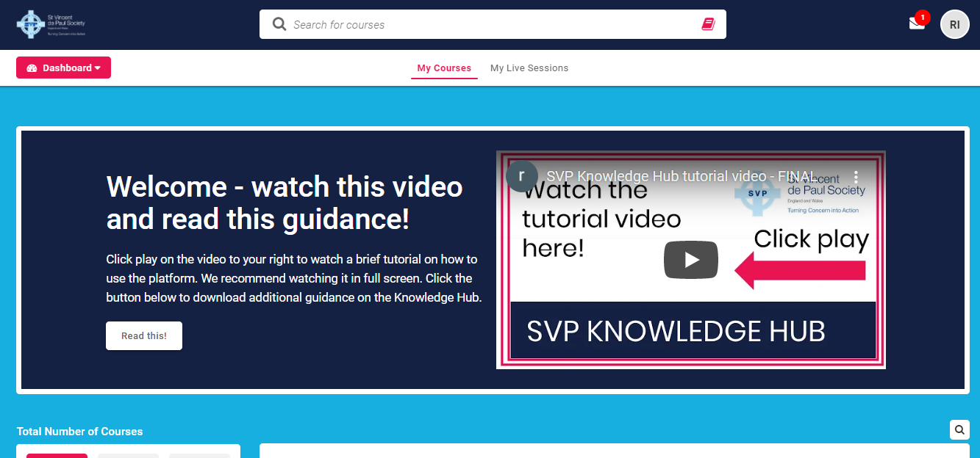
Knowledge Hub and other training
Book training
Complete courses
Download resources
Any questions? Email:
Knowledge@svp.org.uk
https://membersknowledgehub.svp.org.uk
Notes:
Be sure to visit the Knowledge Hub to view further training or book courses. Click the link above to log in. Any questions, please email rebeccam@svp.org.uk.

Slide 23

Please contact the Membership
Finance Team at:
Email: quarterlyreturn@svp.org.uk
Tel: 01274 513045 (option 1)
Banking queries: banking@svp.org.uk
Gift Aid queries: giftaid@svp.org.uk
Any questions?

