Slide 1
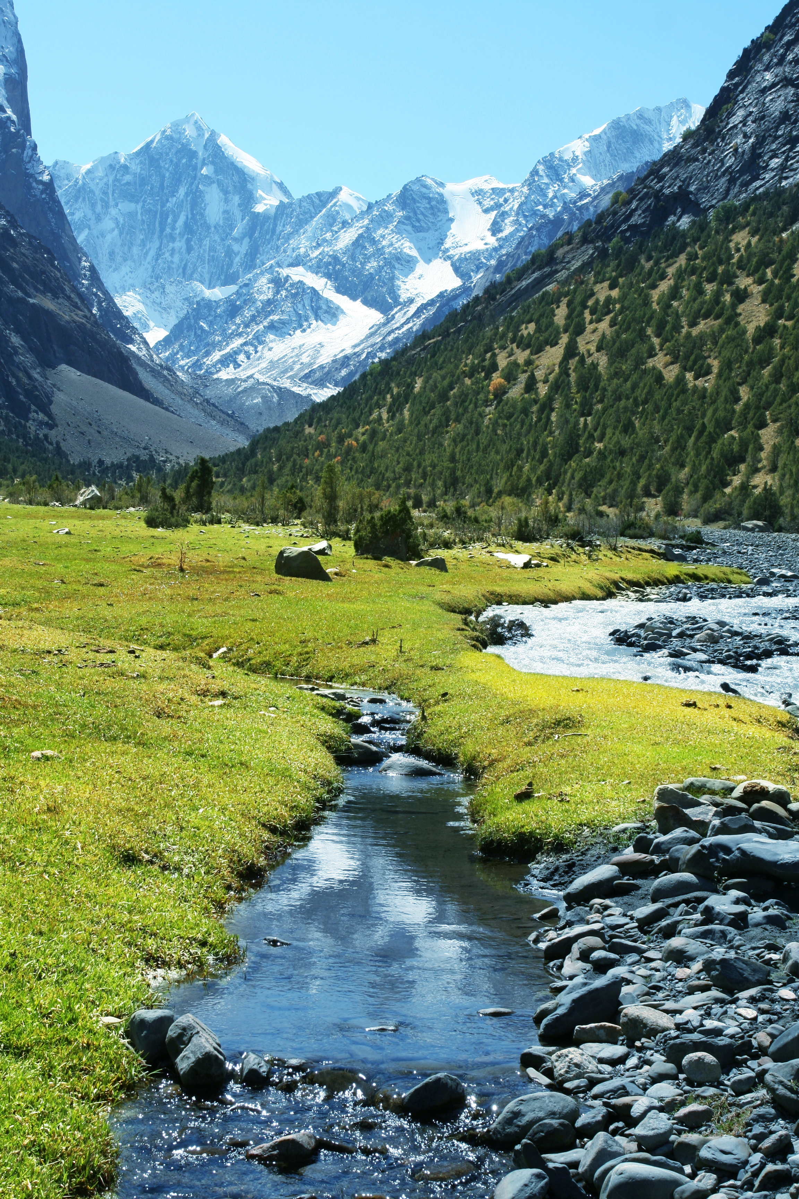


Living mission, jubilee and beyond
SVP
to the heights
CHALLENGE
TO THE
HEIGHTS
Living mission, jubilee and beyond

Slide 2

TO THE
HEIGHTS
SVP
to the heights
Living mission, jubilee and beyond
CHALLENGE
Living mission, jubilee and beyond
It’s time to find out how you can raise money for the SVP in our as part of the
To the Heights Challenge!

Slide 3
TO THE
HEIGHTS
SVP
to the heights
Living mission, jubilee and beyond
CHALLENGE
Living mission, jubilee and beyond
Opening Prayer
Heavenly Father, thank you for bringing us together today. Help us to be kind, to help others, and to try our best in everything we do. As we learn about going “to the heights”, help us grow closer to you.
Amen.

Slide 4





TO THE
HEIGHTS
SVP
to the heights
Living mission, jubilee and beyond
CHALLENGE
Living mission, jubilee and beyond
What’s the challenge?
Pick a mountain and try to reach the top of that mountain in one of 3 ways...
Ben Nevis, Scotland = 1345m, 8 hrs
1
2
3
Cover the distance
Give your time
Fundraise

Slide 5



TO THE
HEIGHTS
SVP
to the heights
Living mission, jubilee and beyond
CHALLENGE
Living mission, jubilee and beyond
This session is all about
Pick a mountain, use the height as your fundraising target.
For example: Ben Nevis, Scotland = 1345m
Your target could be...
£1345.00
£134.50
£13.45
£134.50

Slide 6





TO THE
HEIGHTS
SVP
to the heights
Living mission, jubilee and beyond
CHALLENGE
Living mission, jubilee and beyond
Our inspiration!
Pier Giorgio Frassati is a Vincentian saint who loved:
Caring
for others
Climbing mountains!
His faith
Verso L’Alto - To the Heights
He was a member of the SVP-just like you!

Slide 7

TO THE
HEIGHTS
SVP
to the heights
Living mission, jubilee and beyond
CHALLENGE
Living mission, jubilee and beyond
How does the SVP use donations to support people in need?

Slide 8






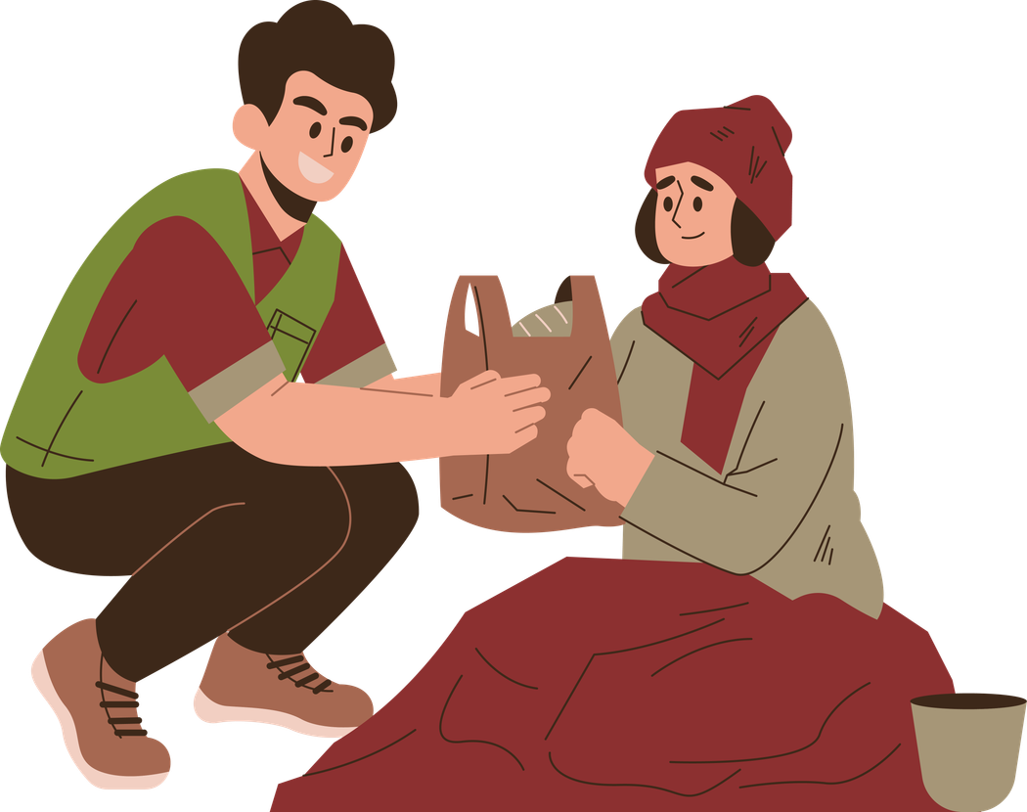





TO THE
HEIGHTS
SVP
to the heights
Living mission, jubilee and beyond
CHALLENGE
Living mission, jubilee and beyond
Can you guess how much it would cost to provide each thing?
A. Helps turn an empty house into a warm home
(bed, table, fridge, etc.)
C. Pays for around 28 care packages for people sleeping rough
E. Helps run mental health programmes for 6 months
D. Helps fund a yearly outreach van (fuel and insurance)
B. Provides hot meals for 20 people each week for 4 months

Slide 9
TO THE
HEIGHTS
SVP
to the heights
Living mission, jubilee and beyond
CHALLENGE
Living mission, jubilee and beyond
Can you guess how much it would cost to provide each thing?
A. Helps turn an empty house into a warm home
(bed, table, fridge, etc.)
C. Pays for around 28 care packages for people sleeping rough
E. Helps run mental health programmes for 6 months
D. Helps fund a yearly outreach van (fuel and insurance)
B. Provides hot meals for 20 people each week for 4 months

Slide 10

TO THE
HEIGHTS
SVP
to the heights
Living mission, jubilee and beyond
CHALLENGE
Living mission, jubilee and beyond
  Decide what mountain you are going to choose for your challenge.
  Get into small groups.
  Come up with a fundraising idea to get the whole school involved in.
  Present your idea to the rest of the Mini Vinnies.

Slide 11
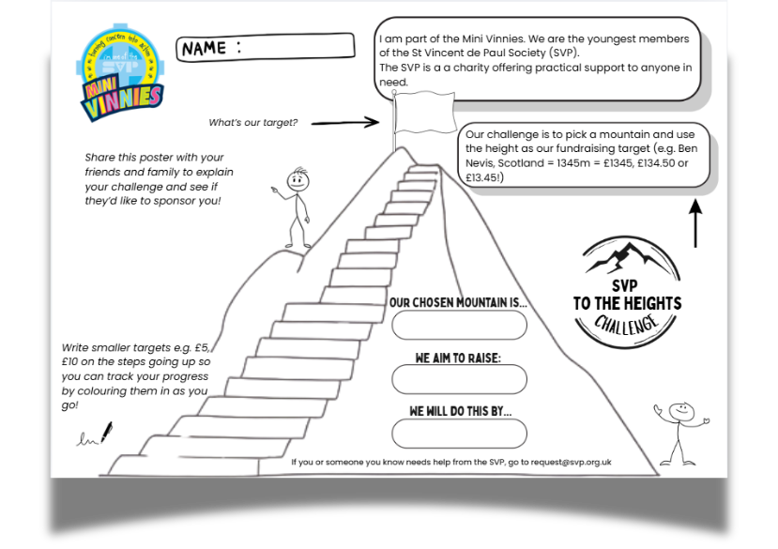
TO THE
HEIGHTS
SVP
to the heights
Living mission, jubilee and beyond
CHALLENGE
Living mission, jubilee and beyond

Slide 12
TO THE
HEIGHTS
SVP
to the heights
Living mission, jubilee and beyond
CHALLENGE
Living mission, jubilee and beyond
Closing Prayer
Lord, we are excited to reach to the heights this summer, and supporting others through our fundraising. Inspire us and be with us as we take on this challenge.
Amen.

