Slide 1


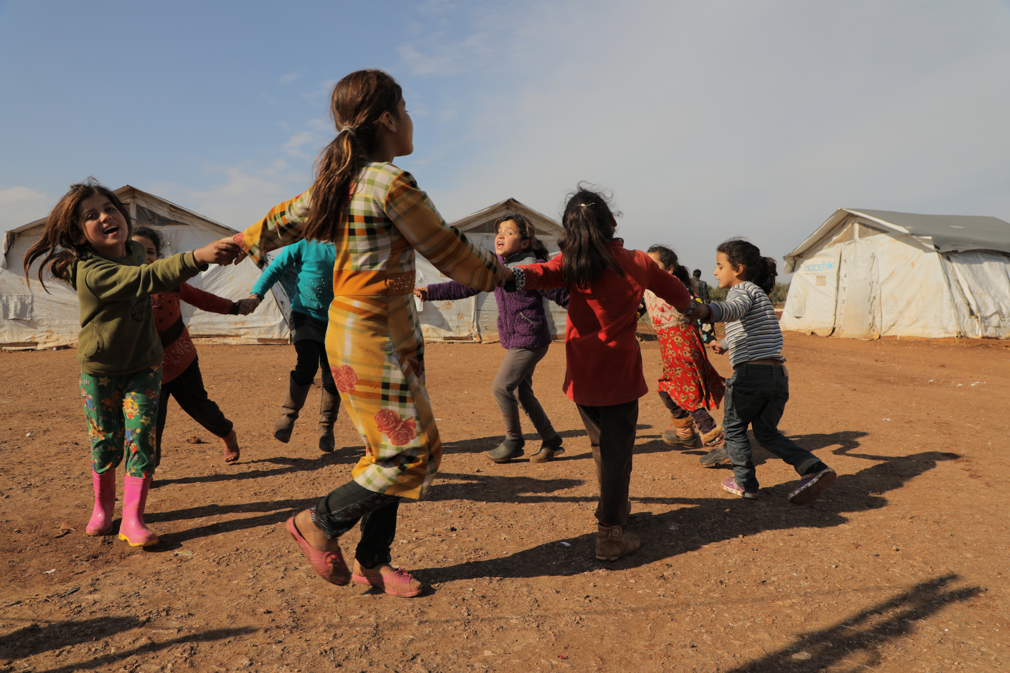
Prayer for refugees

Slide 2

Refugee Week
Refugee week is celebrated in June to remember all those who have had to leave their country because it's no longer safe for them to live there.

Slide 3
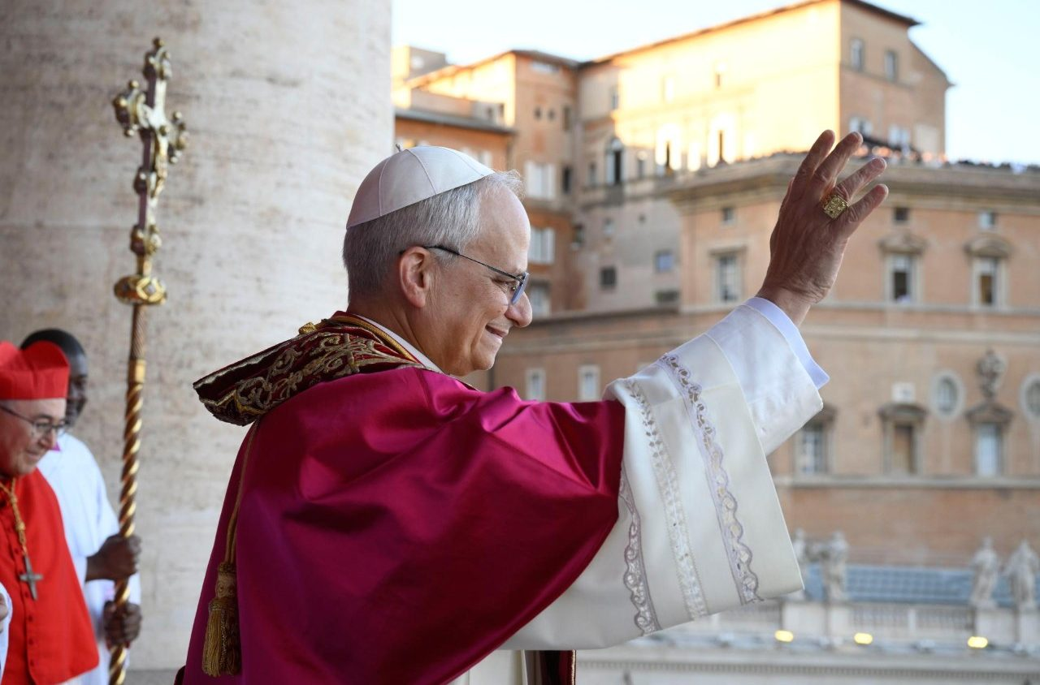
Pope Leo XIV
In his homily about refugees and migrants, Pope Leo teaches us to:
“learn, more and more, to welcome others — to receive them with generosity.”

Slide 4
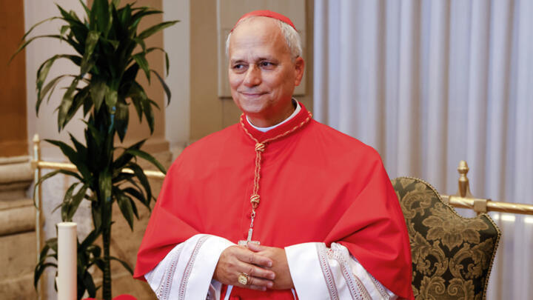
Pope Leo XIV
“And when we truly see them, when we genuinely desire to know them, we begin to recognize that they have stories, lives, and dignity.”

Slide 5
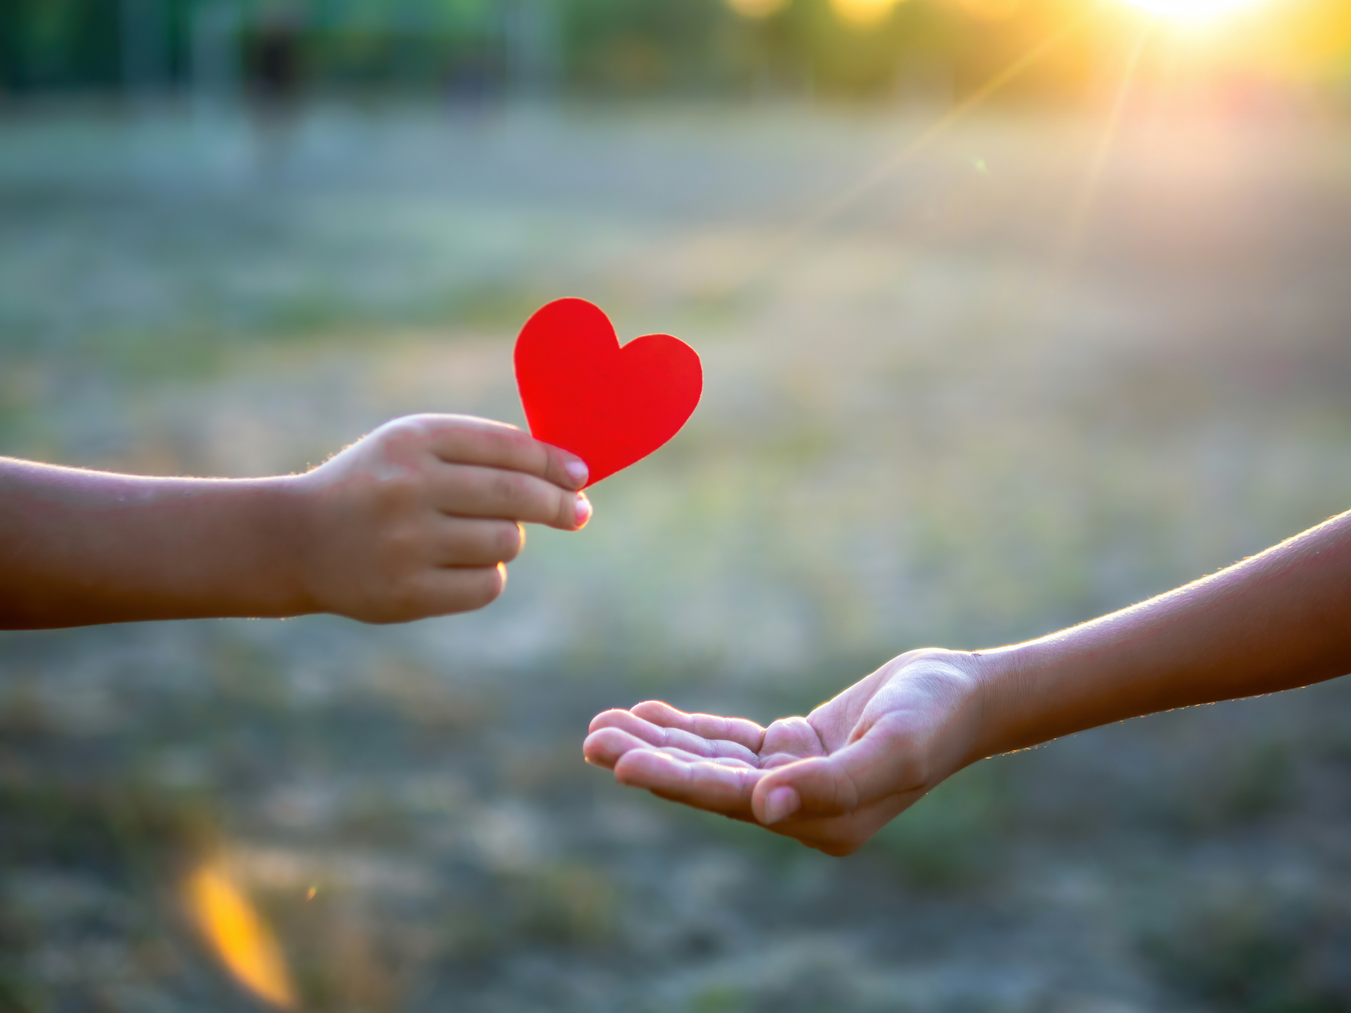
On the margins
As young Vincentians, we are called to share God’s love with everybody, especially those who are on the margins.
- This means people who who are treated differently and go through challenges because of who they are or where they come from.

Slide 6
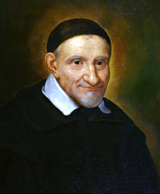
St Vincent de Paul
Inspired by St Vincent de Paul, we try not to judge anyone, but to be welcoming to everybody we meet.
We are reminded of Jesus’ story of the Good Samaritan - a man who looked after a hurt stranger even though they were from different communities.

Slide 7
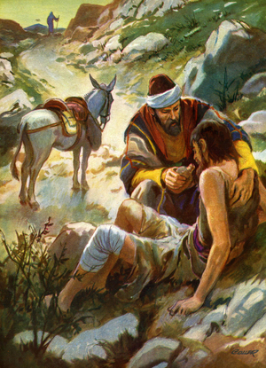
The Good Samaritan
But a Samaritan, as he journeyed, came to where he was, and when he saw him, he had compassion.
He went to him and bound up his wounds, pouring on oil and wine. Then he set him on his own animal and brought him to an inn and took care of him.
Luke 10:33-34

Slide 8
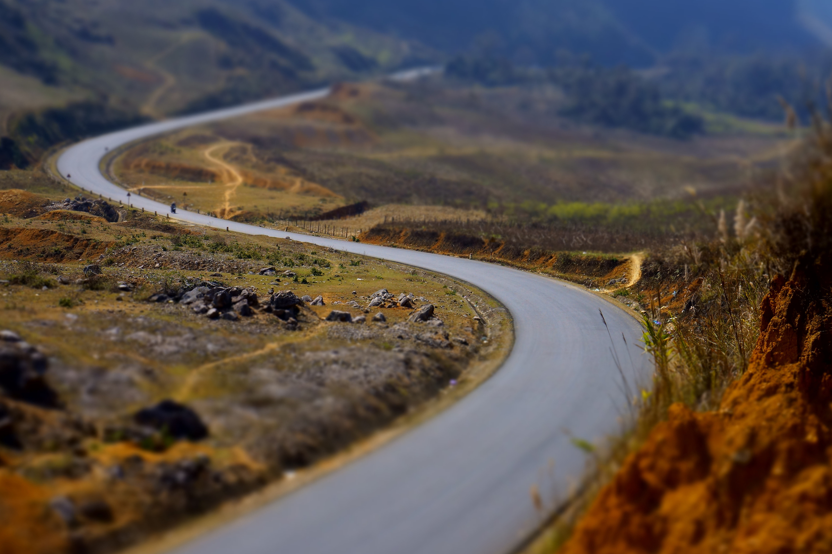
Let us pray...
Lord, we pray those who have left their country for any reason. May they be welcomed into their new home with love and warmth.
Protect those who are away from friends and family, and help them find a supportive community wherever they are.

Slide 9
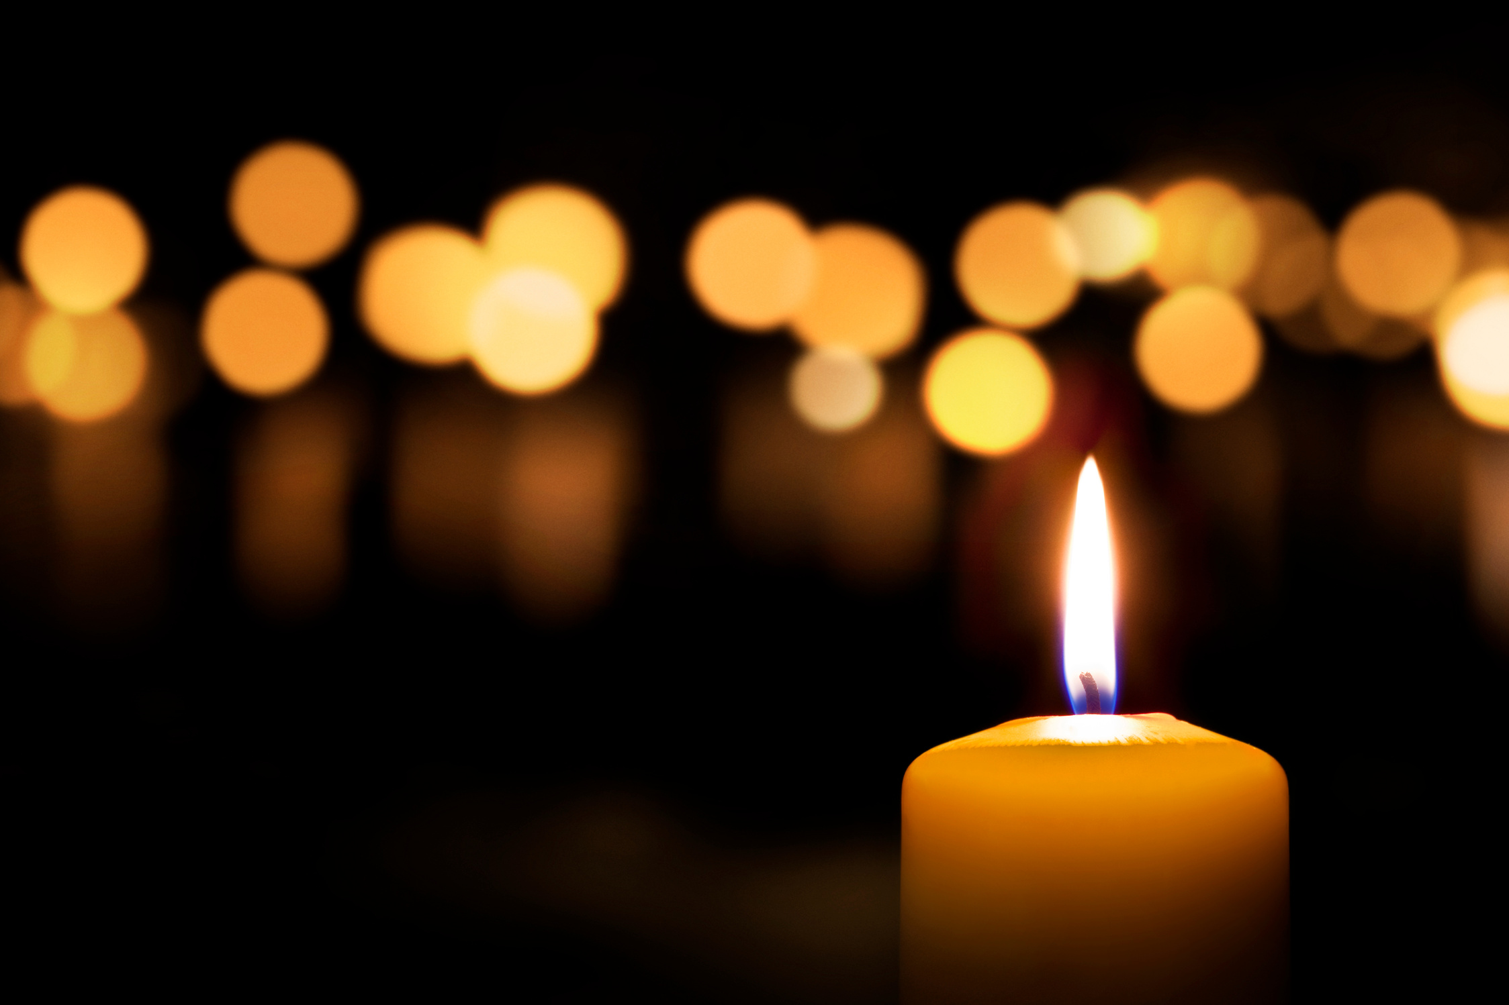
Let us pray...
Open the doors of our heart.
Open the doors of welcome.
Open the doors of power.
Open the doors of our mind.
Open the doors to opportunity.
Amen.

