Slide 1














Slide 2

What is this?

Slide 3

What is this?

Slide 4
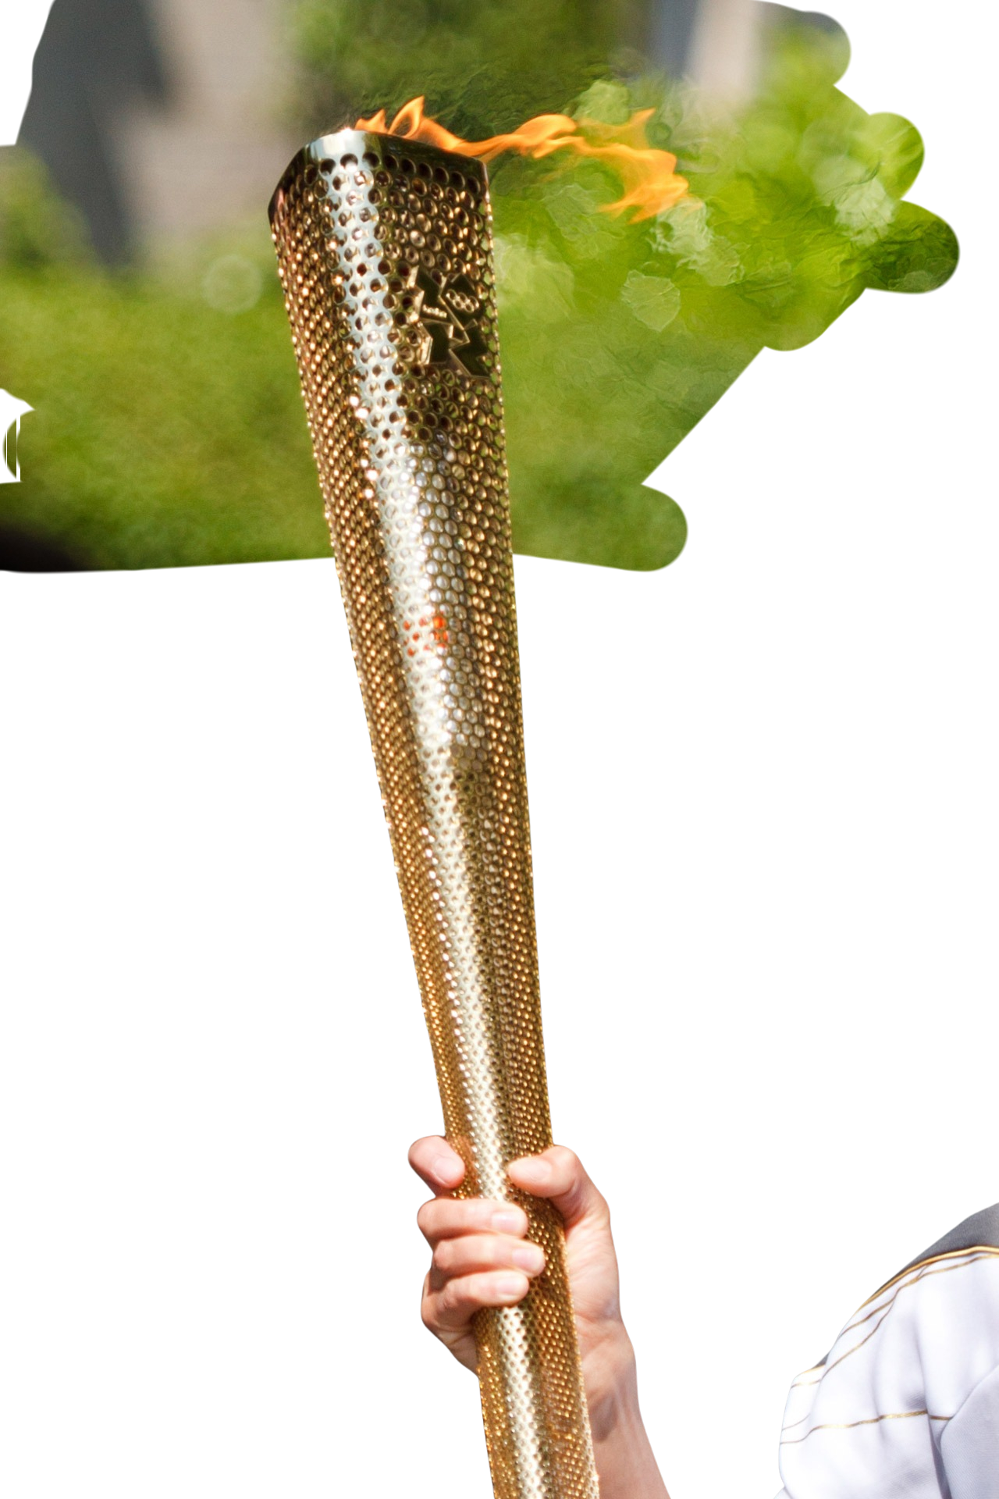
What is this?

Slide 5
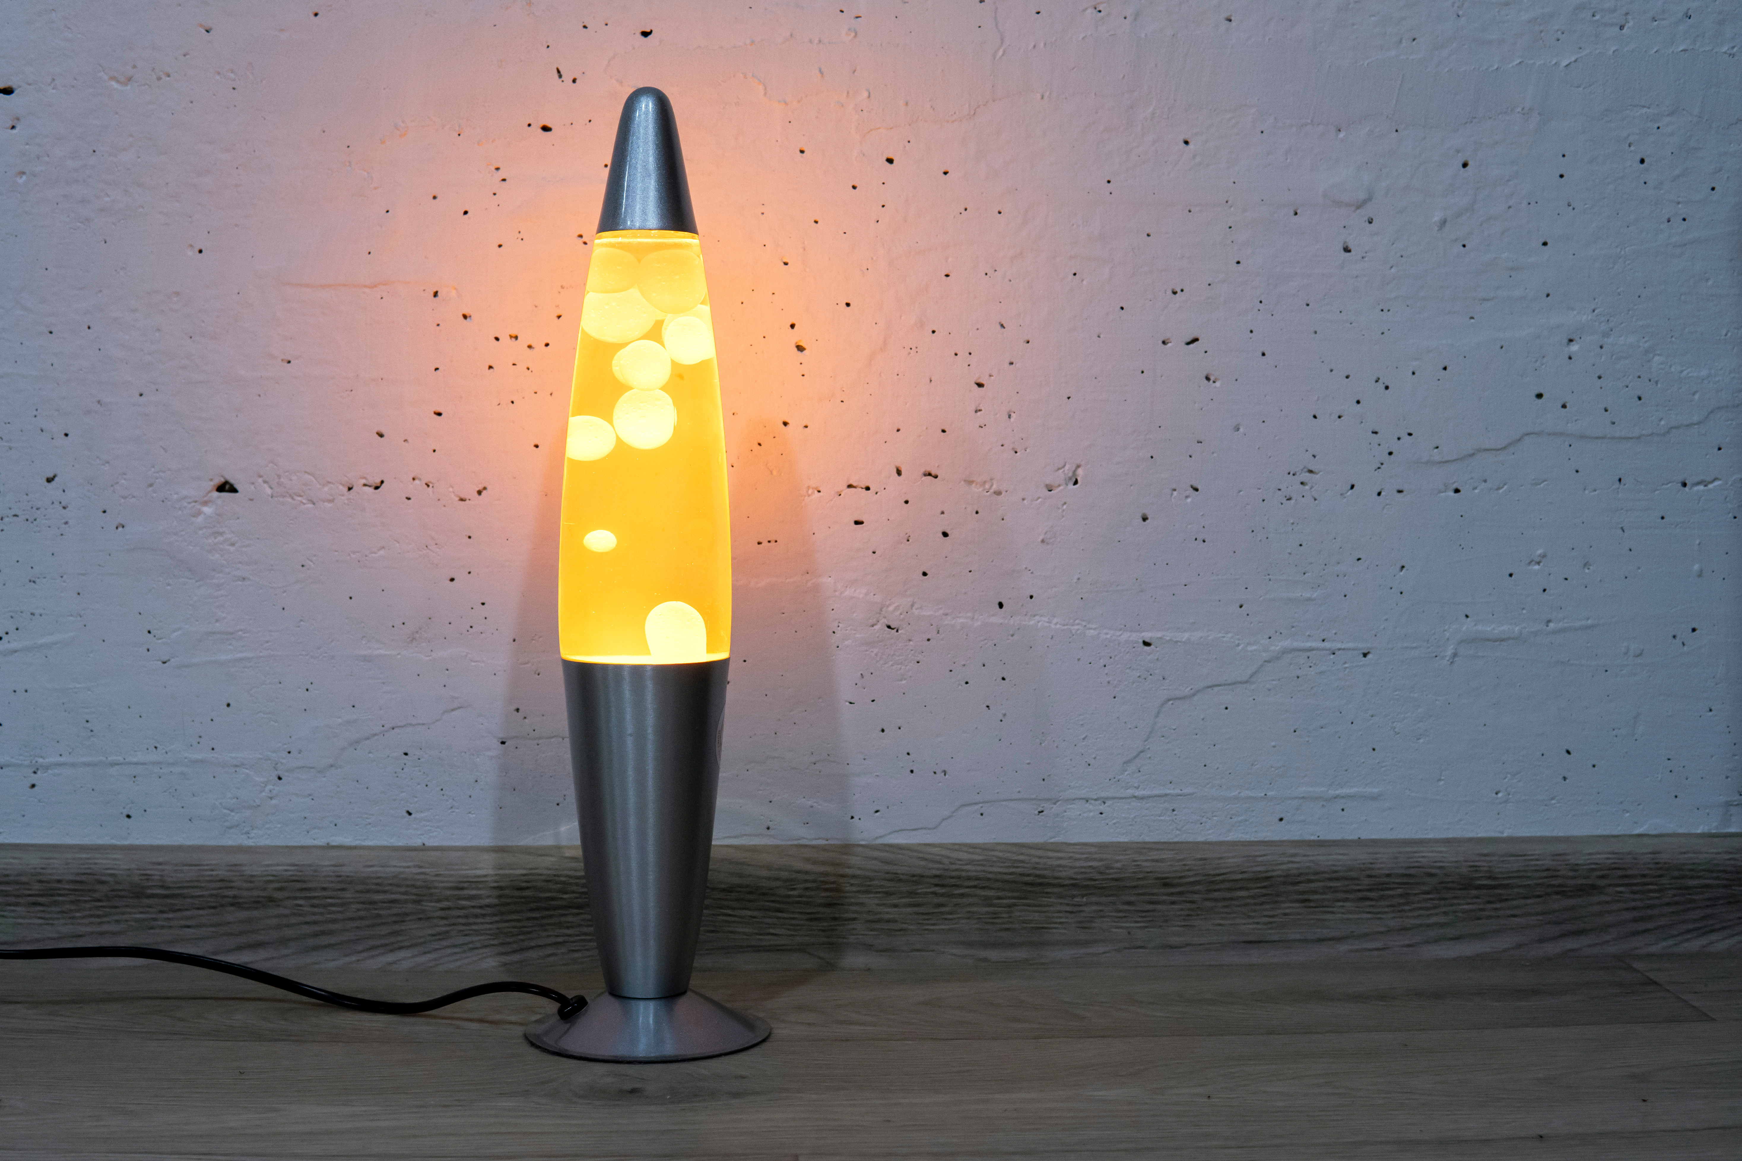
What is this?

Slide 6

What is this?

Slide 7

What is this?

Slide 8

What is this?

Slide 9
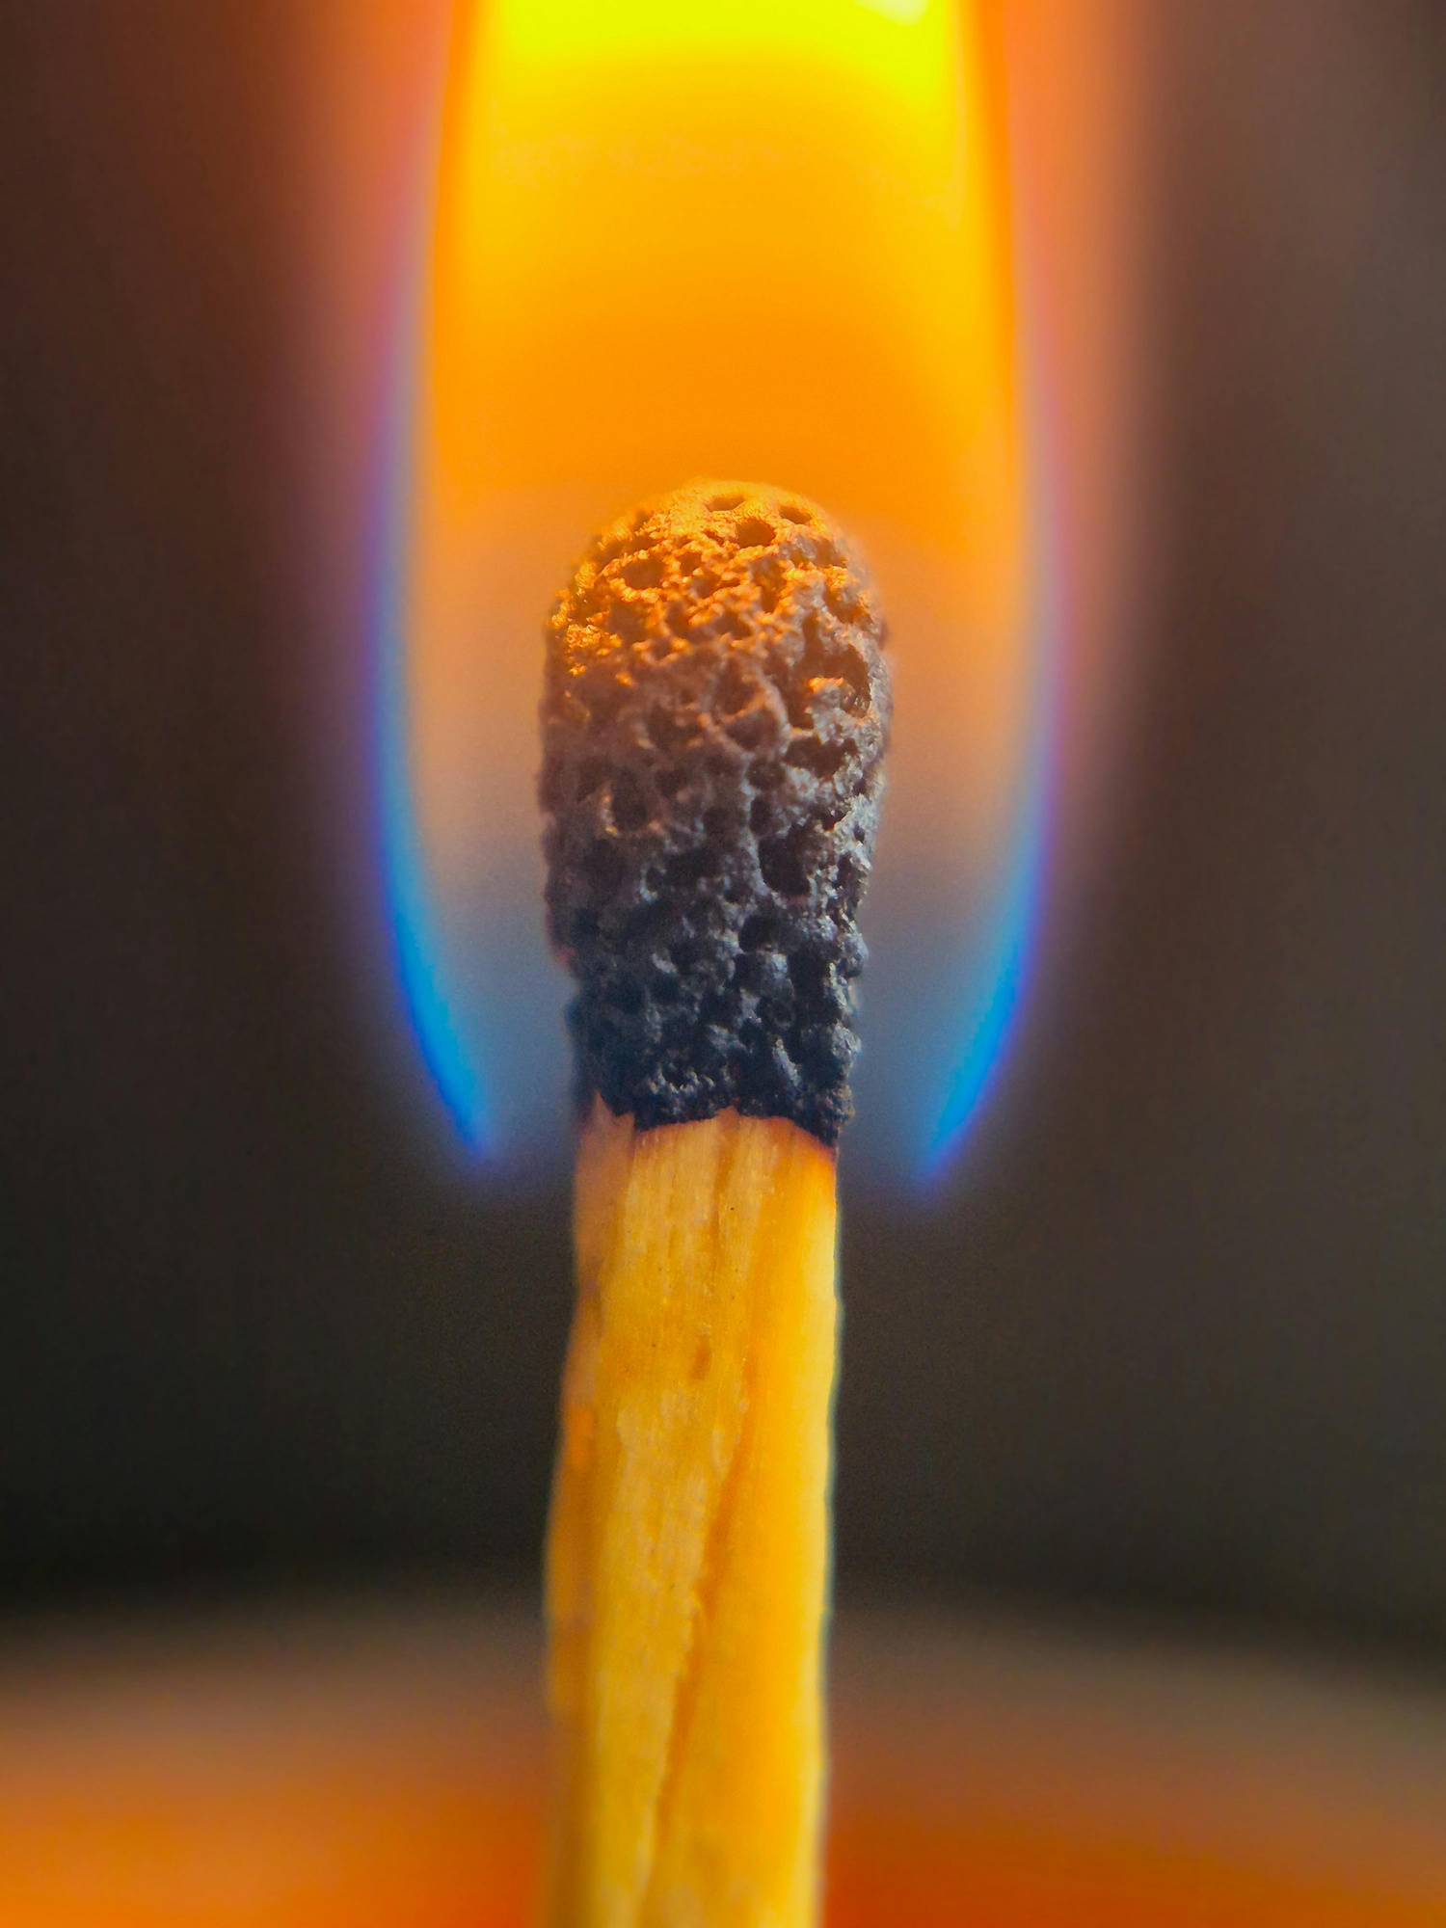
What is this?

Slide 10










What do all these things have in common?

Slide 11
They all bring light.
They help people see.
They offer guidance.
They make a difference to the people around them.

Slide 12
But they do it in different ways.

Slide 13
The same is true of people.
God created us differently because the world needs different kinds of light.

Slide 14

In the name of the Father
and of the Son,
and of the Holy Spirit
Amen

Slide 15


Slide 16



"You are the light of the world.
A town built on a hill cannot be hidden.
Neither do people light a lamp and put it under a bowl. Instead they put it on its stand, and it gives light to everyone in the house.
In the same way, let your light shine before others, that they may see your good deeds and glorify your Father in heaven."
Matthew 5:14-16

Slide 17
How can we notice the light in people whose stories are different from our own?
How can we allow our own light to shine for others?
Matthew 5:14-16

Slide 18
God of light,
help us to carry your light into this new year.
May we use our gifts generously,
welcome one another warmly,
and bring hope to those we meet.
May our many stories reflect your one light.
Amen.

Slide 19
In the name of the Father
and of the Son,
and of the Holy Spirit
Amen

