Slide 1














Slide 2

What is this?

Slide 3

What is this?

Slide 4

What is this?

Slide 5
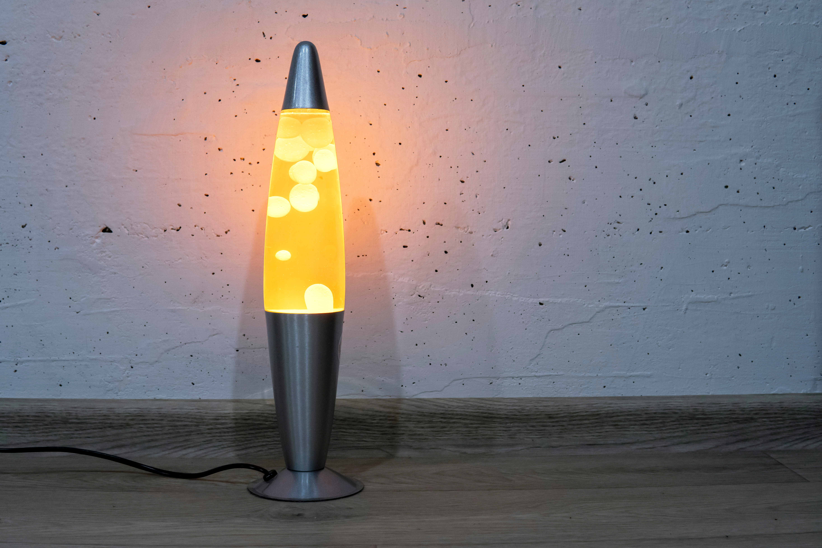
What is this?

Slide 6

What is this?

Slide 7

What is this?

Slide 8

What is this?

Slide 9
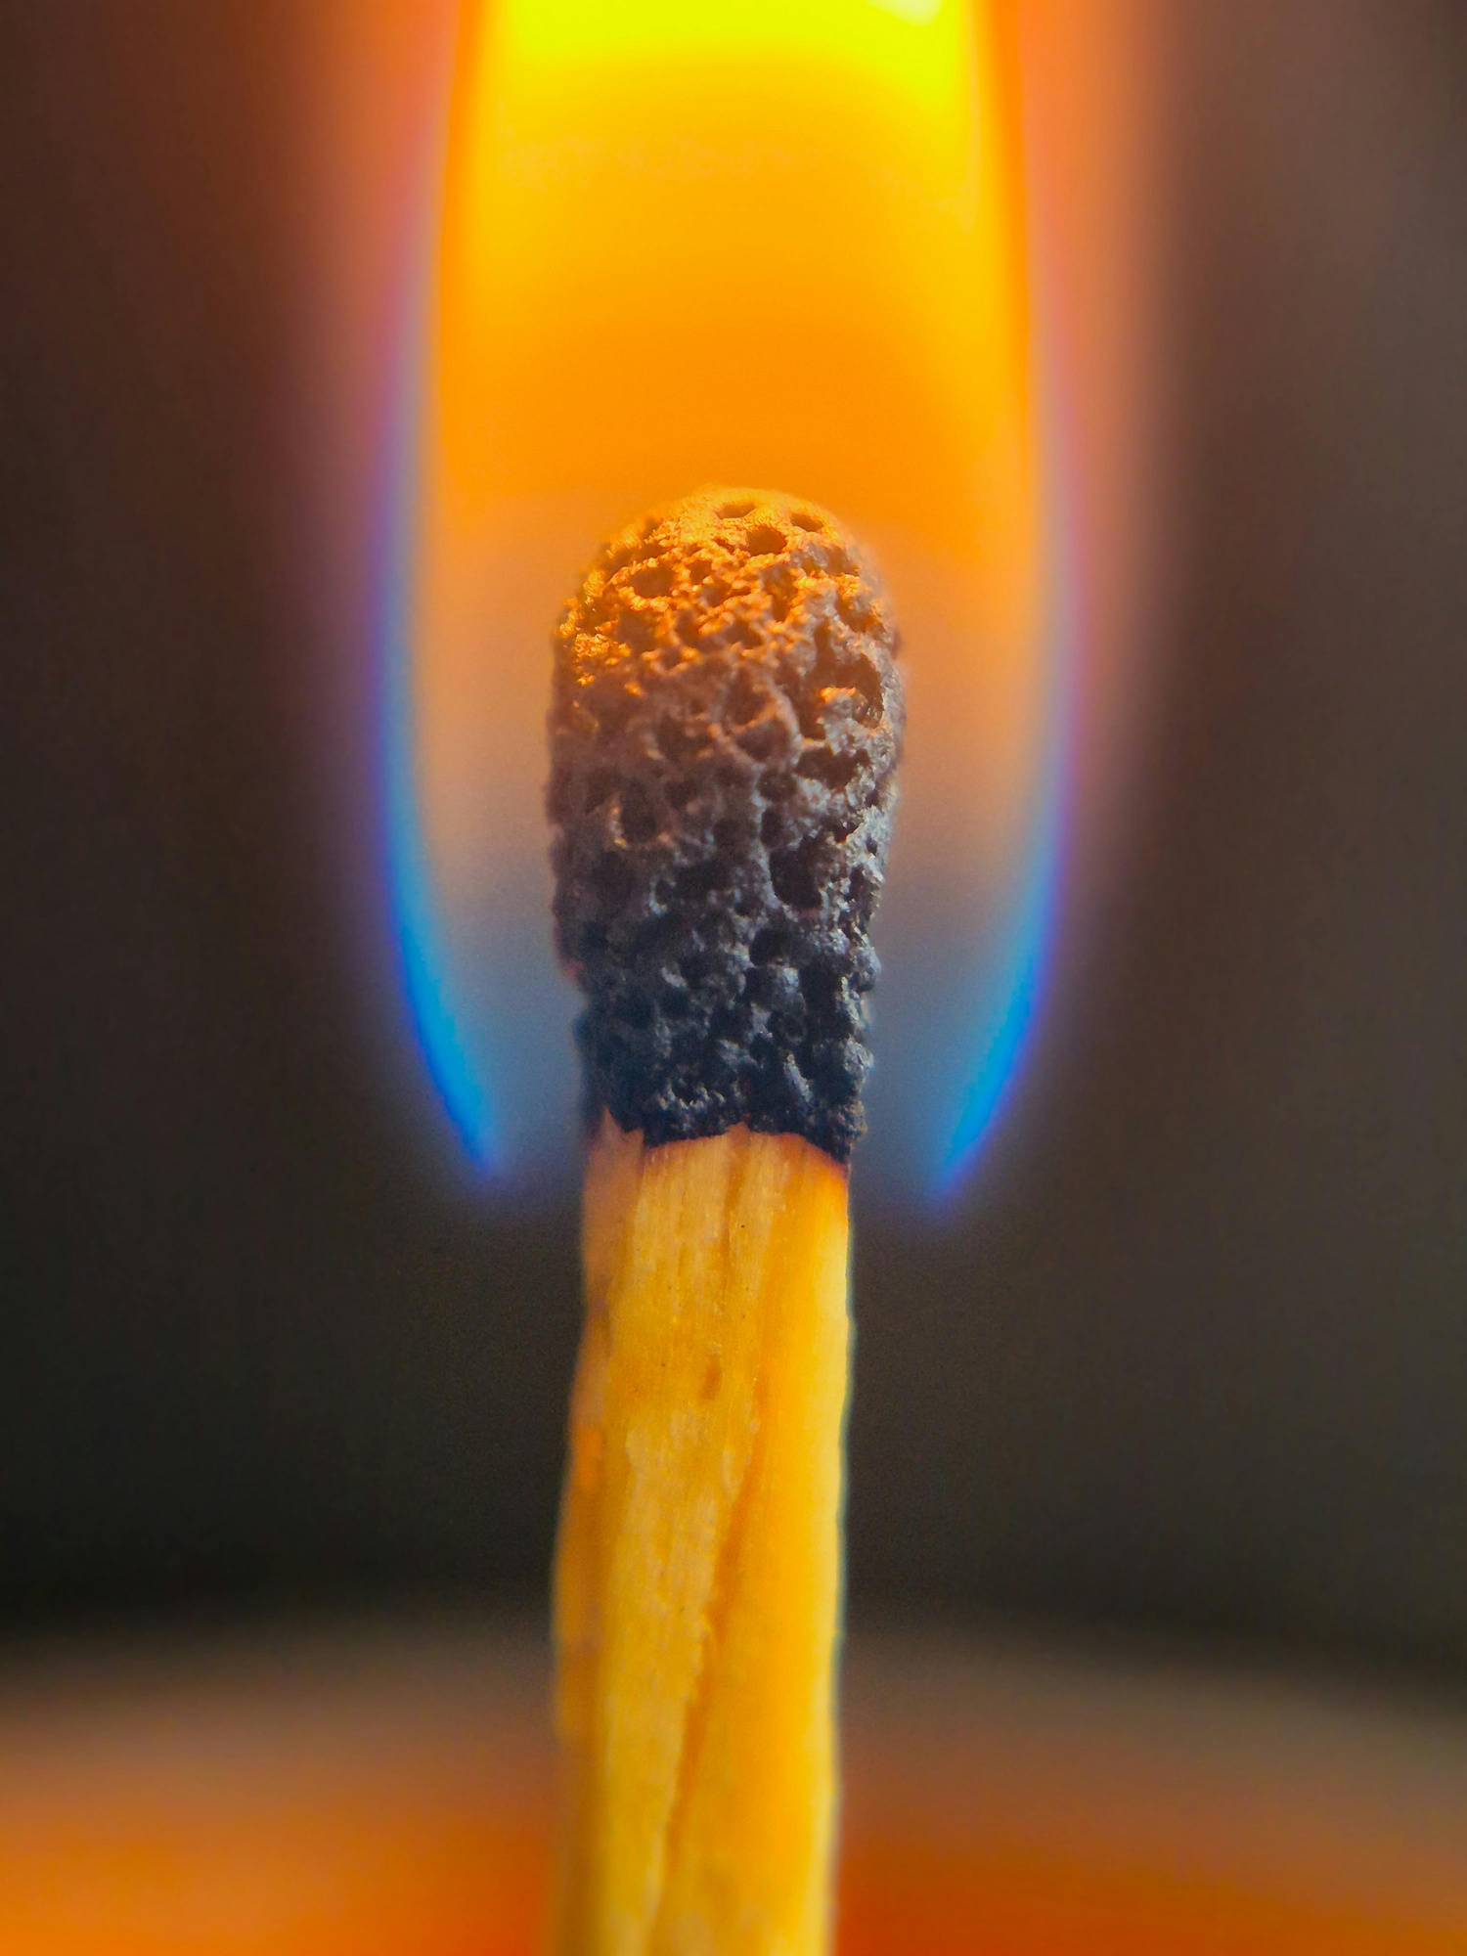
What is this?

Slide 10










What do all these things have in common?

Slide 11

They all bring light.
They help people see.
They offer guidance.
They make a difference to the people around them.

Slide 12
But they do it in different ways.

Slide 13

A lighthouse guides ships.

Slide 14
A candle brings warmth and comfort.

Slide 15

A torch helps us find the next step.

Slide 16

A streetlamp lights the way home.

Slide 17
No single light does everything.

Slide 18
The same is true of people.
God created us differently because the world needs different kinds of light.

