Slide 1
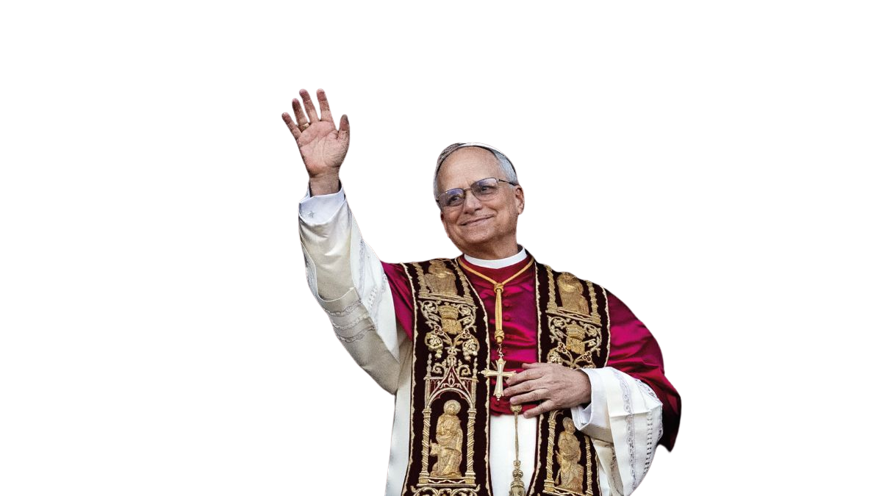

Pope Leo challenges us:

Slide 2


“weavers of hope”
Let us become
in our world, sharing who we are and what we have,
so that the presence of Jesus may grow among us and his Kingdom
take shape.

Slide 3
This year, each of us will write another chapter in our story.
The question is not whether our light matters.
The question is how we will use it.
Every gift, every act of service, every word of encouragement is a thread in that weaving. As we share our light with others, we help to build a community rooted in hope, faith and love.

