Slide 1







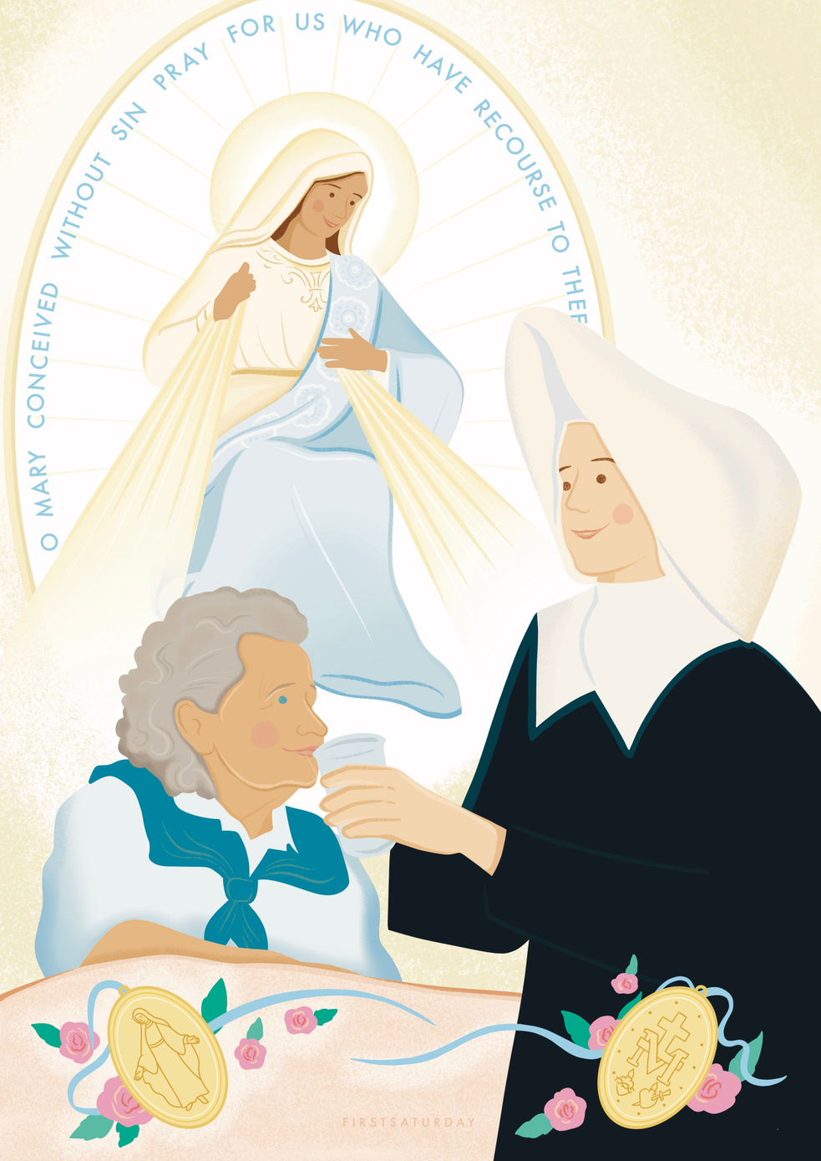
November
St Catherine Labouré
About...
Born in 1806 in France, St Catherine Labouré was a member of the Daughters of Charity of Saint Vincent de Paul.

Slide 2

November
Following her heart
She was inspired to join the religious life from a young age, and felt called to serve the sick as a nurse. She joined the Daughters of Charity in 1830 and spent the rest of her life working with the sick and elderly.

Slide 3
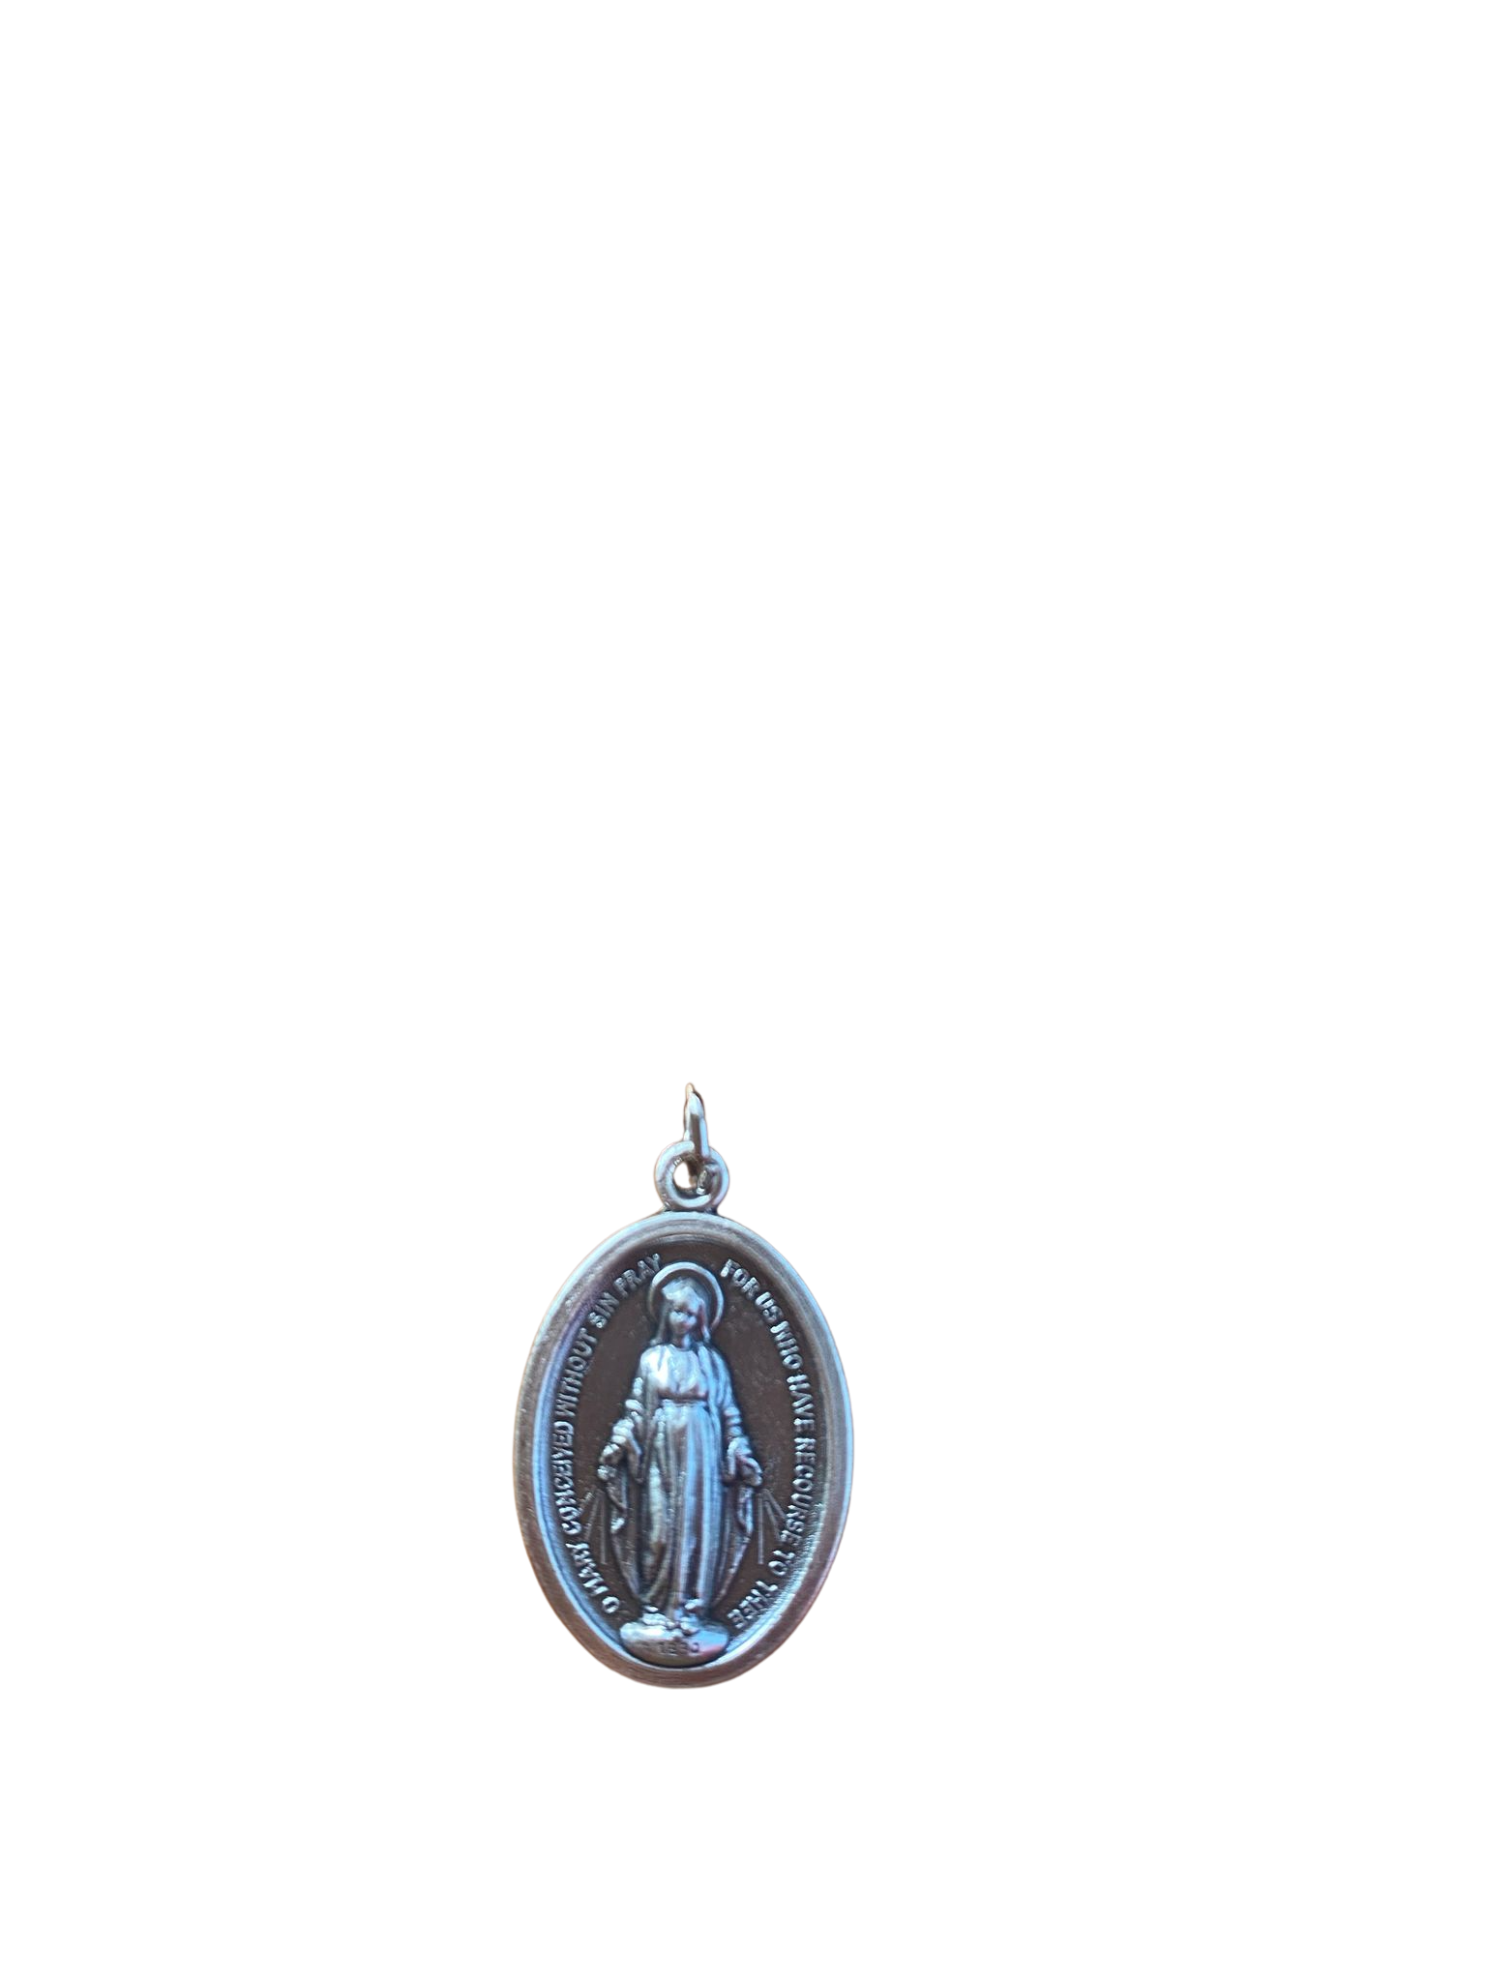
November
The Miraculous Medal
At this convent, the Blessed Virgin Mary appeared to St Catherine. She was given the design of a medal to be made as a reminder of the many graces available to those who turn to our Lady in prayer. This became known as the Miraculous Medal.

Slide 4

November
Reflection...
St Catherine Labouré was quiet and humble but still made a big impact. What small actions can we do everyday to make the world a better place?

Slide 5

November
St Catherine Labouré
Prayer...
Lord, thank you for the example that St Catherine Labouré gave us. Help us to always listen and to make a positive change one act of kindness at a time. Amen.

Slide 6
November
St Catherine Labouré
Call to Action...
Choose someone from your family or friends to ask some questions to this week. Try to listen and learn from them, like St Catherine Labouré.
Example question: “What is your earliest memory?”

