Slide 1







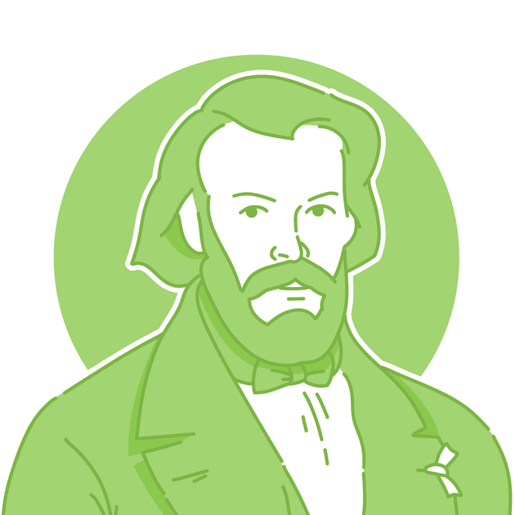
October
About... Blessed Frédéric Ozanam
Blessed Frédéric Ozanam was born in Milan, Italy, in 1813 and grew up in Lyon, France.
As a university student, he was asked what the Church was doing to help the poor in their community. This challenged Frédéric to put his faith into action...

Slide 2
October
Blessed Frédéric Ozanam
About...
Blessed Frédéric Ozanam founded the
St Vincent de Paul Society as a student in 1833. He was inspired by the life of St Vincent de Paul to put his faith into action and help anyone in need in his community.

Slide 3

October
Blessed Frédéric Ozanam
Reflection...
Frédéric did some acts of kindness by himself, but he realised he and his friends could make a bigger difference if they worked together. What was the last act of kindness you did as a group?

Slide 4
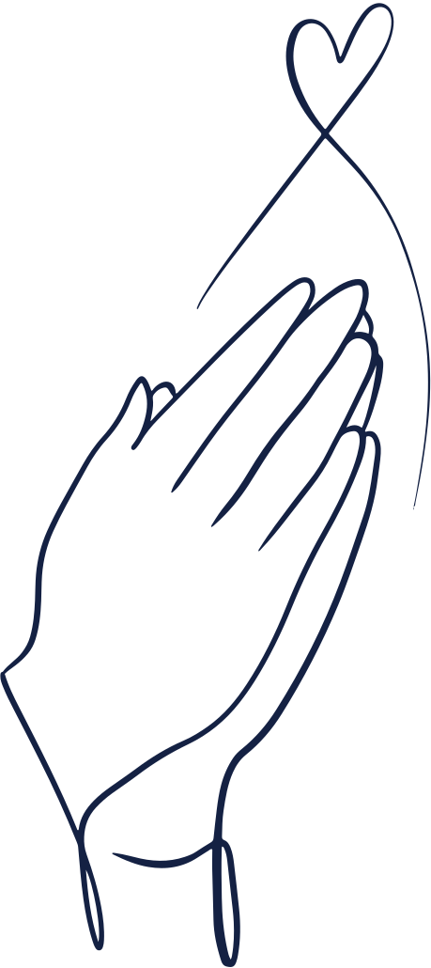
October
Blessed Frédéric Ozanam
Prayer...
Lord, help us to work together like our founder Blessed Frédéric Ozanam and his friends.
May we each use our gifts to see who needs our help, think about what we can do, and put our values into action. Amen.

Slide 5
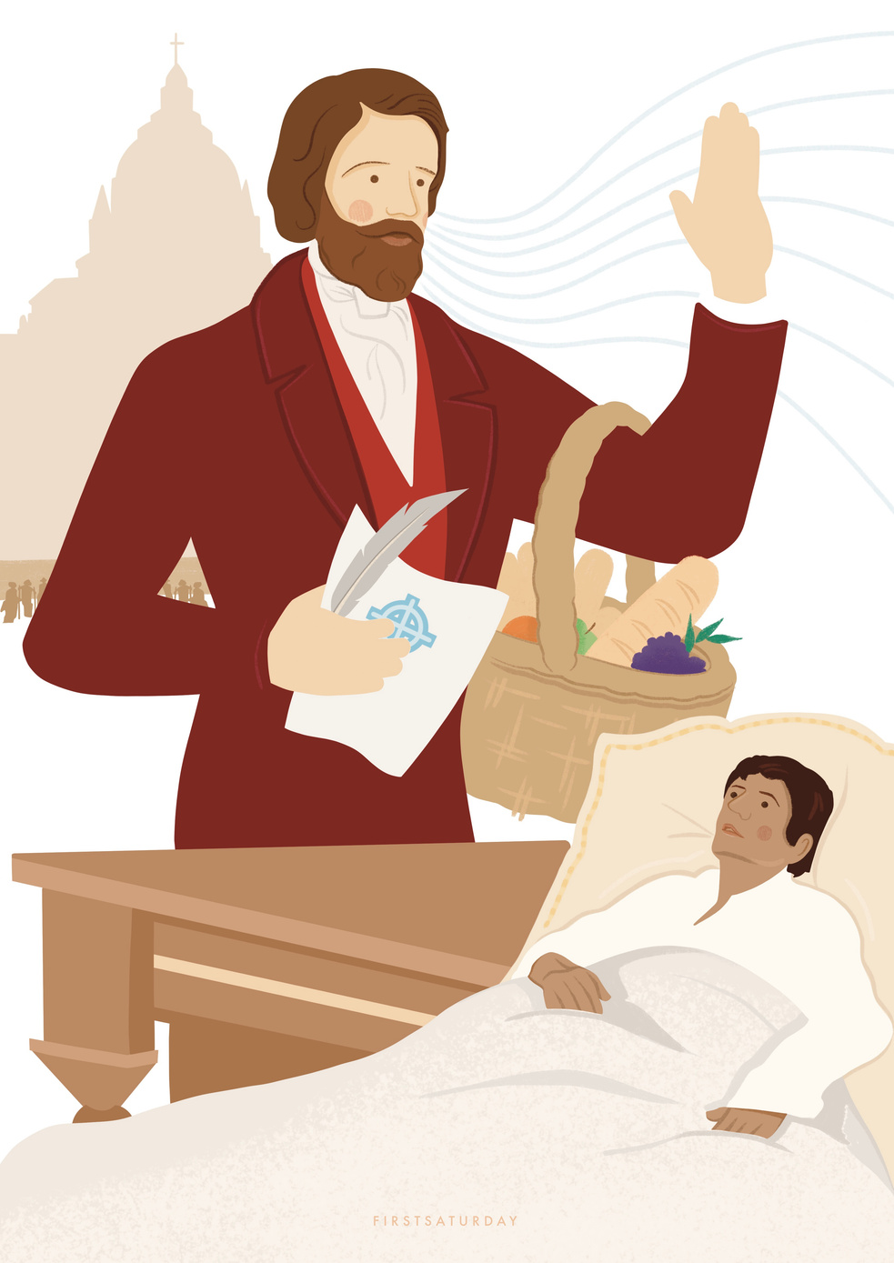
October
Your Light in Action
Blessed Frédéric Ozanam saw that he could make a difference by working together with others.
What do you like about working as a team?

Slide 6

October
Blessed Frédéric Ozanam
Call to action...
Make a plan as a group in your school or parish to do something for your community this year
e.g. organise a coffee morning, bake sale, visit a care home etc.

